Slide 1
Supporting the ABUHB Decarbonisation Agenda with Technology
Victoria Richards-Green
ABUHB Clinical Informatics Lead Pharmacist

Slide 2
How can technology support Decarbonisation?
Using the All-Wales Asthma & COPD guidelines and key elements of the ABUHB Decarbonisation strategy, an App is being developed within ABUHB that can simplify and support inhaler reviews across all healthcare settings, without the need for specialist inhaler knowledge

Slide 3
What can the app do?
Match SABA inhalers to regular inhalers by device type and resistance (when a SABA is indicated)
Push for the use of the correct spacer with all MDi inhalers
Push for the use of MART in Asthmatics that don't use their preventor inhalers regularly (Reducing SABA overuse)
Combine multiple inhalers into fewer devices
Select the device best suited to the patient's inhalation technique
Promote Dry Power inhalers as the first line for all patients able to use one
Priorities the lowest GWP inhaler is all situations
Consider inhaler resistance in COPD patients using Dry Powder inhalers (aiding correct inhaler choice)

Slide 4
What can't the app do?
Rationalise inhalers for patients with conditions other than Asthma or COPD
Step up uncontrolled Asthmatics
Step down well controlled Asthmatics
Optimise inhaler combinations that don't correspond to licensed indications or All-Wales guidelines
Make a clinical decision - The final choice of inhaler relies on the knowledge of the health care professional undertaking the assessment

Slide 5
What data does it use?
Where possible data comes via independent sources rather than direct from Pharma
Data used in the development includes:
ICS strength classification – via Right Breathe website
Device resistance rating – via In-check dial grading
Licensed indications – via Electronic Medicines Compendium
Global Warming Potential (GWP) – this is a combination of All-Wales guidance and information obtained through the development of the ABUHB Decarbonisation strategy

Slide 6
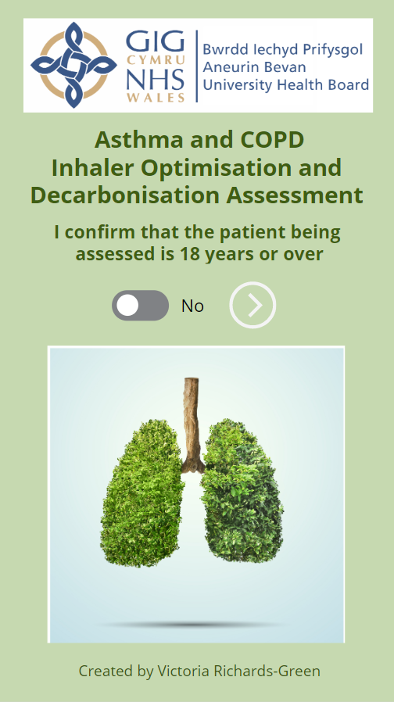
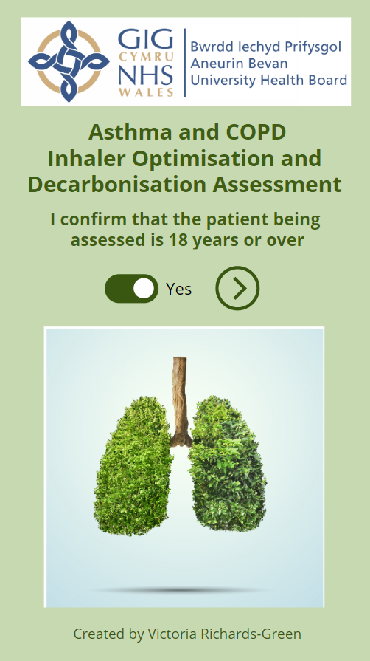
Before you start an Assessment

Slide 7
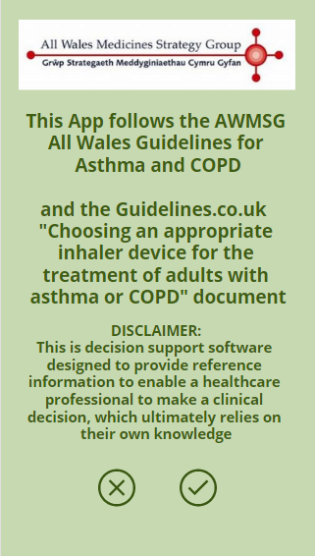
The app is a decision support tool and is not classed as a medical device by the MHRA

Slide 8
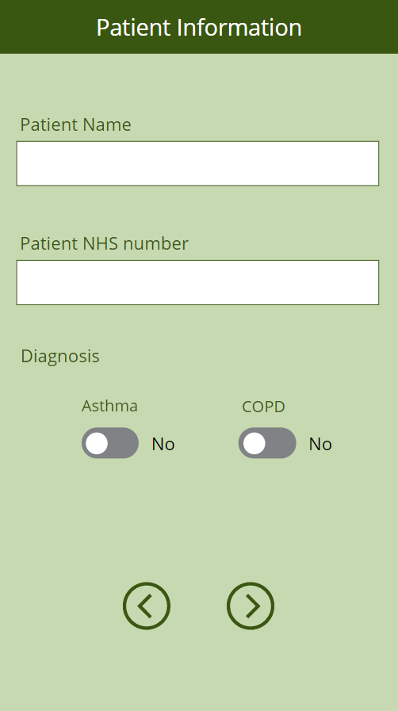
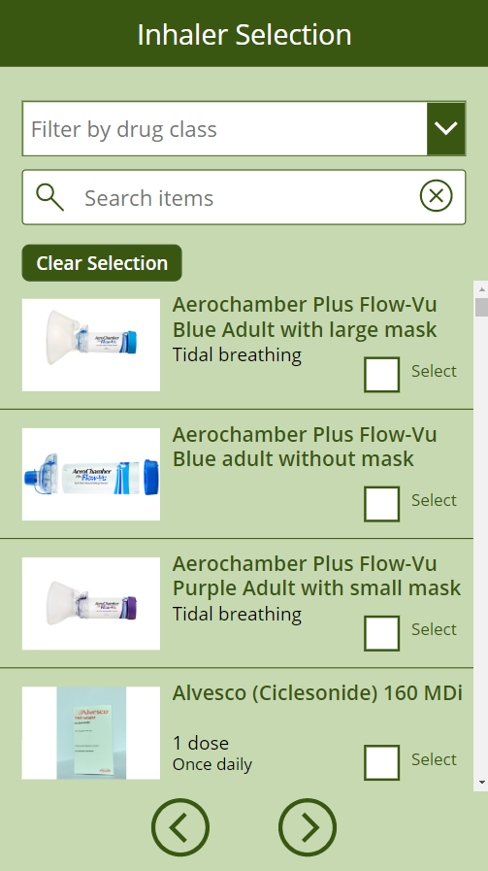
Patient Data Screens

Slide 9
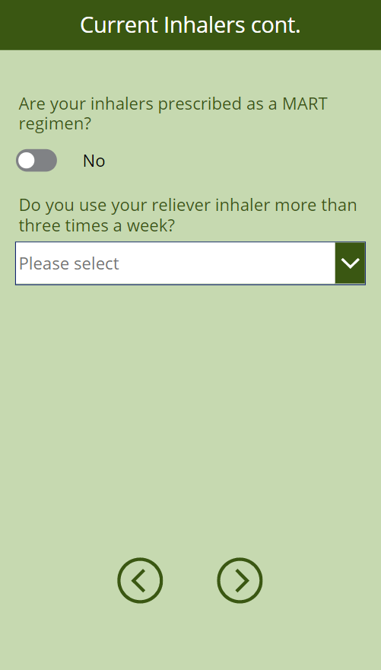
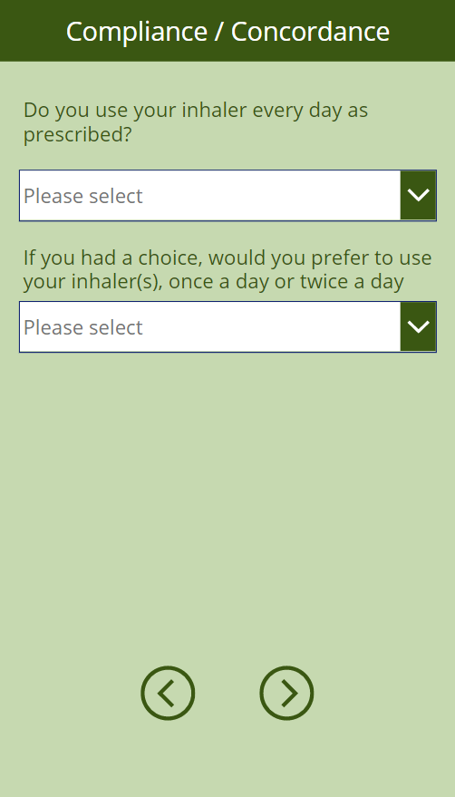
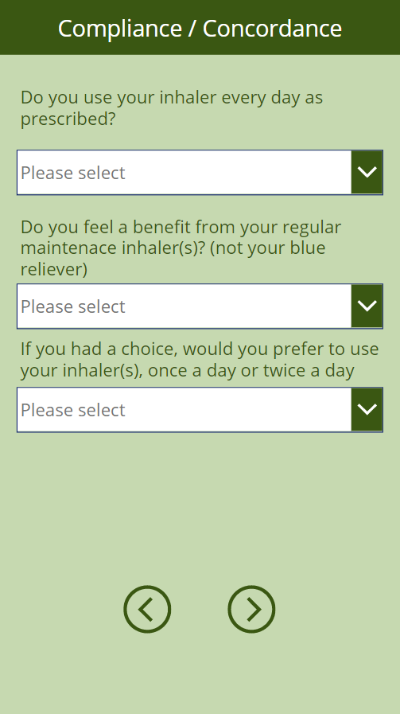
Compliance and Concordance Screens
Asthma
COPD

Slide 10
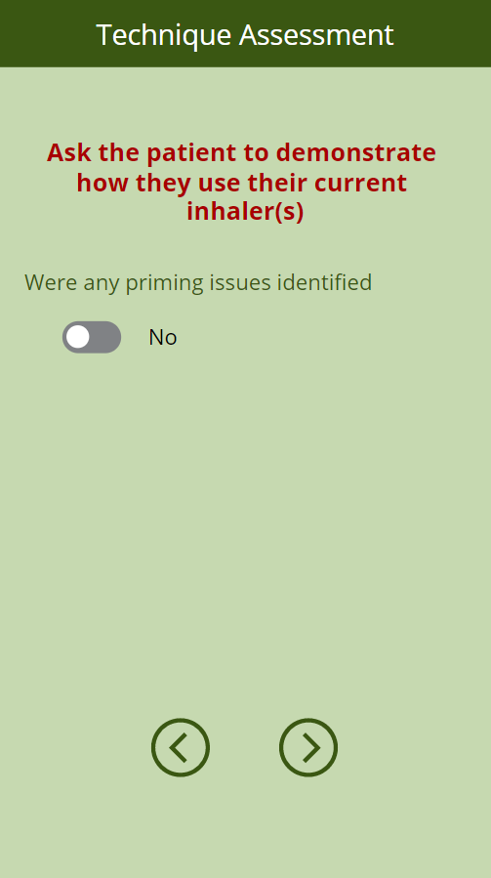
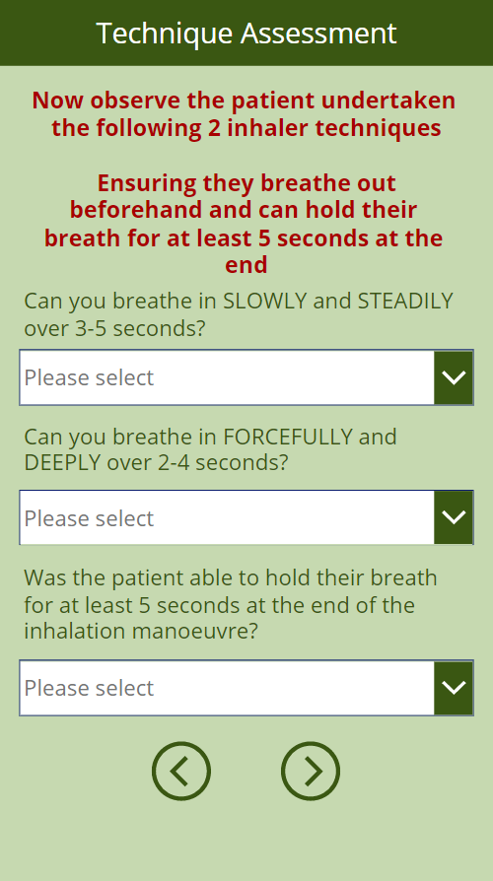
Technique Assessment

Slide 11
Next comes the clever bit...

Slide 12
Selecting the best inhaler for your patient
The app will then take all the information and provide a short list (based on guidelines) of the most appropriate inhaler for your patient
The list is ordered to show the lower GWP inhalers first and in descending order of device resistance
At this point the patient can be involved in the inhaler selection
The app is intuitive and will only show screens, questions and inhalers relevant to information provided (I will cover this off in more detail during the live demo)

Slide 13
Once the new inhaler(s) and supportive device (where appropriate) have been selected, the outcome of the assessment is summarised in a printable screen

Slide 14
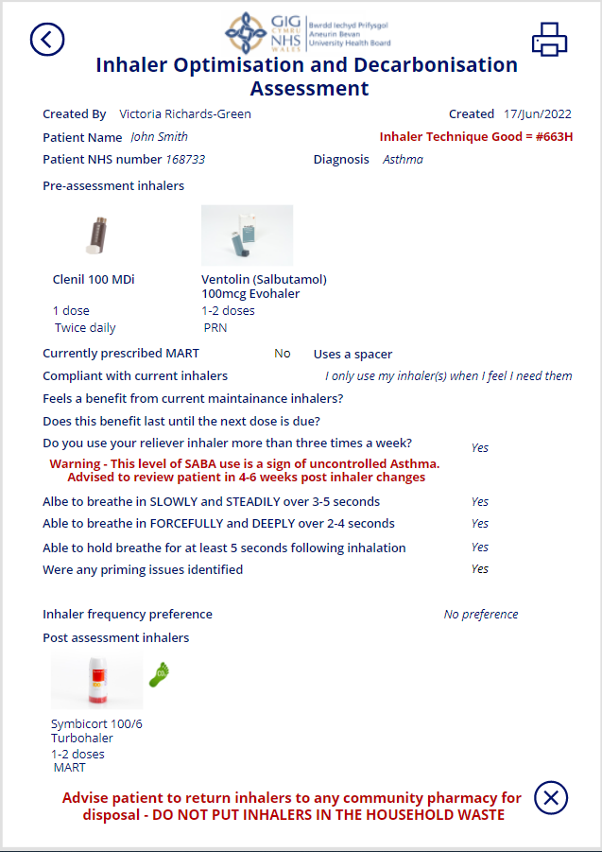

Slide 15
Who can use it?
At the point of launch it will be available to use by anyone within ABUHB with an NHS email address, including:
Primary care staff in GP surgeries (Doctors, Nurses, Pharmacists, Physicians Associates)
Secondary care staff, on wards and in clinics (Doctors, Nurses, Pharmacists, Pharmacy Technicians, Physicians Associates)
Community Pharmacies

Slide 16
The data generated by each assessment is logged in a secure list within ABUHB's Microsoft 365 environment
Data can then be used to review:
Assessment numbers
Sector engagement
Inhaler prescribing trends
Carbon savings
Cost savings
What happens to the data?

Slide 17
Live Demonstration
Notes:
Demos to run
1. Clenil 100mcg + Ventolin (Over using SABA, under using Clenil) - can do
2. Th

Slide 18
Future Developments
PDF copy of the Summary screen, to allow for attachment to a patient's electronic record

Slide 19
Any Questions?

