Slide 1



Establishing a POPS service in elective general surgery
Dr Margaret Coakley – Consultant Anaesthetist
Dr Nia Humphry – Consultant Perioperative Geriatrician

Slide 2


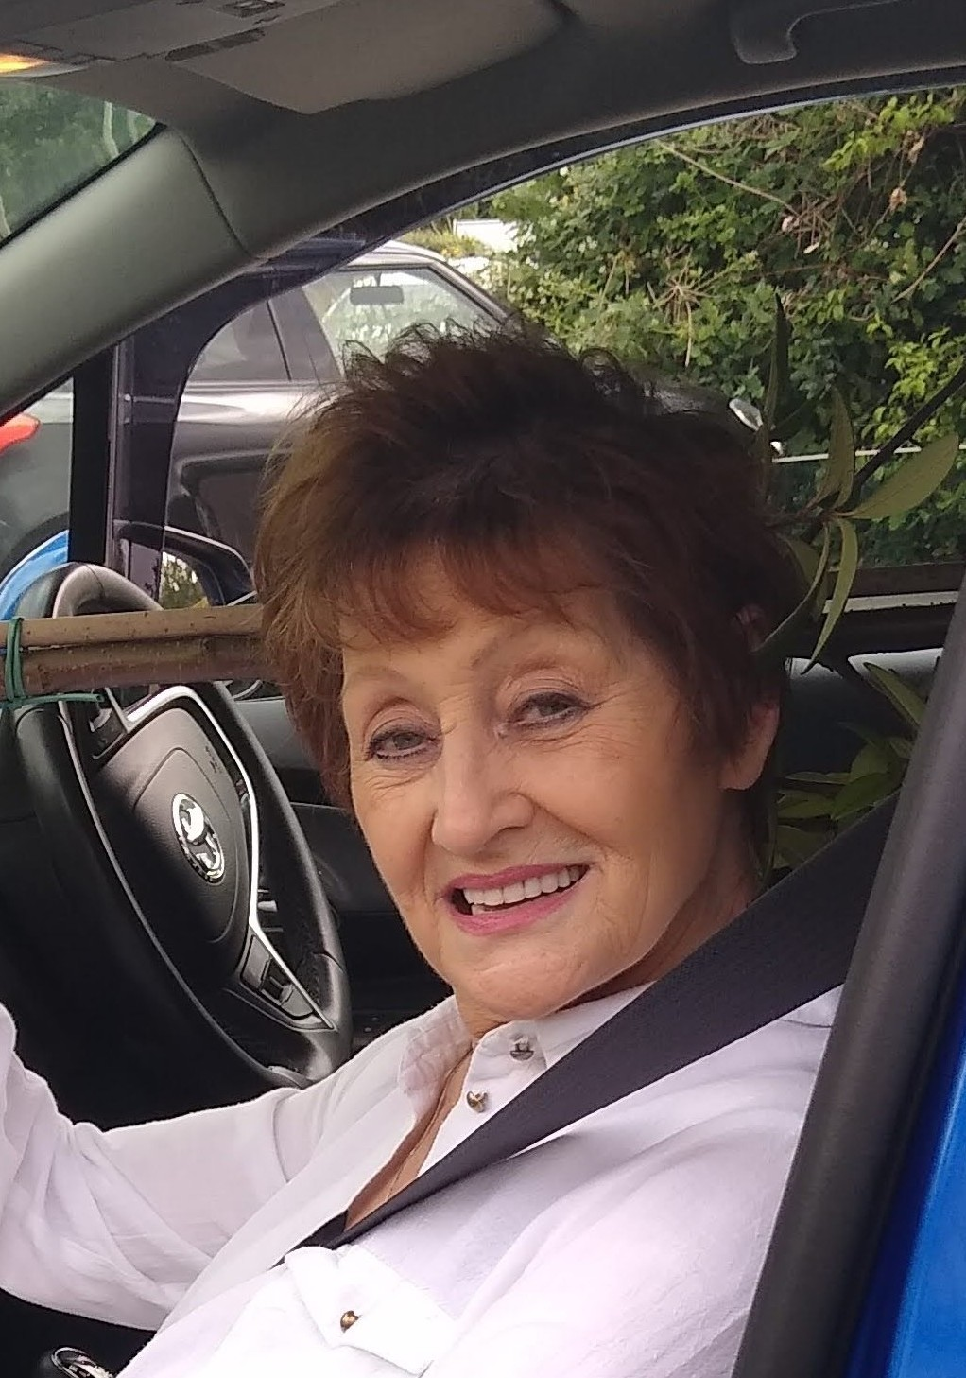

Background
Notes:
Describe the context and project rationale (the challenge)
Key info: health board, organisation/department, key stakeholders e.g. industry or charity partners
Older surgical patients with frailty have higher perioperative M&M
Patients like Maureen, who was waiting for a ....[procedure] have further deconditioned during the pandemic.
Guidance from the Centre for Perioperative Care advises that the underpinning principles when managing this high risk group should include
Frailty assessment
CGA
SDM

Slide 3
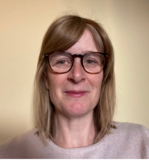
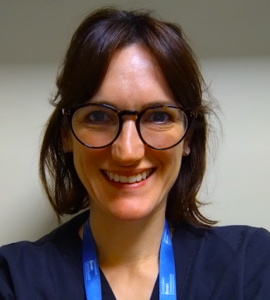
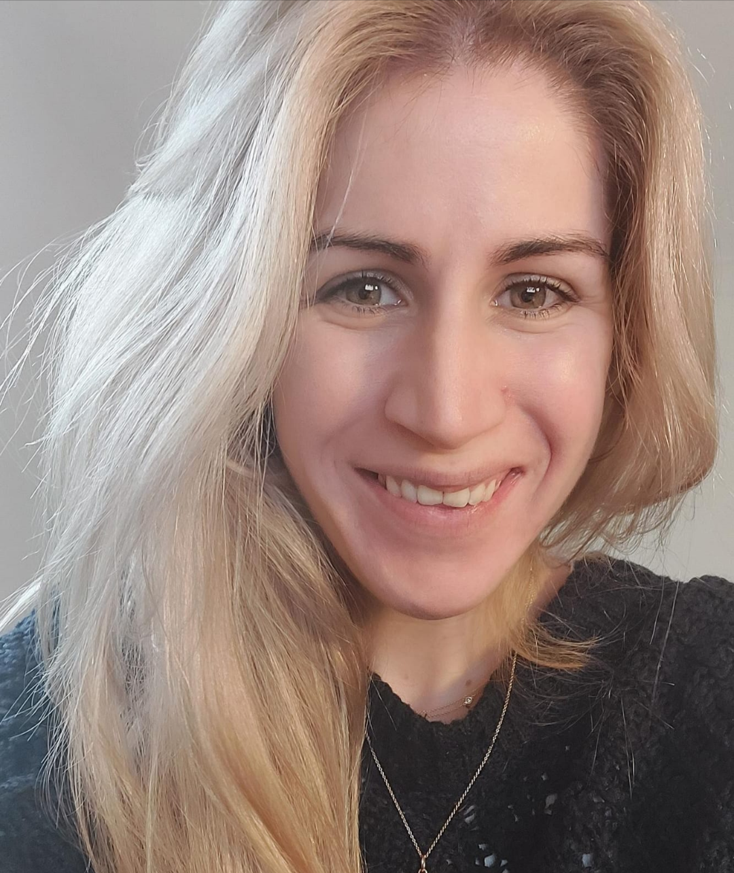
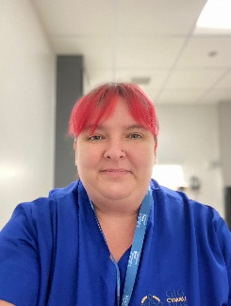
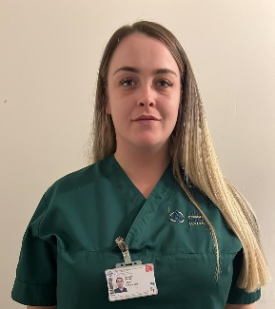
Aims & Objectives
1. Establish frailty screening in patients ≥65 attending POAC
2. Offer a preop Comprehensive Geriatric Assessment (CGA) to those living with frailty
3. Upskill staff in managing geriatric syndromes
4. Inform resource required to provide a substantive service:
  throughout perioperative pathway
  across surgical specialties
Notes:
Describe the outcomes
Key info: cost and time savings, labour hours saved, touch points before vs after, waiting list numbers and time on list before vs after, length of stay before vs after, ROI etc.
The aims of this project are based on that CPOC guidance.
As well as screening for frailty and offering CGA, it’s important that we upskill the existing workforce who managing these patients , particularly regarding frailty and delirium.
This service started with a few defined surgical specialties, but by screening all patients 65 and over coming through POAC, we can try and plan for future expansion to offer equity across all specialties.
Here is our team, Nia and I co-led and supervised the project.
Alex in the centre is a Geriatric Medicine trainee who completed this project as part of her out of programme year as a WCLF
Kate our band 6 CNS in blue and Brooke our HCSW in green were both funded by the BC PCIP funds.

Slide 4

Project Pathway
POAC
Patients age ≥65 with CFS ≥5, awaiting planned general surgery
(Urology / ENT / Maxillofacial surgery)
Surgical Consultants
POPS NURSE
Nutrition
Cognition
Signposting to prehabilitation
Home adaptations
POPS DOCTOR
Optimise comorbidities
Medication review
Shared Decision Making
Treatment Escalation Planning
Anaesthesia liaison
Feedback outcome:
Referring clinician
GP
POAC nurse
Responsible clinician
Prehab
POPS MDT
Cancer CNS
Prehab
Multiprofessional
Case-based learning
↓ anaesthetic workload
↓ GP workload
↓ specialist referral
Primary Care
Notes:
Describe the outcomes
Key info: cost and time savings, labour hours saved, touch points before vs after, waiting list numbers and time on list before vs after, length of stay before vs after, ROI etc.
This is the pathway we developed.
The majority of referrals came from POAC, but we encouraged referrals from earlier in the patient pathway
The CGA was delivered between the POPS Nurse and Doctor, with all patients discussed at an MDT that included a geriatrician, anaesthetist and pharmacist.
The points in red are components that were (partly) present in the old pathway, but those highlighted in green are additional as a result of this service.
The benefits of this new structure are highlighted in the yellow box.

Slide 5
Project Outcomes
POPS CNS
POPS DOCTOR
153 patients
75% virtual consultation
84 nutrition interventions
12% referred to Care & Repair
105 patients
76% F2F consultation
Medications: 66 stopped, 43 started
153 new diagnoses made
84% participated in SDM
17% did not proceed with surgery
Notes:
Describe the outcomes
Key info: cost and time savings, labour hours saved, touch points before vs after, waiting list numbers and time on list before vs after, length of stay before vs after, ROI etc.
153 patients were seen in the service over 10 months. All were seen by the nurse, then around two-thirds went on to see the POPS doctor according to clinical need and clinic capacity.
The majority of nurse consultations were virtual – either by phone or video using Attend Anywhere – whereas most of the doctor consultations were face-to-face (based on clinician and patient preference)
Over half the patients in the nurse clinic were at high risk of malnutrition and required intervention in the form of diet advice sheets or supplement drinks
12% of patients were referred to C&R for home adaptations
In the Doctor clinic most patients engaged in SDM discussions regarding the proposed surgery – it was not done if the patient lacked mental capacity to have this discussion
17% of the patients DNP with surgery, 14% as a direct result of the SDM discussion with the POPS Doctor.

Slide 6
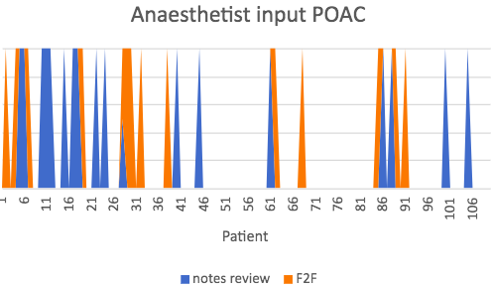

Did It Work?
Annual recurring saving
£41 per patient
Opportunity cost >£10K / month
Downward trend in need for Consultant Anaesthetist review
Notes:
Describe the impacts. How has the innovation reduced demand for/improved planned care services?
Medication review included optimisation and deprescribing with x no new meds started and y meds stopped
This yielded an annual recurring saving of £41 / patient / year
As the project progressed we observed that fewer of our patients were also having a separate anaesthetist review in the form of notes review of F2F appointment. This took time to happen as people’s understanding and confidence in service grew. This freed up appointments for other high risk patients to be seen by the anaesthetist.
Patients not proceeding with surgery yields a significant opportunity cost of >£10k per calendar month, but also frees up space on lists for those who are proceeding, reducing their waiting time.

Slide 7
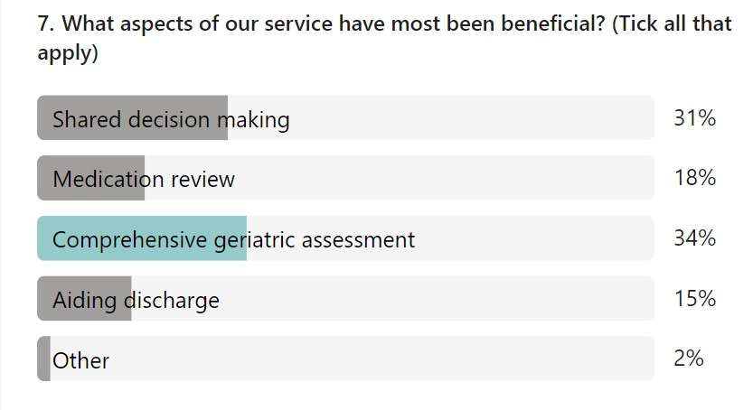
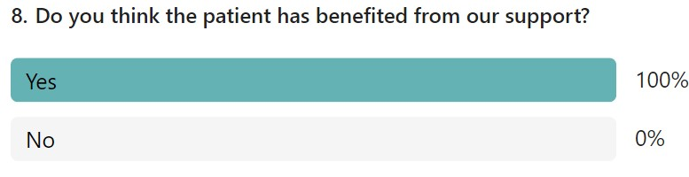
Feedback
"Keeping up to date with what "they" were doing, and why they were doing it. Attend Anywhere (video appointment) saved travelling to Cardiff...and getting another £40 fine“
"I was told straight - didn't go around in circles. Told the truth and I could make the choice I wanted then."
"Gave us information about procedure and risks, and options about doing nothing. It was not problematic, so we decided to watch and wait"
Notes:
Describe the findings of any patient and staff surveys/feedback. Discuss the role of the patient representative and any co-production activities.
Key info: number of patients/staff surveyed/interviewed.
We sought feedback from staff who felt that the CGA and SDM were the most beneficial aspects of the service.
All staff surveyed felt patients benefited from our input
Patient feedback has also been very positive as you can see from the quotes here on the right – there is a theme that patient felt better informed about the proposed surgery and more empowered to decide whether or not to proceed.

Slide 8



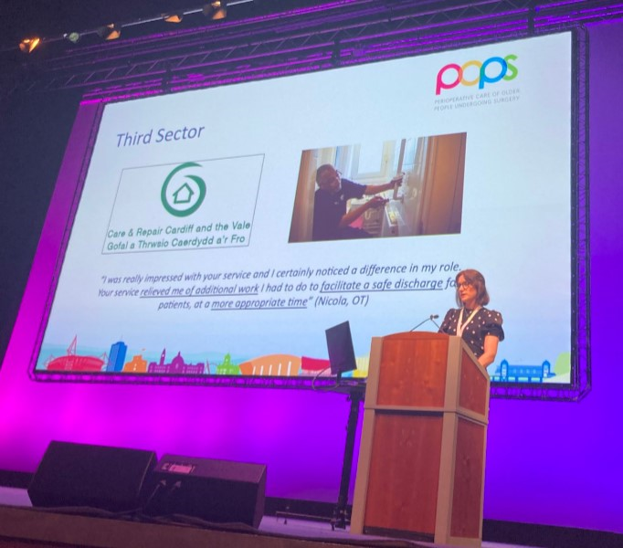
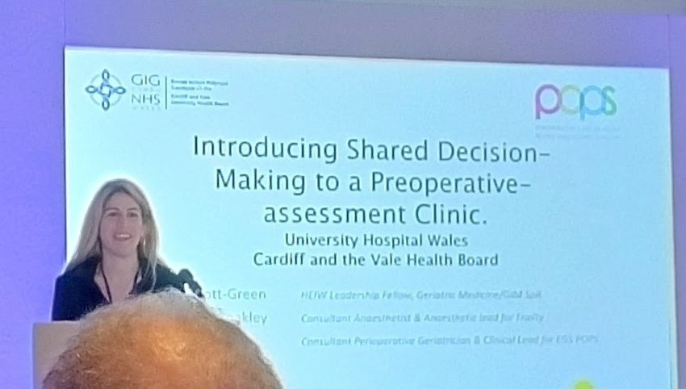



Outputs and Accolades
Notes:
Detail of outputs e.g. presentations, publications and accolades e.g. awards
Multiple opportunities to present at national and international conferences in Wales, England, Scotland and Belgium over the past year.
Alex won prize for best platform presentation at AAA conference in May with talk on SDM
Finalists in NHS Wales Awards 2023 in the ‘Delivering higher value health and care’ category

Slide 9
What Next?
Local
Substantive service - £91K pa funding
Expand specialties
National
All Wales Innovation Leads
Patient involvement
Toolkit
Postop geriatrician input
Wider MDT involvement
Notes:
Describe the potential wider impact e.g. what does this mean for planned care services in Wales? Can the innovation be adopted and spread in other health boards?
We have had substantive funding approved from our planned care board that includes 6 sessions for a Cons Geriatrician, a full time CNS and some co-Ordinator time.
With this we hope to widen our scope to include vascular surgery, gain more OT involvement, offer post-op input on the ward which we hope will reduce complication rates as well as give an opportunity to build a rapport with and upskill ward colleagues.
Patient representation is important going forward and we need their input in developing a patient information leaflet for the service.
We are currently building our toolkit which will include proformas, letter templates, job plans etc in the hope that this could be spread and scale to other health boards as needed, with the support of innovation leads across Wales.

Slide 10

Reflections
Notes:
Describe any barriers to and enablers of innovation you have experienced alongside any personal reflections….
Remote supervision/ establishing roles at outset of a new service and adapting these roles as it evolved. With this we realised importance of teamwork and in particular established the weekly MDT Teamwork – sum productivity of the team was greater than its parts; support colleagues when challenges faced; learnt from each other’s good practice, co-lead’s from different specialties reduced blind spots in the pathway
Co-Leadership gave a better understanding of the pathway / reduced blind spots as much as possible, shared learning opportunities, support each other at busy times
Challenge to embed a change in a new area – re delirium training in post op ward – not used to POPS concept, poor insight into delirium recognition, limited engagement with training / not seen as high priority – hope this will change with substantive service as post op ward rounds will be provided / more contact points in this area.

Slide 11
Conclusions
Holistic
optimisation
Value of third sector
Patient voice
Patient-directed intervention
Notes:
Provide a recap of how the innovation has improved planned care services in Wales
The key improvements in this planned care have been that....
1. Surgical intervention is more patient directed rather than pathology directed, through the standardisation of SDM approach
2. Patients are holistically optimised for surgery as a result of the CGA
3. This was our first experience of working with the third sector – there were benefits for both patient and colleagues, as home adaptations were already in place preop; with no additional cost to the NHS
4. The power of the patient voice ...not just in terms of SDM...when discussing project outcome, data is needed to demonstrate benefits, particularly in the current financial climate. But a patient story can be more powerful in reaching hearts and minds.....we recorded Trevor’s Story with our patient experience team – it’s a 2 minute clip and if you’d like to watch it please scan this QR code.
N.B QR code active for 13 days from 9th Sept, when expired youtube link to Trevor’s Story is via https://www.youtube.com/watch?v=7sgnbhlyLCY

