Slide 1
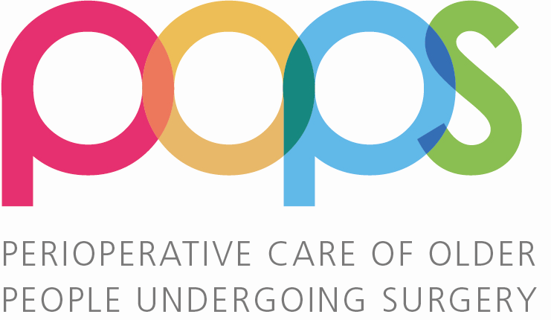

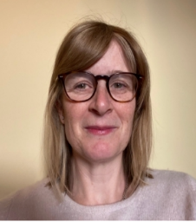
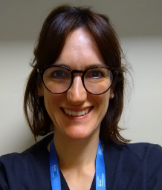
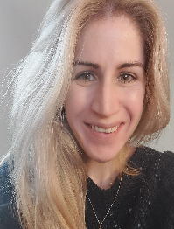
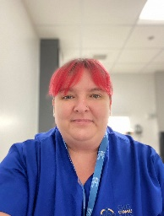
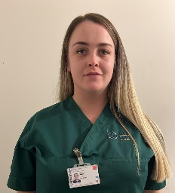

Establishing a POPS
Service in Elective Surgery
Dr Margaret Coakley (Anaesthetist), Dr Nia Humphry (Perioperative Geriatrician)
Contact: margaret.coakley@wales.nhs.uk
Background: Older patients living with frailty are at higher risk of perioperative morbidity and mortality. The Covid-19 pandemic has led to deconditioning and delays in elective surgery for these patients. The 2021 guidelines from the Centre for Perioperative Care (CPOC) promotes early frailty assessment and Shared Decision Making (SDM) as part of a Comprehensive Geriatric Assessment (CGA) in this high-risk group.
Project Aims
1. Establish preoperative frailty screening for ≥65s
2. Offer CGA to those living with frailty*
3. Upskill staff in geriatric syndromes (e.g., delirium)
4. Inform business case to sustain a POPS service
*General Surgery, Urology, ENT and Maxillofacial
Meet the team...
Nia
Consultant
Geriatrician
Brooke
Healthcare Support
Worker
Margaret
Consultant
Anaesthetist
Katie
Clinical Nurse
Specialist
Alex
POPS Leadership
Fellow
SET UP
→
FRAILTY SCREENING
→
COMPREHENSIVE GERIATRIC ASSESSMENT
→
FOLLOW UP
Team appointed
Link with Care and Repair
Baseline data
Project tools created (assessment proforma, letter template etc.)
Pre-Operative Assessment Clinic (POAC) nurse training
Frail patients referred for CGA
CNS assessment: including cognition, nutrition, home environment
POPS Fellow review: optimize co-morbidities, new diagnoses, medication review, SDM
POPS MDT discussion – letter to stakeholders
Week 1: screen for delirium & morbidity
90 days: telephone review, assess quality of life & decision regret
Delirium training for ward nurses
Project Impact
55% patients deemed high risk of malnutrition and received intervention
SDM delivered to 84% patients seen by POPS Fellow, 14% not proceeding with proposed surgery as a result. Opportunity cost savings >£73K by month seven of project. Listen to Trevor’s Story https://youtu.be/7sgnbhlyLCY
66 medications stopped, 43 started; recurring annual cost saving £41/patient
Reduction in Consultant Anaesthetist appointments as all CGAs discussed with anaesthetist via POPS MDT
153 new diagnoses made, most commonly cognitive impairment (n=19); minority (37%) accepted referral to memory clinic
Reduction in OTs workload, “Your service relieved me of additional work I had to do to facilitate a safe discharge for patients at a more appropriate time.”
Project Outcomes
Frailty scoring established in POAC (153 CGAs completed)
Funding secured for substantive service (£91,829/year)
Learning Points
Shared Decision Making - ensures patient-directed not pathology-directed management
Third sector value - beneficial for patients and colleagues, with no additional cost.
The power of a patient story - it often leaves data in the shadows!
Next Steps
Appoint a substantive team
Patient coproduction
Embed a perioperative delirium pathway
Provide a toolkit for other Health Boards
Notes:
Clinical Nurse Specialist (CNS) and Healthcare Support Worker (salaries funded by the Bevan Commission)
HEIW Welsh Clinical Leadership Fellow (trainee in geriatric medicine). Supervised by authors
Staff Feedback Whilst we had a lot of positive comments from all stakeholders that completed our survey ( n= 39) main themes are shown in Fig 1
Patient feedback emphasised the positive impact of SDM on patient experience …“I was told straight- didn't go around in circles. Told the truth and I could make the choice I wanted then.” See further quotes overleaf.A video of a patient story is referenced below (3).
Evidence suggests CGA reduces perioperative morbidity, mortality and functional decline, with reductions in length of stay and subsequent cost savings. SDM helps avoid both inappropriate procedures and decisional regret for patients. It releases space on surgical waiting lists for those who do wish to undergo surgery.

Slide 2
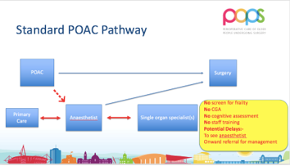
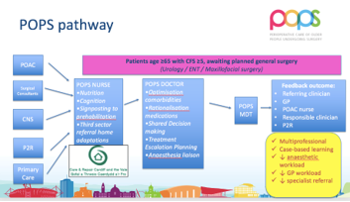
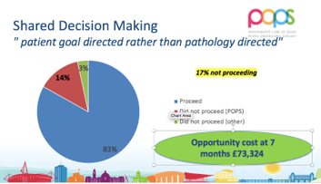
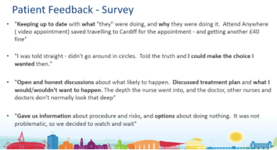
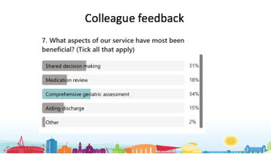
Figure 1: Previous POAC pathway demonstrated lack of frailty assessment and potential referrals to primary or secondary care to manage co-morbidities, with subsequent delays in proceeding to surgery
Figure 2: The new POPS pathway detects frailty, ensures a standardised and holistic assessment, with less onward referrals and reduced need for anaesthetist review
Figure 3: 17% of patient seen in POPS clinic did not proceed with the proposed surgery – 14% due to patient choice following SDM discussion by POPS Fellow
Figure 4: Quotes from patient feedback survey demonstrate patients valued information shared with them in POPS clinic through SDM process
“The ward staff found the CGA information very helpful in assessments, the service makes a huge difference to the patient but also to nursing staff in trying to provide excellent care”
Deputy Ward Manager, Surgery
"This service has been invaluable to us as a therapy team with limited ability to influence or mitigate any effects from frailty. We have managed to create a good link with the nurse...we have learnt a lot about frailty, how to assess it and associated risks in surgical patients "
Prehab to Rehab Physiotherapist
“Working with your service has helped get written information to, and start first-line supplements in high-risk patients prior to surgery…..also highlighting ‘at risk’ patients to us for intervention on admission.”
Dietician
Figure 5: Colleagues found the CGA and SDM aspects of the POPS clinic most beneficial
Figure 6: Colleague feedback quotes

