Slide 1

Enhanced Community Gynaecology Clinic
Delivering Improved Services for Endometrial Cancer Diagnosis – the HRT Problem
Alan Treharne
Consultant Gynaecologist, Hywel Dda UHB

Slide 2
The Problem: Unscheduled Bleeding on HRT
- Impact of a well-established service (Menopause on USC)
- Recognised across Wales and UK
- Research proven incidence
- Not enough clinical capacity
Need to do more with what we have – promote prudent management

Slide 3
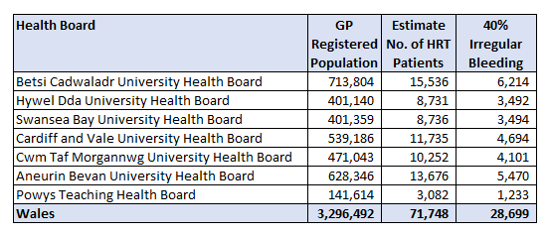
Size of the Problem – Estimated Impact

Slide 4
Clinical Importance
Approximately 8% conversion from primary care to secondary care
As a proportion of the estimated referrals, this means an additional 2,295 patients
This reflects a need for 1 clinic/HB to avoid impact

Slide 5




What Have We Done?

Slide 6
How Did We Do This?
Best practice
Clinician with ultrasound and specialist experience
Single appointment pathway

Slide 7
Secondary Care Services?
Health board | 40% | 8 % conversion | WTCE
Betsi | 6214 | 497 | 1.8
Hywel Dda | 3492 | 279 | 1.0
Swansea Bay | 3494 | 279 | 1.0
CAV | 4694 | 375 | 1.4
Cwm Taf | 4101 | 328 | 1.2
Aneurin Bevan | 5470 | 437 | 1.6
Powys | 98 | 98 | 0.36

Slide 8
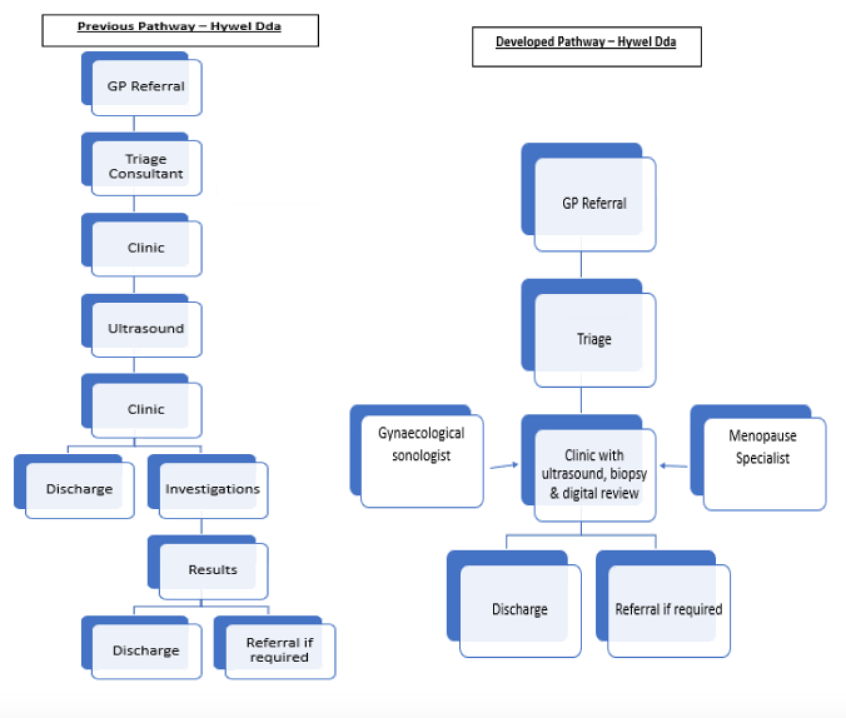

Slide 9


Why Did We Do This?

Slide 10
What Was the Impact?
Resource | Previous pathway | Developed pathway
New appointment (consultant) | £262 | £262
Ultrasound scan | £143 | Nil
Follow up (consultant) | £125 | Nil
Total | £530 | £262
Resource release per patient | Nil | £268
Per 276 patients per year Over 4 clinics |  | £73,968 £295,872

Slide 11
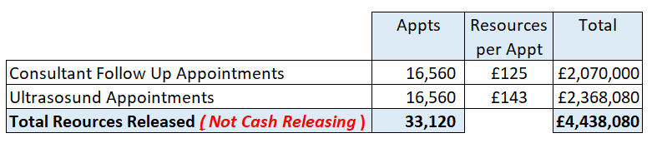
Impact if Scaled

Slide 12
Endorses Current Frameworks
Quality and Safety Framework (WG 2021)
Safe – reduces need for more invasive imaging such as MRI and CT in benign pathology
Effective – evidence based superior diagnostic accuracy for uterine pathology, eliminating the need for hysteroscopy and the potential associated morbidities
Person-centred – responsive to population needs, reduces hospital visits and associated impact on work, family and finances
Timely – elimination of multiple hospital appointments, increases clinical capacity, reduces waiting times, and increases secondary care capacity for USC diagnosis and imaging
Efficient – significantly reduces time to diagnosis and treatment
Equitable – central location for the Health Board

Slide 13
System Benefits
NHS waiting lists fall
Improved recruitment and retention
Demand managed
Better investment through resource release incentives
Teaching and training improved
Financial stability
Data collection enhanced
Value driven healthcare

Slide 14
Conclusions and the Future
Outcomes
Novel clinical innovation for a national problem
Clear financial impact
Embracing prudent practice
Improving patient outcomes
Next steps
National upscale
National clinical frameworks
Health and care pathways
Expansion of services
More innovation and investment – digital solutions
Research and training

Slide 15
With Thanks to the Team:
Dr. Helen Munro
Lyndon Freeman, Lauren Davies, Sarah Rees and Lisa Humphrey
Dr. Tom Howson
The team in Cardigan Integrated Care Centre and Bronglias
Cardigan hospital league of friends
Christian Newman and Iwan Williams-Evans
Sally Davey and Steven Johnson
Helena Clarke
Jane Hanford and Sherene Reardon-John

Slide 16
alan.treharne@wales.nhs.uk
Thank you
Contact details:

