Slide 1



Improving Planned Care in the Frail
Dr David Burberry, Dr Karina James, Dr Duncan Soppitt, Dr Greg Taylor, Dr Jugdeep Dhesi,

Slide 2

Project Background
Increasing numbers of frail, elderly patients are undergoing elective and emergency surgery, increased adverse outcomes
1/3 frail patients are admitted under surgical specialities
¼ patients requiring emergency laparotomy are frail
  90 day mortality >60 is 4x higher.
  Increased LOS
Patients referred for elective procedures are often screened in the community but rarely is it communicated
Waiting times on elective surgical lists are often in excess of 5 years
Patients are often referred to other specialities whilst on the list (e.g. Cardiology for ECG etc) and join at the bottom of the queue
Patients attend pre-assessment clinics every 6 months whilst on the surgical waiting list (resulting in a number of 65+ patients attending 10+ pre-assessment clinics)
A number of patients are unsuitable for surgery, but remain on the list/ 6 monthly pre-assessment cycles
Evidence is emerging for CLINICAL and COST benefits to frailty involvement in perioperative medicine (POPS)
Increasing numbers of frail, elderly patients are
Evidence is emerging for CLINICAL and COST benefits to frailty involvement in perioperative medicine (POPS)

Slide 3
Aims and Objectives
To assess demand for geriatric led perioperative service
To assess the cost benefit of the service
To identify a screening tool that can be used electronically to identify patients that would benefit from a geriatric review
To map out additional benefits in improving patient care
To develop the service with robust patient involvement and feedback

Slide 4
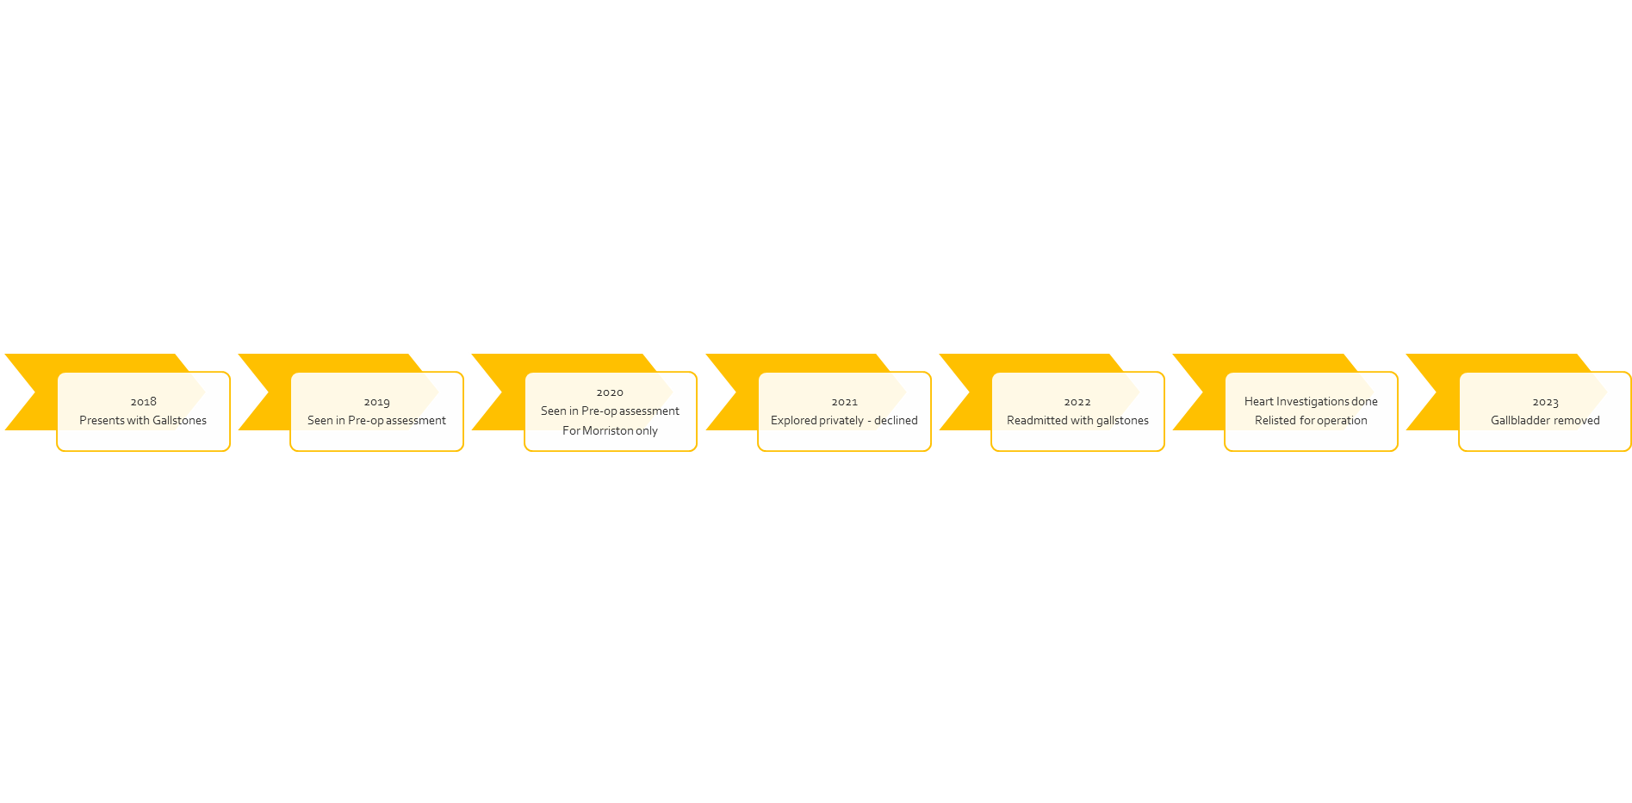
Project Approach
Mr M
Patient comments
‘I can’t have my gallbladder out while I am waiting for my hip’
‘I’m falling because my knee keeps giving way, I haven’t heard about the op for years’
‘I’ve given up on the waiting list’

Slide 5
Project Approach
Step 1
Written questionnaire to all patients on Laparoscopic Cholecystectomy list >65
Step 2
Telephone contact and WCP (clinical notes) trawl to do a clinical frailty score, hospital frailty risk score and CRANE questionnaire (clinical fellow)
Step 3
MDT discussion to determine whether patient will benefit from clinical review
Step 4
Patients either kept on list, removed for list or clinical review done with COTE team

Slide 6
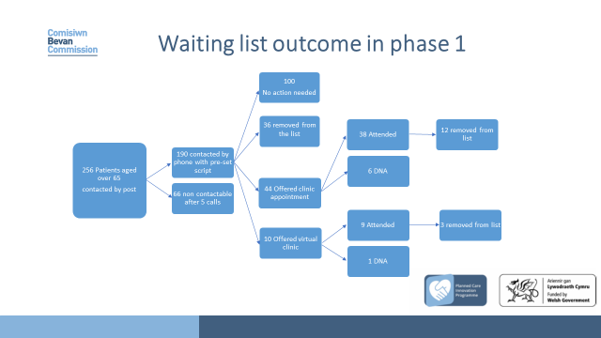
Project Outcomes

Slide 7
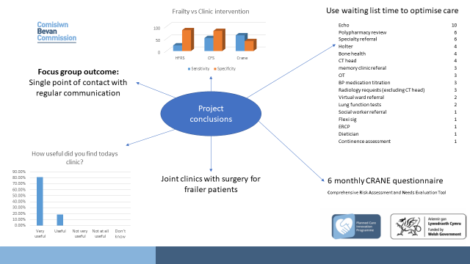
Did it work?
  Savings £250,000 on lap chole list
  Excellent patient feedback
  Supports waiting list screening

Slide 8
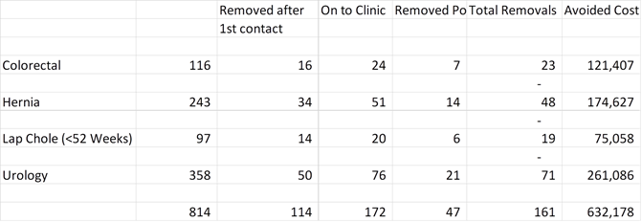
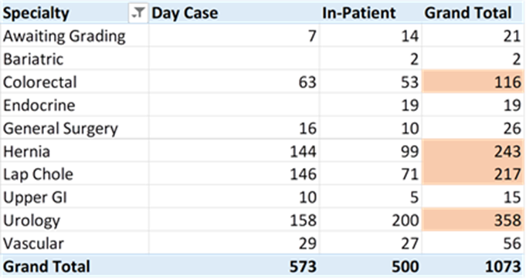
What Next?
Benefits realisation – year 1 Swansea Bay
Replicating the Bevan work the following were identified as the largest patient cohort
Cost savings of targeting patient cohorts year 1 outlined
Scope
Current Waiting lists General Surgery, Urology, Vascular
Over 65
Excludes USC

Slide 9
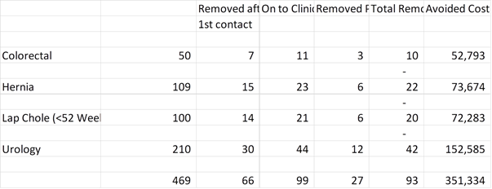
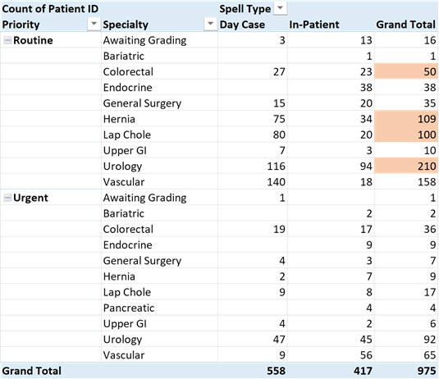
What Next?
Benefits realisation – year 2 onwards Swansea Bay
Additions to the list over the last 12 months
Over 65
Excludes USC
Recurrent savings OP list opportunity year 2 onwards

Slide 10
What Next?
Benefits realisation – year 2 onwards Swansea Bay
Additional benefits
Financial
Medicines Management costs
Reduction in numbers listed for surgery/ reduction in overall waiting times
Reduction in referrals to speciality (e.g. Cardiology) whilst on the surgical waiting list due to geriatricians MDT
Patient / Quality
Optimisation
Engagement
Reduction of time to initial clinic and reduced overall time for decision
IMPROVED SATISFACTION

Slide 11
Resource implications – Swansea Bay
Workforce requirement – Outpatients pathway
Workforce:
B8a / Admin: facilitate 2 clinics a week/ 20hs o direct patient contact via telephone calls to screen those requiring attendance at MDT clinic and paperwork/ communication with primary care/ specialities
Consultant sessions: Assumes 12 patients a week seen at Consultant MDT clinic (conversion rate telephone – clinic 5:1)
Outcome: GP referral to MDT one stop shop clinic target time: 14 weeks
 |  | Full Year | Part Year
3 Consultant Sessions |  | 42,000 | 21,000
Band 3 Admin | 1 WTE | 30,000 | 15,000
Band 8a | 1 WTE | 74,000 | 37,000
Total |  | 146,000 | 73,000

Slide 12
Conclusions
The trial has been successful and demonstrated that POPs services in elective care can generate cost savings and improve patient care.
The service has been reviewed by the health board with potential savings for the health board mapped out.
We have identified an electronic screening tool and have discussed this at national and international conferences.

Slide 13
Outputs and Accolades
Presented at the National British Geriatric Society in Edinburgh in May 2023
Invited as platform presentation to the Irish Gerentology Society meeting in Galway in September 2023
Shortlisted for NHS Wales award
Chose as frailty project by Swansea Bay Ways project

