Slide 1

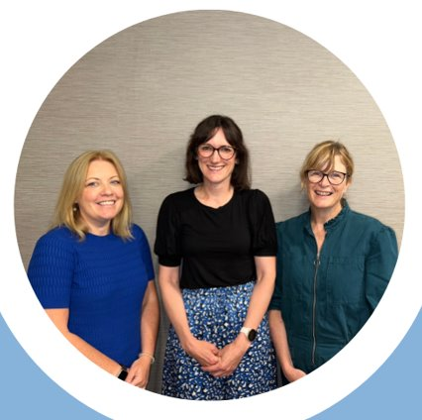


Perioperative Care for Older People in Wales
Dr Nia Humphry
Consultant Geriatrician CAVUHB
Dr Karina James
Consultant Geriatrician SBUHB
Dr Margaret Coakley
Consultant Anaesthetist CAVUHB

Slide 2
Drivers for change
Who's doing what?
The value of interdisciplinary working

Slide 3
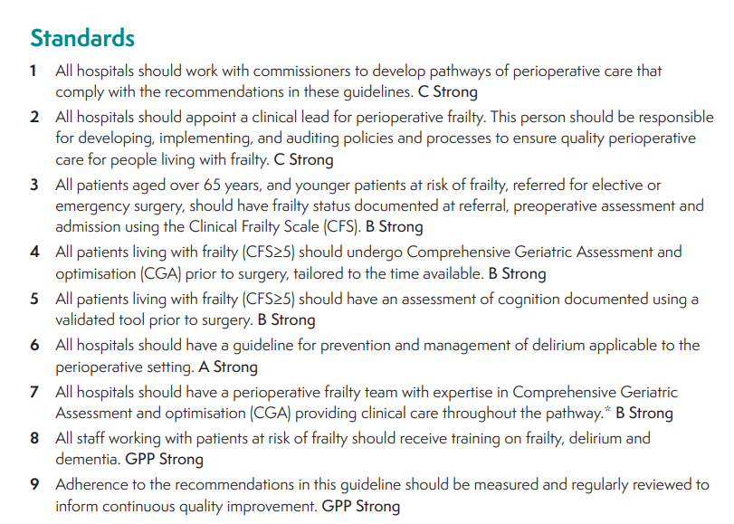


DRIVERS FOR CHANGE

Slide 4

DRIVERS FOR CHANGE
2022 - Pilot POPS in planned care
CAVUHB & SBUHB
Different patient and staff populations
Same principles – CGA & SDM
Led to substantive funding

Slide 5


DRIVERS FOR CHANGE
Bevan project support Feb 25 – Aug 26
P&I support Apr 25 – Mar 26
Set up or expand POPS in planned care
Savings if model scaled in Wales:
£3.3m patients not proceeding (n=884)
£1.4m primary/secondary care appts
£258,000 medication changes

Slide 6
POPS A&S
Frailty
assessment
Cognition
screening
SDM + personalised
risk score
Medication
review
CASE for CHANGE
Problem statement
Costs: capital vs revenue, fixed vs variable
The Challenge: why change is needed
Impact & benefits: patient, operational, financial
The Solution
Strategic alignment: national & local
ROI
Implementation timeline
Call to Action
Case for change
>6000 frail patients a/w elective surgery
£4,958,000 potential savings
Core fidelity
Scalable
Modifiable
Resources:
£102,000 / health board
Implementation support
Toolkit
Co-morbidity optimisation Continence
Bone health Future care planning
Face-to-face delivery Workforce members
Notes:
Savings of £803 / patient through SDM, reduction in primary and secondary care appts and medication changes
Scaleable units in larger box
Modifiable units (not exhaustive list) in smaller box
NHS P&I Transformation Fund for salaries and start-up costs: 3PAs Cons Geriatrician, Band 6 1WTE, Band 3 administrator 1WTE + £5K start-up costs for equipment etc

Slide 7
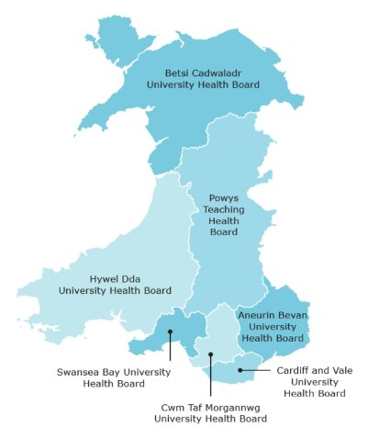
All 6 sites engaged in opening discussions
2 non-adopting sites limited by workforce capacity
4/6 sites adopted
2 new services, 2 expansions
Staggered start dates
Funding only part-utilised by all

Slide 8
Money isn’t always the answer
(especially when time-limited)
Barrier for one site = enabler for another
Slow still = progress!
Strategic fit drives early progress
Notes:
Non-recurrent pots of money don’t always lead to engagement, and hard to spend it all if time-limited!
Barriers and enablers varied between organisations – eg geriatrician capacity prevented progress in the 2 non-adopting sites, but was instrumental to progress in the other 4 sites
Adoption felt slow but 4/6 sites generating outputs = great progress in 9 months since funding approved
Strategic fit – alignment with local priorities eg waiting list validation, helped drive progress earlier in certain sites
.
In the 2 non-adopting HBs, geriatrician capacity was a key factor that prevented adoption.
Utilisation of non-doctor roles increased output at several sites

Slide 9


Slide 10
2020
Emergency laparotomy (NELA criteria)
2026
Emergency laparotomy
EGS ≥65 and CFS ≥5
Vascular surgery
Elective surgery:
General surgery
Urology
ENT
Maxillofacial surgery
Gynaecology
(Orthopaedics)

Slide 11
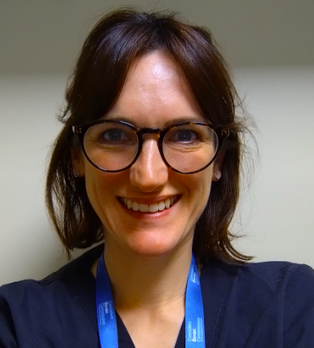
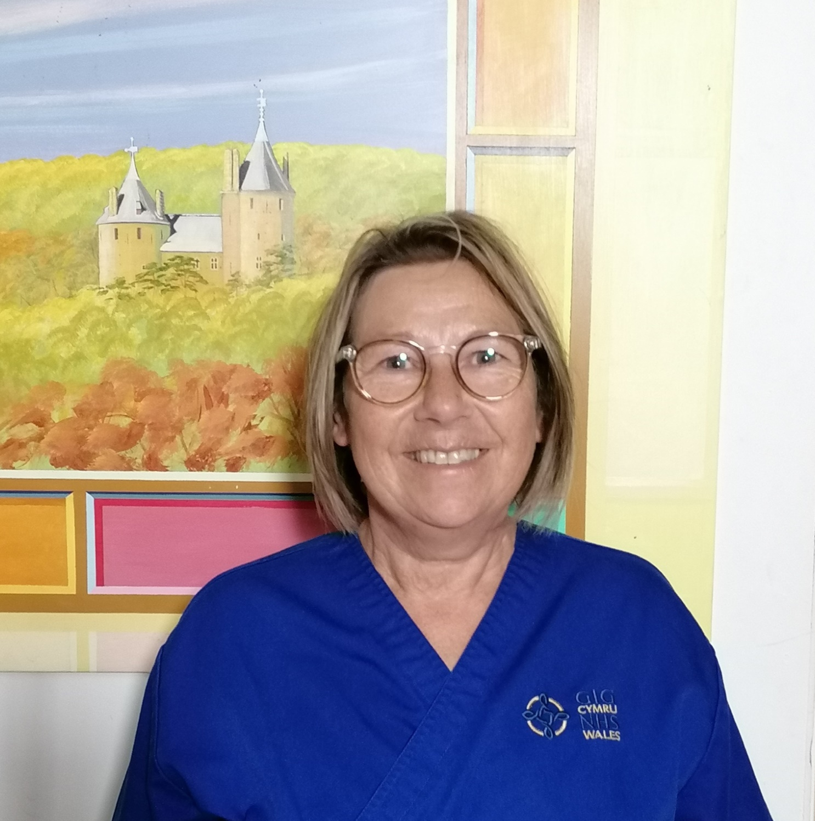
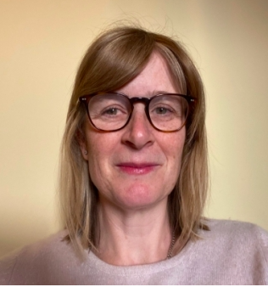
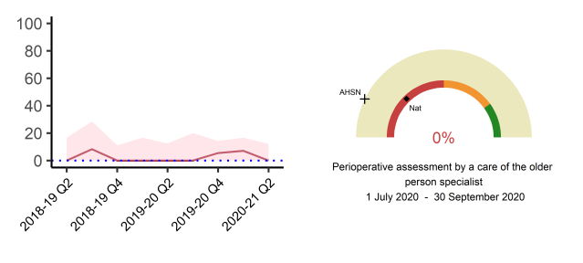
Consultant Geriatrician
NELA Nurse Practitioner
Consultant Anaesthetist
October 2020 – funded by SCB
Core team:
Consultant Geriatrician (10 PA)
Nurse Practitioner (24hrs / week)
Proactive retrieval – support until discharge
Notes:
POPS service in CAV started in emergency stream 2020 as per NELA recommendations.
Frail=high risk, but rarely / poorly assessed

Slide 12
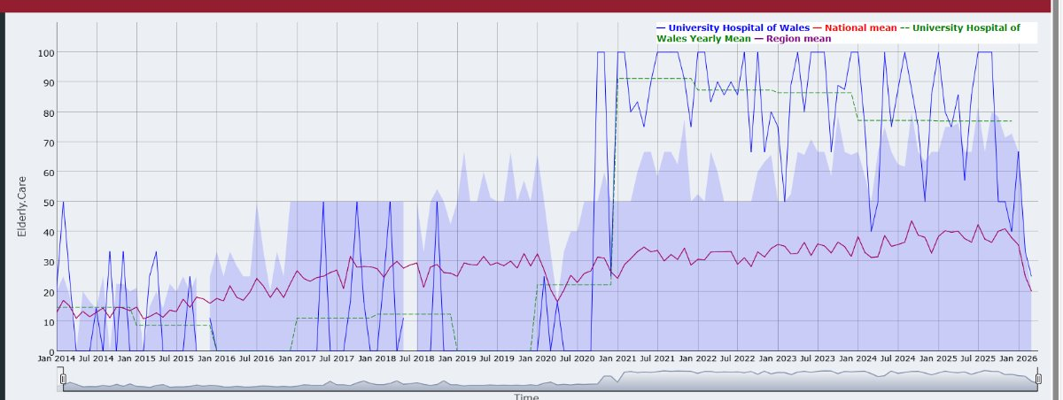

Slide 13
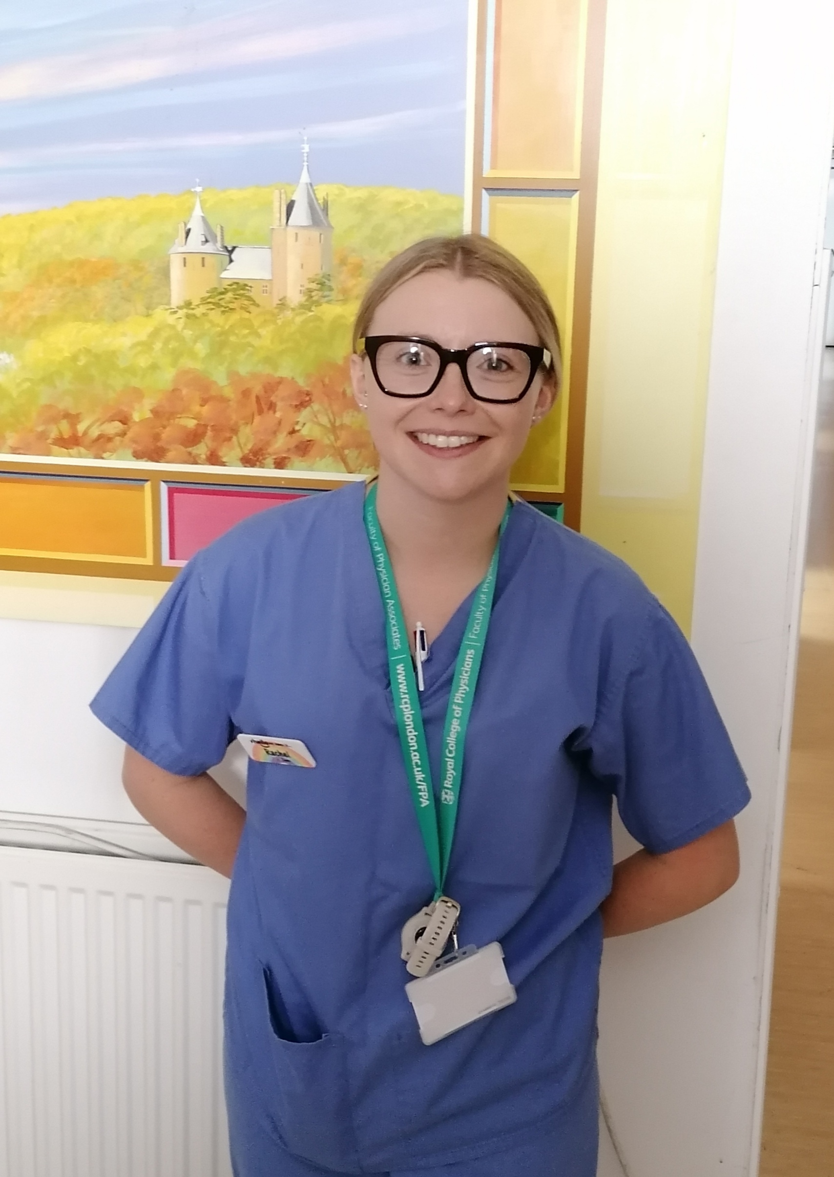
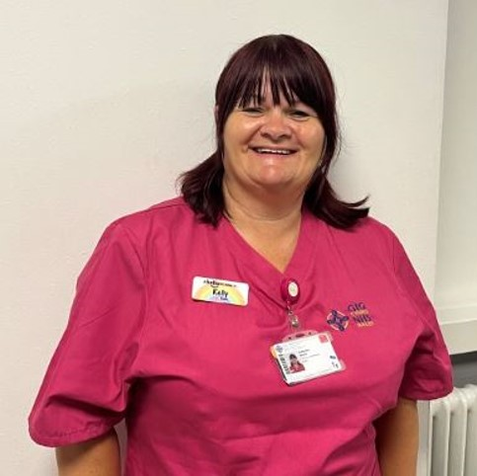
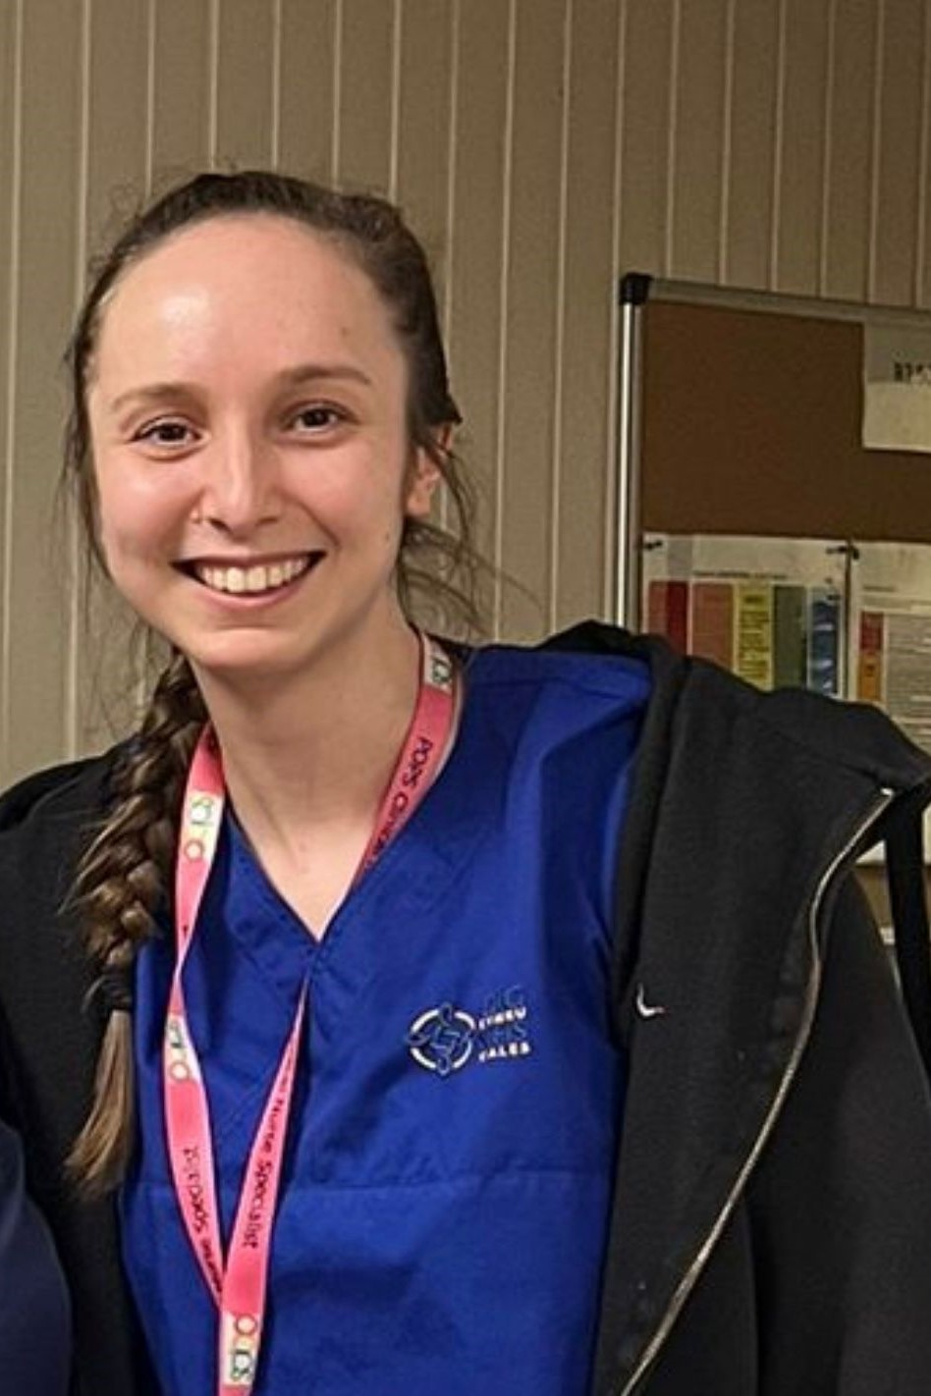
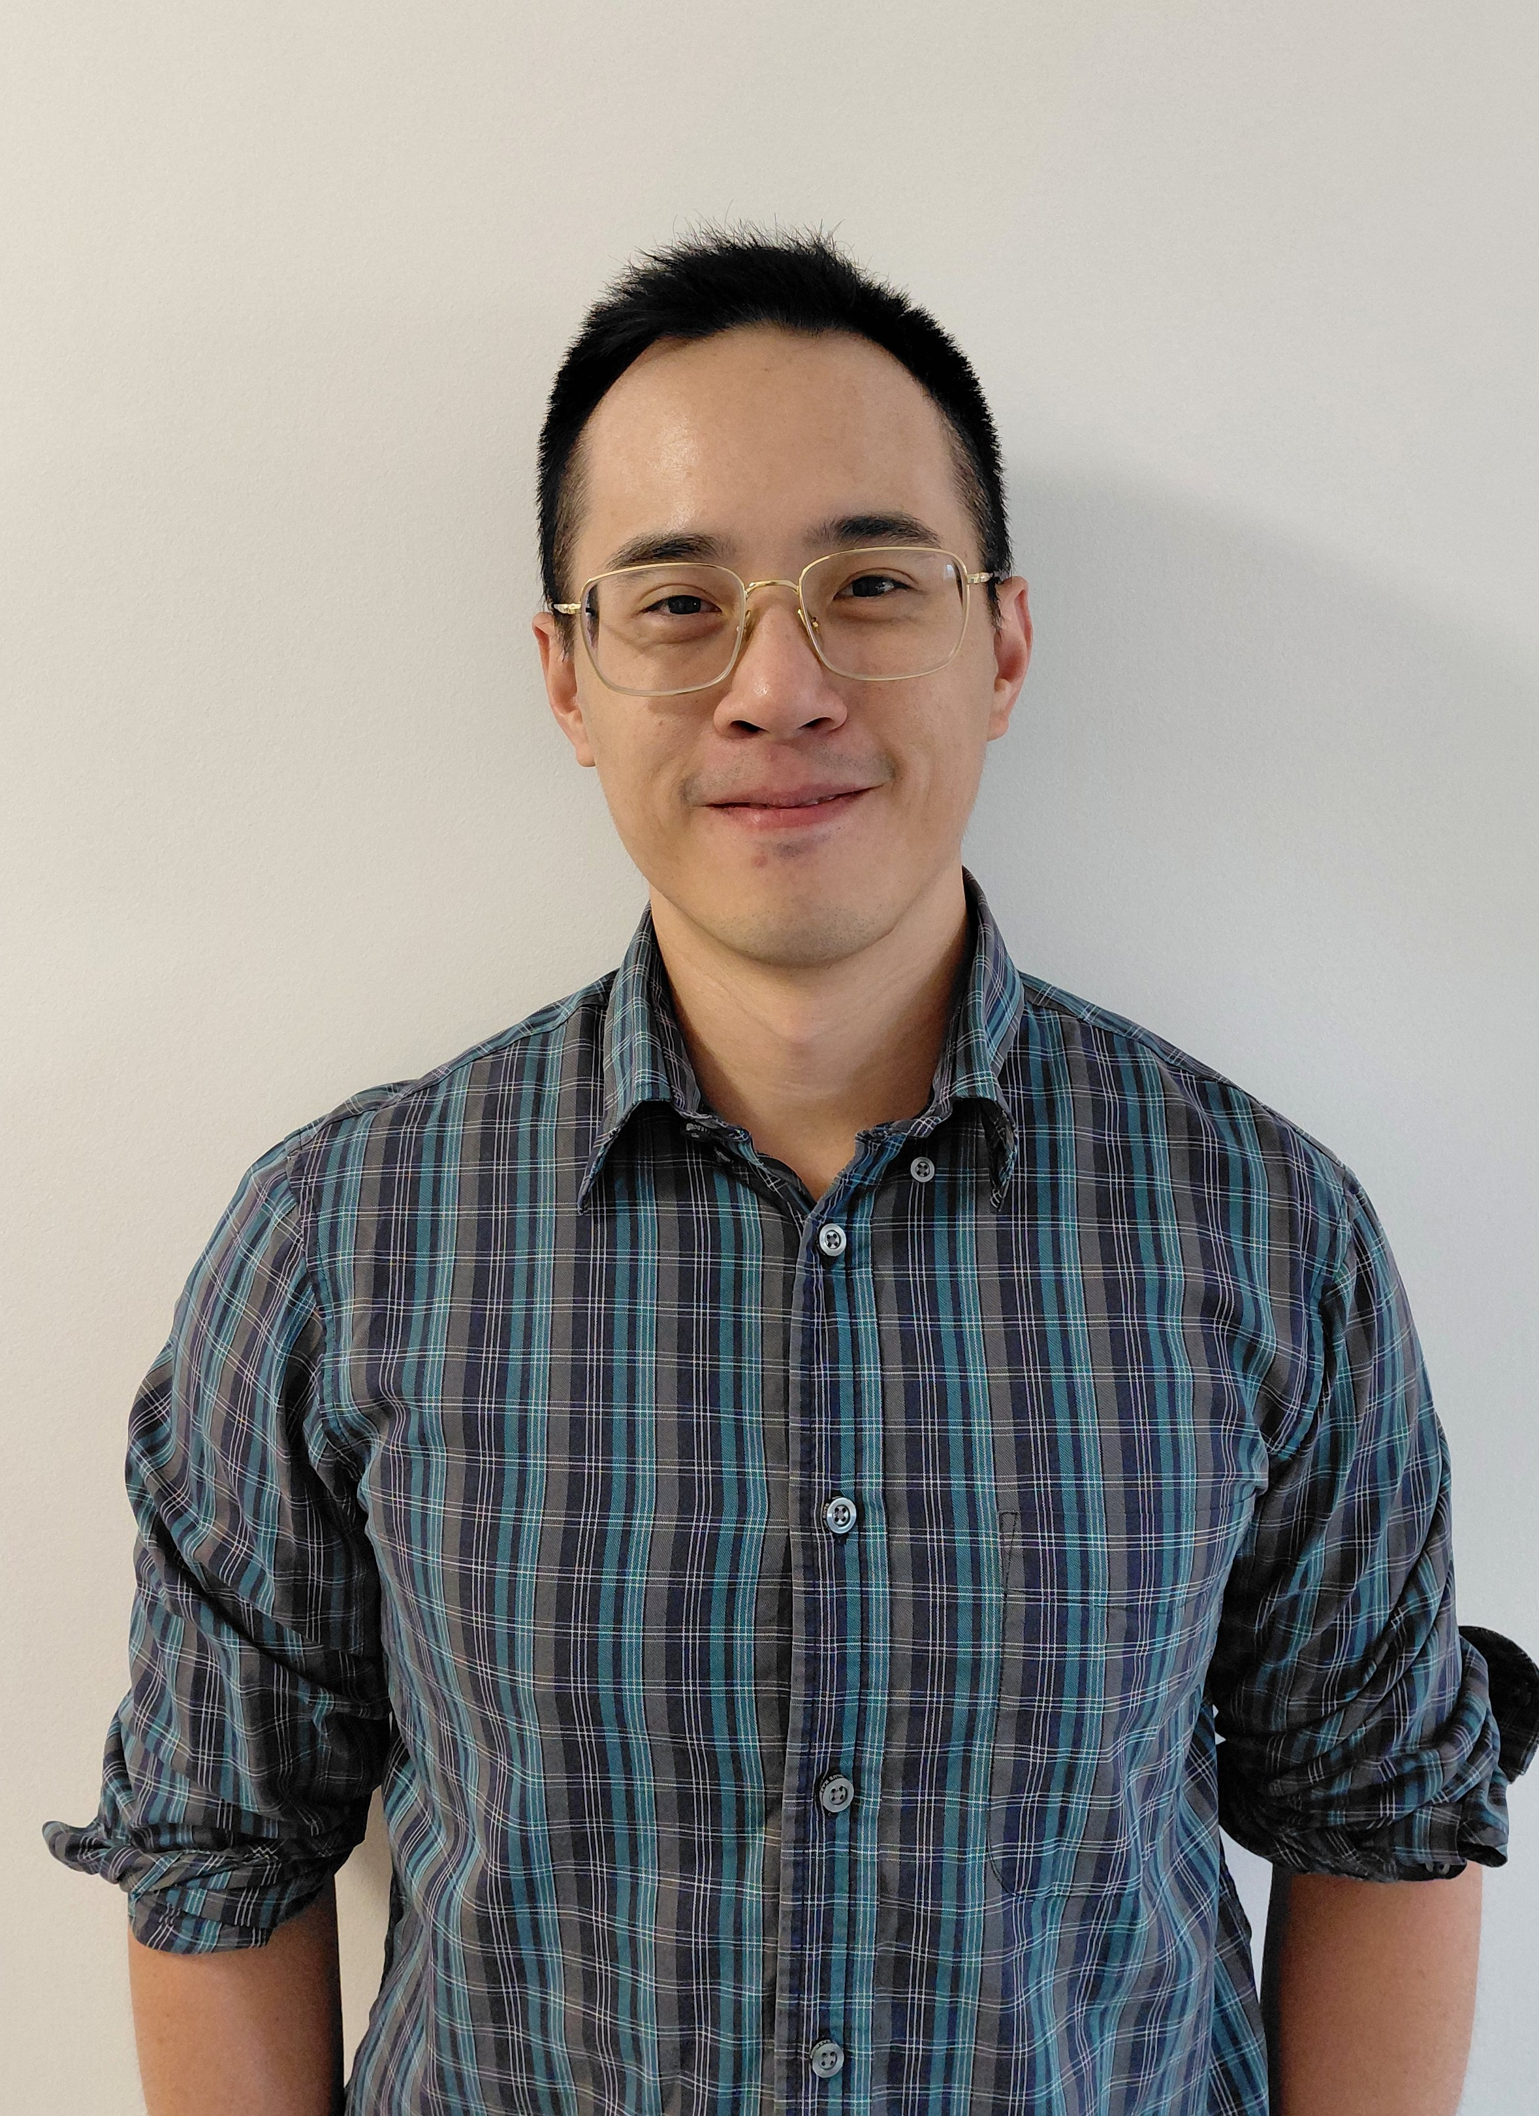

Team expansion (emergency general surgery)
Physician Associate
November 2021
Surgery Clinical Board
Memory Link Worker
February 2022 (secondment)
Memory Service
April 2023 (substantive)
Regional Partnership Board
CNS
May 2022
Clinical Fellow
November 2022
Welsh Government - sSDEC
Acute internal medicine OOPE
July 2024 – 6/12 WTE

Slide 14
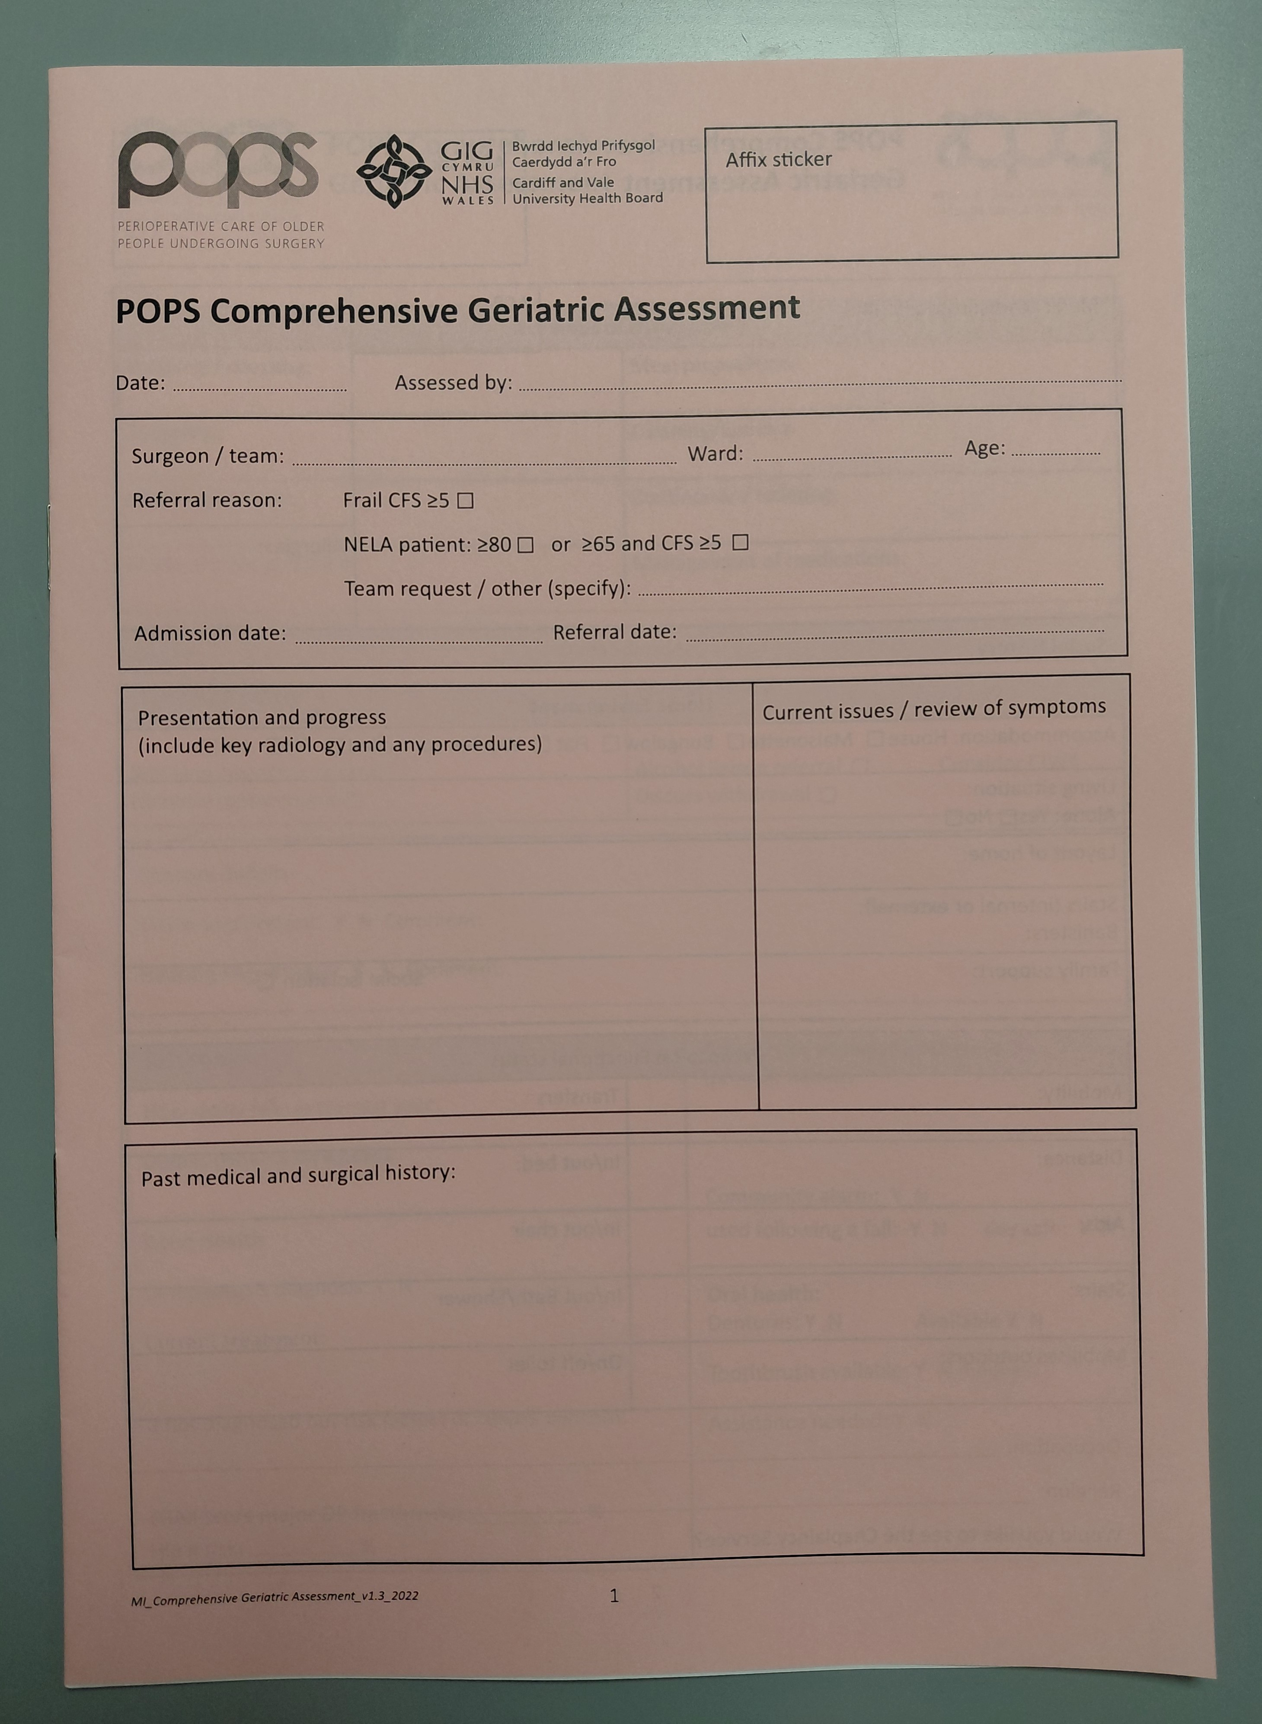
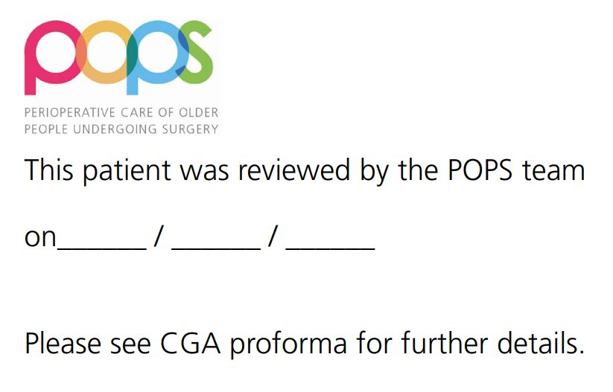
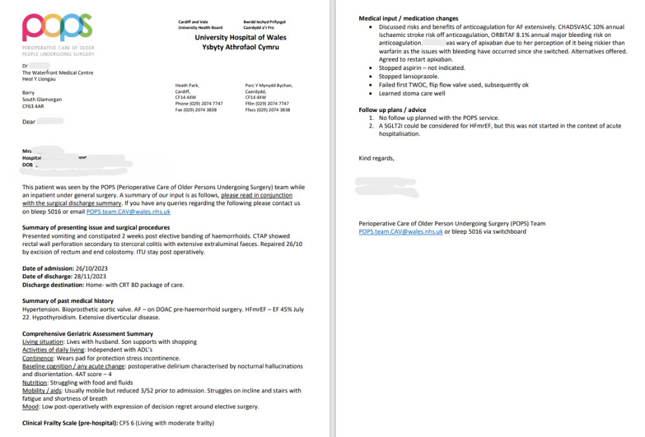
Service expansion (emergency general surgery)
Frailty screening introduced in sSDEC = proactive retrieval non-NELA
NELA patients as per criteria
Non-NELA ≥65 and CFS ≥5
Medical concerns
Specialties: UGI / LGI / HPB / Endocrine surgery
Delivery:
AM handover Mon-Fri
Triage CFS +/- screen
Bleep Mon-Fri 8-5pm

Slide 15
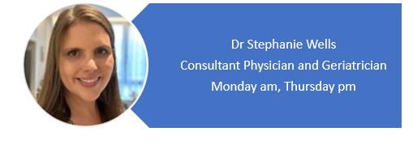

Service expansion (emergency vascular surgery)
July 2022
Hub: Monday AM, Thursday PM
Spoke: inpatient rehab beds
Future work:
Preop input for elective AAA repairs & complex EVAR (Bristol)
Improve EOLC in critical limb ischaemia
Notes:
Funding from centralisation of vascular services
Since July 2022
Acute sessions 2 half days / week and rehab vascular beds in hospital footprint

Slide 16
Elective Surgery
POAC
Surgery
⇡
✖️ Screen for frailty
✖️ CGA
✖️ Assess cognition
✖️ Staff training
✖️ Standardised SDM (12%)
Anaesthetist
Single organ specialist(s)
Primary Care
Notes:
Previous pathway for over 65s
No consideration of frailty as a risk factor
Multiple referrals to single organ specialists, or back to primary care to manage co-morbidities such as diabetes or hypertension.
No single clinician overseeing
Delay in progressing to / optimizing for surgery
Also no standardized SDM-baseline 6 patients participated in SDM – we focus on the intraop / immediate post op discussions only 4 had documented discussions about postop functional decline

Slide 17
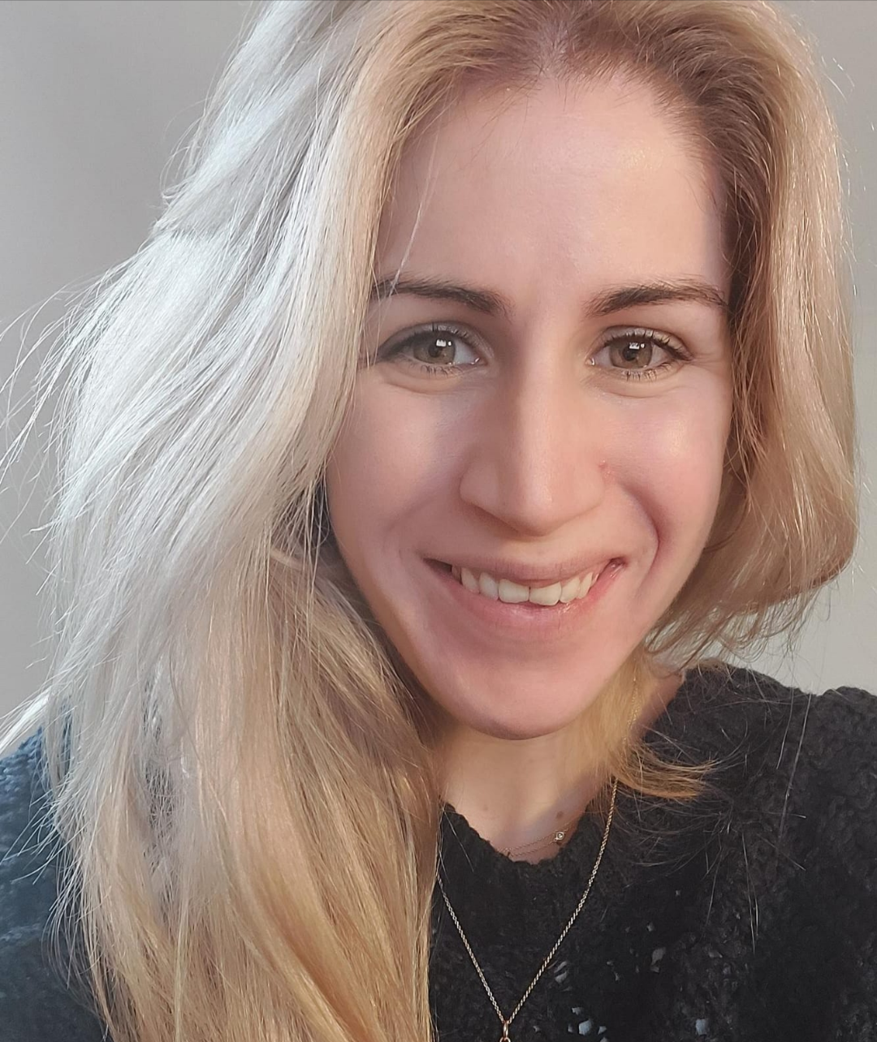
Elective Surgery Pilot
Geriatrician & Anaesthetic co-leads
Baseline dataset 50 patients – lack of SDM, multiple appointments
External funding for leadership fellow, CNS, support worker
August 2022 – 1 year pilot
Notes:
BC = health and social care think tank
WAG £1 million for PCIP in particular to tackle the backlog post covid
Prudent healthcare principles – coproduction, greatest need first, do only what is needed, reduce inappropriate variation
£55k awarded from BC for salaries – Band 6 Frailty CNS 1 WTE, Band 2 Frailty Support Worker 0.6WTE
Separate application for HEIW LF – workforce body for NHS Wales – project selected by ST6 geriatric medicine ~2 days/ week with the service – 2 clinics, 1 team meeting, 1 MDT
Started Aug 22

Slide 18

Elective Surgery Pilot
Project Aims:
Establish frailty scoring for all over 65s in POAC
Deliver Comprehensive Geriatric Assessment (CGA) preop if CFS ≥5
Upskill staff in ‘geriatric giants’
Perioperative delirium pathway
General surgery initially – capacity for more specialties
Notes:
Aims based on CPOC guidance
Only 1 & 2 achieved in timescale of project (but others have since with substantive service)
Added urology after 3 months, then head and neck. Specialties chosen based on established professional links as short time for impact to be demonstrated
Didn’t have full MDT on offer, but linked with dietetics for nutrition pathway and 3rd sector for home adaptations
Signpost to existing community programmes run by NHS on preparing for surgery, falls prevention, exercise schemes, lifestyle advice

Slide 19
Elective Surgery Pilot
POAC
Patients age ≥65 with CFS ≥5, awaiting planned general surgery
(Urology / ENT / Maxillofacial surgery)
Surgical Consultants
POPS Doctor
POPS nursing assessment
POPS MDT
Feedback outcome:
Referring clinician
POAC nurse
Responsible clinician
P2R
CNS
P2R
90-day follow-up:
Decision Regret Scale
EQ-5D-5L repeated
Attend for surgery:
Flag up to AHPs
Post op 4AT (D1/3/5)
POMS (D3&7)
Notes:
All patients discussed at MDT with geriatrician and anaesthetist present and often pharmacist too
Plan fed back to relevant team members

Slide 20
POPS CNS
POPS DOCTOR
153 patients
75% virtual consultation
84 nutrition interventions
12% referred to Care & Repair
105 patients
76% F2F consultation
Medications: 66 stopped, 43 started
153 new diagnoses made
84% participated in SDM
17% did not proceed with surgery
Elective Surgery Pilot
Key Outputs:
SDM
Medicines management
Case-based learning
Reduced anaesthetic workload

Slide 21
Shared Decision Making
Medicines management
17% not proceeding – 14% after SDM with POPS
Procedure | Cost
Repair rectal prolapse (x2 patients) | £9460
Incisional hernia repair | £3031
Right robotic partial nephrectomy | £7713
Defunctioning colostomy | £6750
ERCP | £3752
Hepatojejunostomy & Roux-en-Y reconstruction | £17,254
Laparoscopic cholecystectomy (x2 patients) | £10,470
Oesophagoscopy | £608
Anterior Resection | £14,286
Suprapubic catheter insertion | -
To align with latest evidence-based practice
Reduce anticholinergic burden
Saving £41/patient/year = £6273
Opportunity cost £10K / month

Slide 22
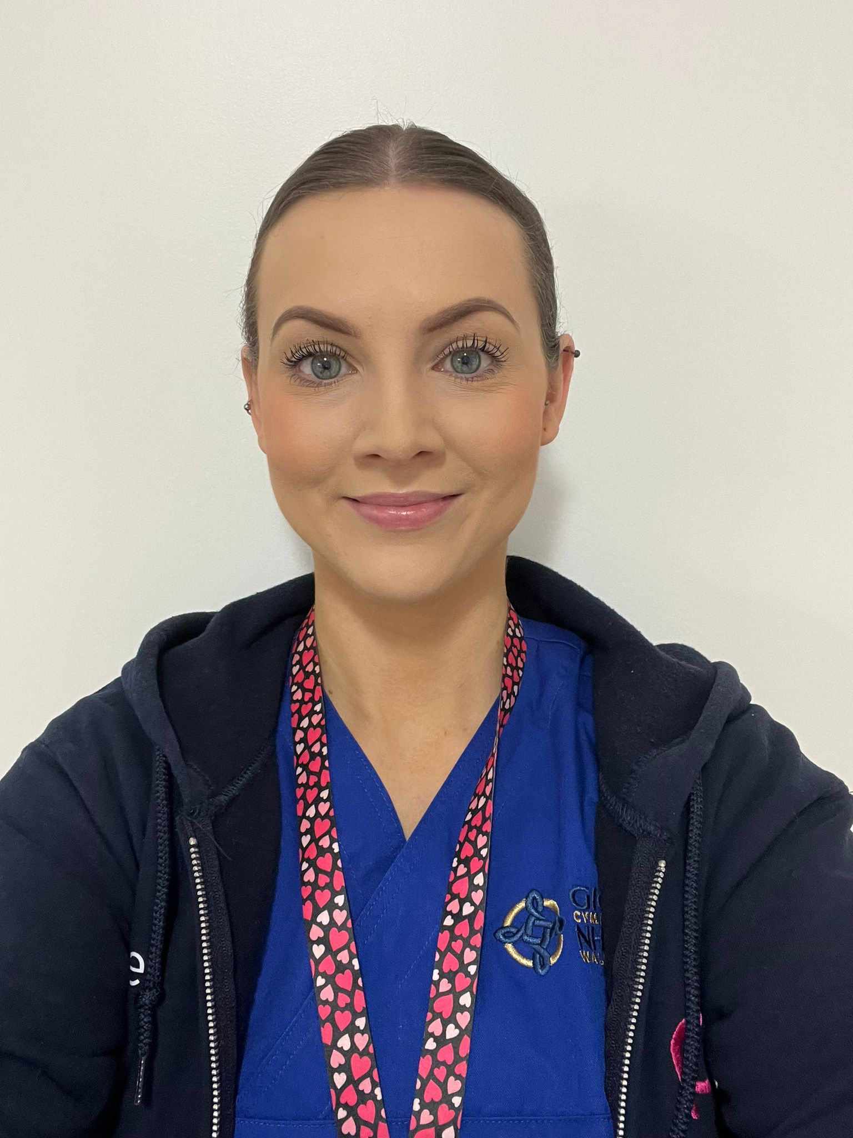
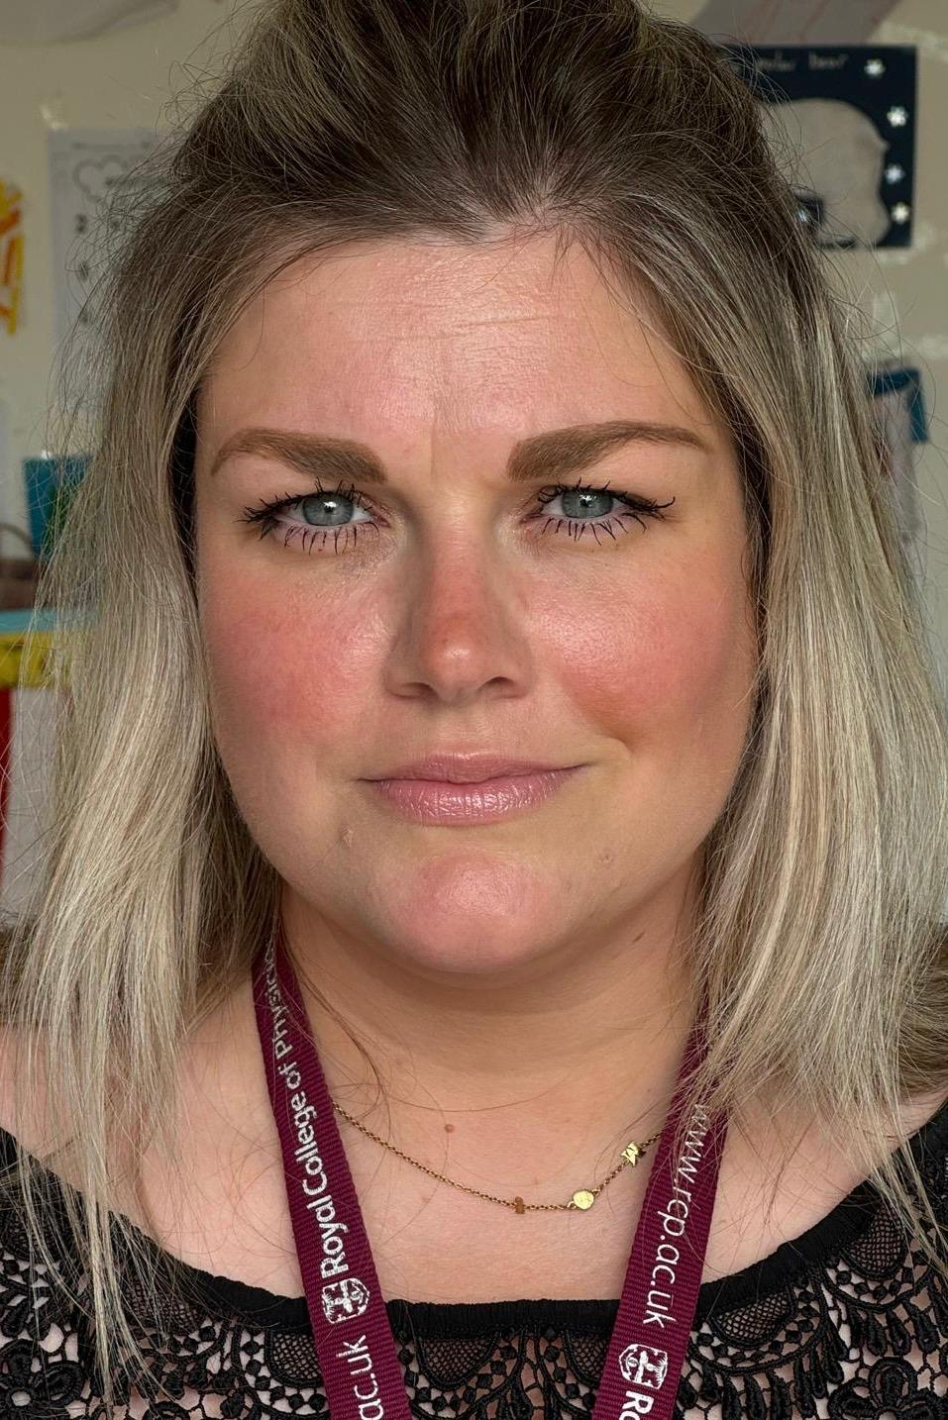
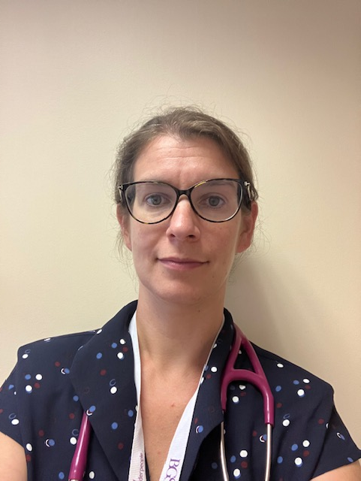
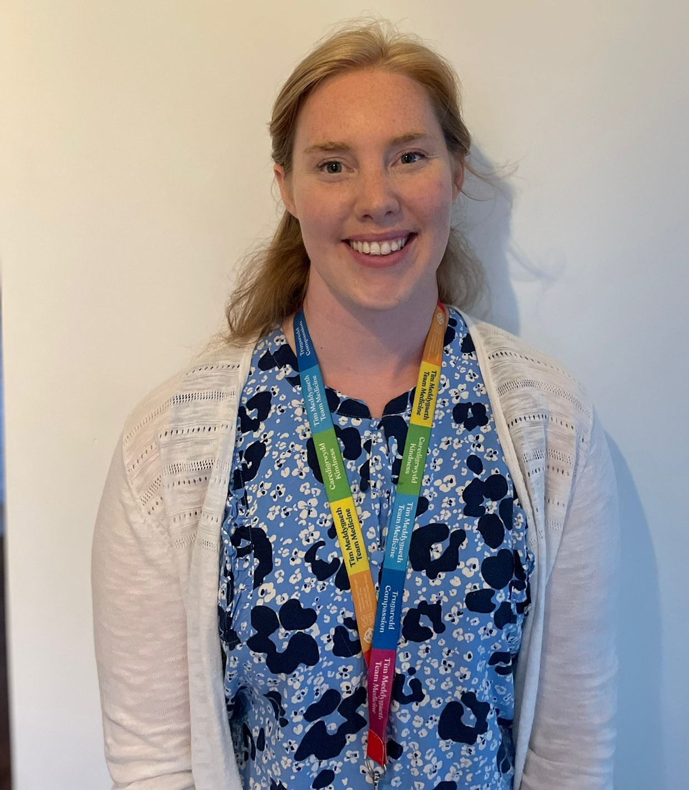
Elective Surgery – Substantive Service
CNS
December 2023
Funding August 2023:
Band 6 CNS (1 WTE)
Band 3 admin support (0.4 WTE)
Consultant Geriatrician (0.6 WTE)
Delivery (weekly):
Clinics: 4 CNS, 3 Consultant
MDT
Post-op ward reviews
Gynaecology added February 2025
Consultant Geriatricians 0.2 WTE / job plan
May 2024
Notes:
CNS is based in POAC and seen as part of the service there.
Admin support has been challenging to implement in terms of expectations from role

Slide 23
Elective Surgery - New Pathway
Next?
Patients ≥65 with CFS ≥5 considering planned surgery
General Surgery, Urology / ENT / Maxillofacial surgery / Gynaecology
POAC
Frailty screening over-65s
Electronic referral to POPS CNS
POPS NURSE
Nutrition
Cognition
Signposting to prehabilitation
Home adaptations
POPS DOCTOR
Optimise comorbidities
New diagnoses
Medication review
Shared Decision Making
Treatment Escalation Planning
Anaesthesia liaison
POPS MDT
Feedback to:
Surgeon
POAC nurse
GP
CNS / Prehab
ADMISSION FOR SURGERY
Screen for delirium
Monitor for medical complications
Link in with therapies
Support early discharge planning
Notes:
See most patients before listed for surgery

Slide 24
Elective Surgery - Expansion
Workforce | Consultant, CNS, Admin
Service type | Expansion
Specialties | Orthopaedics (Cons) Existing specialties (CNS)
Referral route | Proactive waiting list screening Reactive from POAC, anaesthetists, surgeon, Waiting Well
Patients seen | 36 Ortho (Cons) 12 Non-ortho (Cons) 65 Non-ortho (CNS)
Not proceeding | 17% (arthroplasty)
Non-clinical outcomes | 104-week arthroplasty waiting list triage Waiting list validation - over 80s hernia surgery Delirium training for ward staff
Challenges | Late in pathway Arthroplasty guidance – BMI / HbA1c thresholds Competing USC demand in non-arthroplasty group

Slide 25
‘Pread OT’
Listed for THR / TKR
Prepare Well
Consent clinic
POAC
Surgery
Waiting Well
⇡
Anaesthetist
(Screen for frailty)
✖️ CGA
✖️ Assess cognition
✖️ Staff training
✖️ Standardised SDM
Primary Care
Single organ specialist(s)
Notes:
Pread OT sees all hips, NWB status post-op, Knees if referred by POAC

Slide 26
Pilot Oct 25 – Mar 26
42 patients seen - proactive & reactive selection
Female: Male = 2:1
Median age 78 (range 65-94)

Slide 27
7 patients did not proceed (5 TKR, 2 THR)
All as a result of shared decision-making discussion with POPS

Slide 28


Slide 29
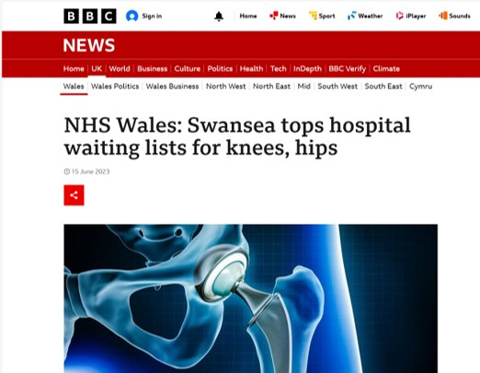
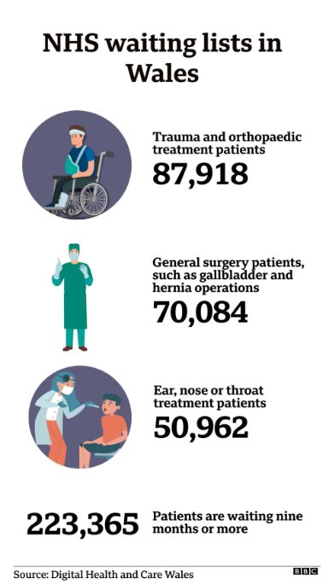
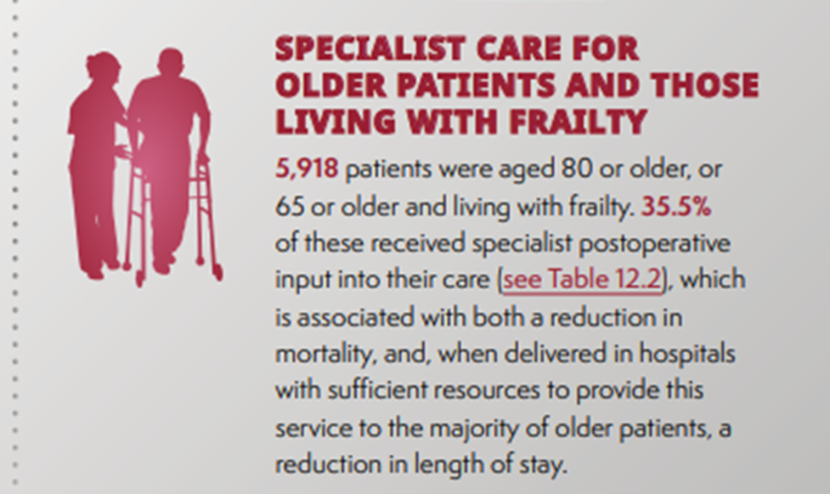
Where we were - 2021
1/3 Patients living with frailty in MH under surgical specialities
Difficulty funding inpatient sessions
Notes:
No formal provision for NELA/Inpatient wirk – adhoc referrals
No elective work

Slide 30
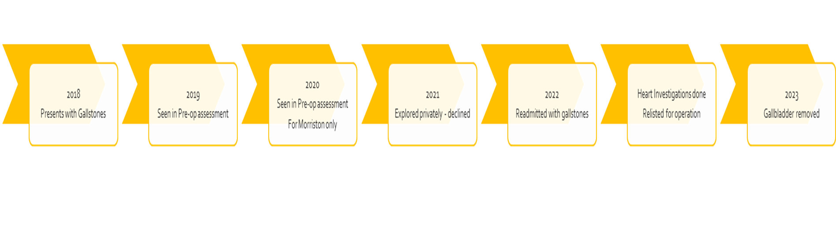
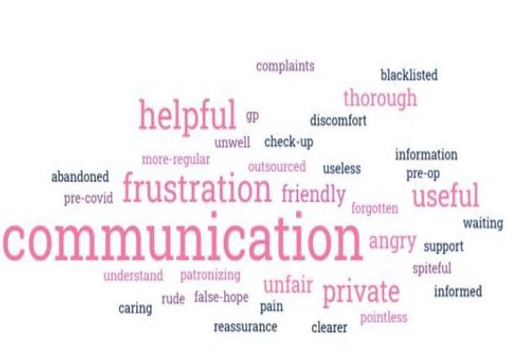
Health Board Priorities/Funding
All Lap Chole list >65
Contacted to screen for frailty
MDT +/– Clinical review
Patient Feedback
Data/Cost savings
51 DNP - £178,500
Notes:
Supported by bevan – funded 1wte jcf

Slide 31
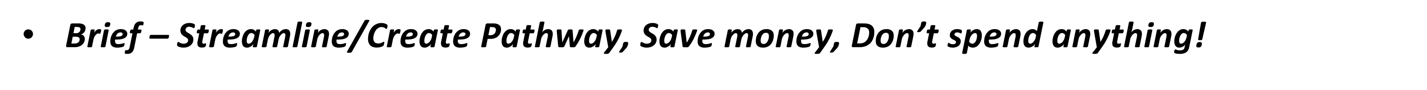
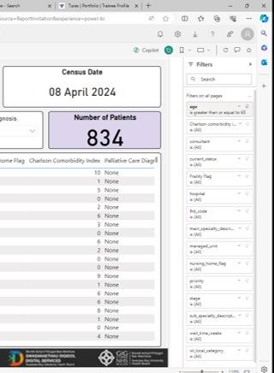
Bevan Funding Complete
No CFS/screening
1 OP Clinic/special interest session
Bayways – VBHC, Digital, Transformation, Execs
Digital solutions?
'If you can prove there may be money'

Slide 32
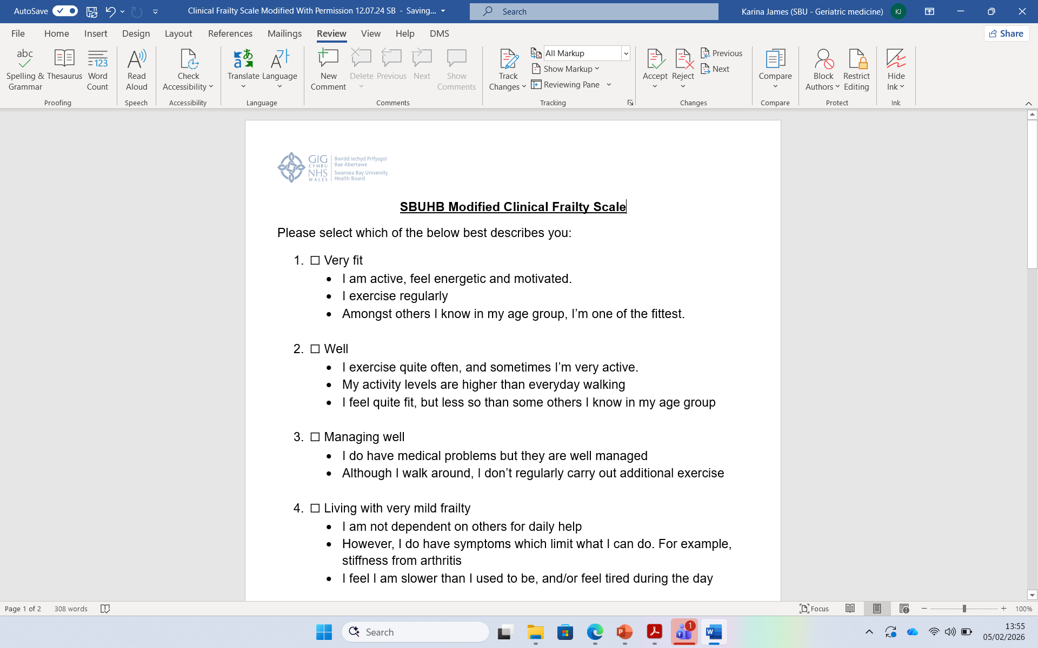
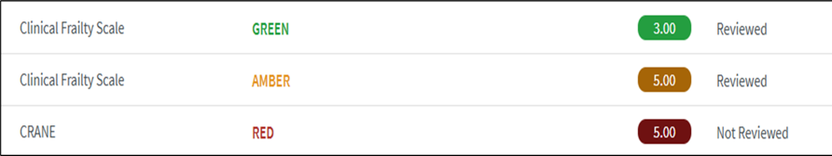

Digital Frailty Screening
Bespoke questionnaire – uses following tools
Modified Clinical Frailty Scale (CFS) – modified so patients can self-assess the severity of their frailty (©2005-2020 Rockwood. Version 2.0). Validation ongoing.
CRANE - Provides a comprehensive evaluation of patient risk factors (The Comprehensive Risk Assessment and Needs Evaluation (CRANE) has been developed by Guy’s and St Thomas NHS Trust GOLD Team).
Notes:
Worked with promptly/ VBHC – upload Q – initial manual, now running automatically – all of GS.

Slide 33
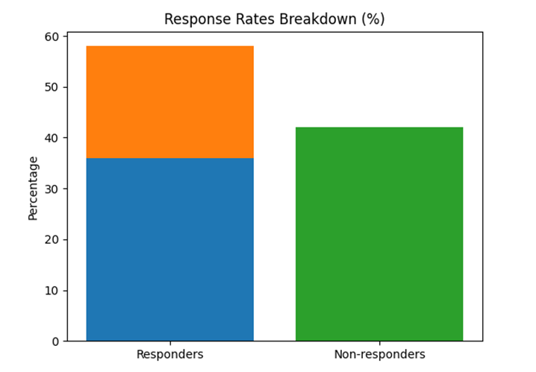
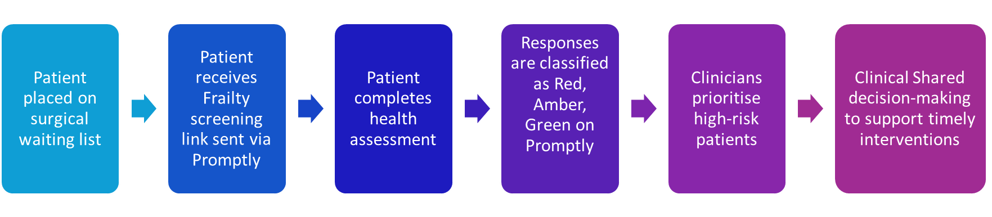
Providing the Proof!
737 patients were contacted - 58.2% responded.
Mean CFS 3.5
135 offered appts
31 did not proceed

Slide 34
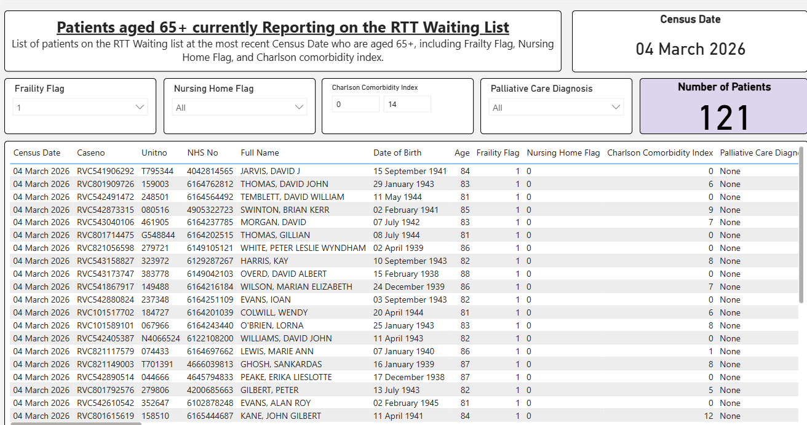
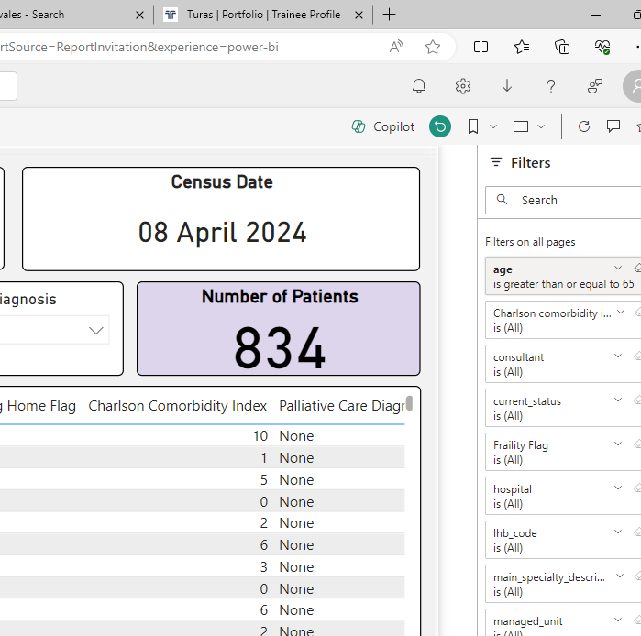
500% increase in reach
Screening time reduced from 20 minutes to 3 minutes for digital responders
200 clinician hours saved
Strong collaboration between perioperative and digital teams
80% of patients found the tool easy to use and felt more informed about their care
Enhanced shared decision-making and appropriate optimisation of care
Scalable model

Slide 35
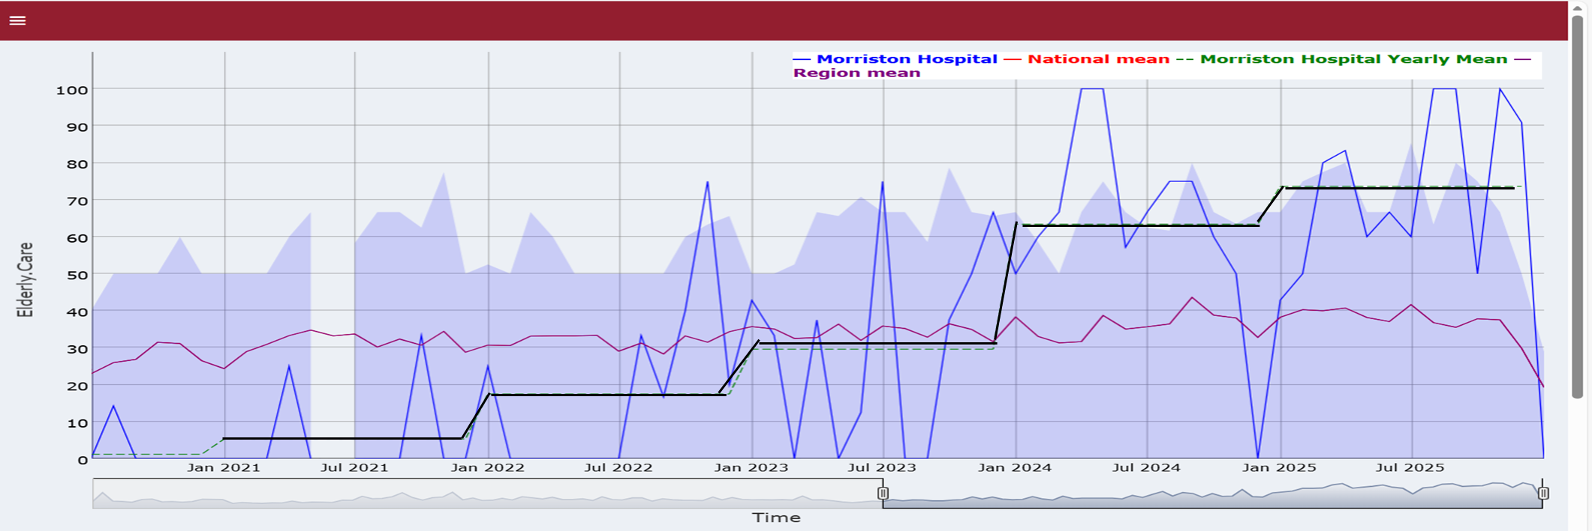
Added to Stage 5 W/l
Digital Frailty Ax
MDT
Virtual/F2F Clinic
Yearly Ax
Recurrent funding – planned care
4 Consultant Sessions
2 WTE JRFs
1 WTE Band 3

Slide 36
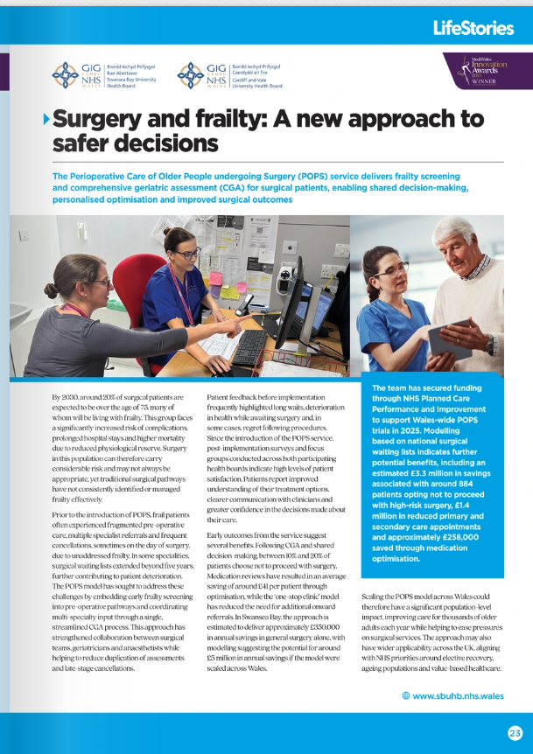
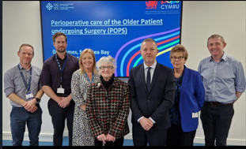
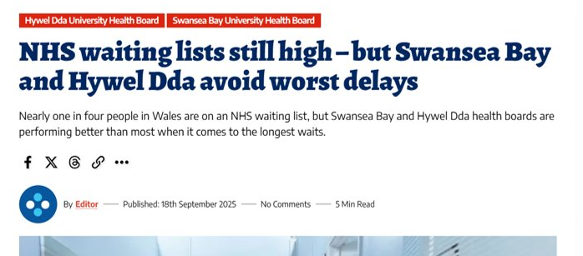
Where are we now?
Daily NELA Screen/review
Virtual and F2F Clinics/MDT
Screen ALL GS elective patients yearly
Colorectal/Gynae USC pathways
Arthoplasty MDT
Frailty screen – stage 1, POAC - HSQ
*CULTURE CHANGE*

Slide 37


Slide 38
ABUHB
Sessional in-reach service since November 2021
~150 laparotomies 65 and over per year (~50% of NELA workload)
All 65 and over NELA screened for frailty and delirium
Involvement in non-NELA patients makes up majority of workload
  Elective surgeries
  Non-NELA emergencies
  Cholecystitis/pancreatitis with medical comorbidities
  Falls and frailty assessment
  “Nothing surgical going on.”

Slide 39
ABUHB
Constraints
Workforce
Funding
Time to tackle the to-do list
ABUHB stepdown model
Enablers
Support from colleagues
  Surgical teams/leads
  NELA leads
  Nursing staff
Flexibility
Interest from deputy COO; pathway redesign
Interest from acute medicine: hybrid job?

Slide 40


Slide 41
BCUHB
Locum Consultant Geriatrician
Emergency general surgery sessions
Workforce | Consultant Admin
Service type | New
Specialties | General surgery Breast Gynaecology Orthopaedics
Referral route | Proactive waiting list screening Reactive from POAC, surgeons, anaesthetists.
Patients seen | 60 - Consultant face-to-face appointments
Not proceeding | 12 (20%)
Non-clinical outcomes | Waiting list validation - lap chole, hernia
Challenges | Lack of admin support Unable to recruit CNS / clinical fellow Apprehension from surgical colleagues

Slide 42


Slide 43
HDdUHB
Workforce | Consultant Physician Associates Admin
Service type | New
Patient selection | Over-80s
Referral route | Proactive waiting list screening
Patients seen | 102 (delivered by Cons & PAs)
Not proceeding | 4 (4%)
Non-clinical outcomes | Waiting list validation
Challenges | Short time to deliver

