Slide 1


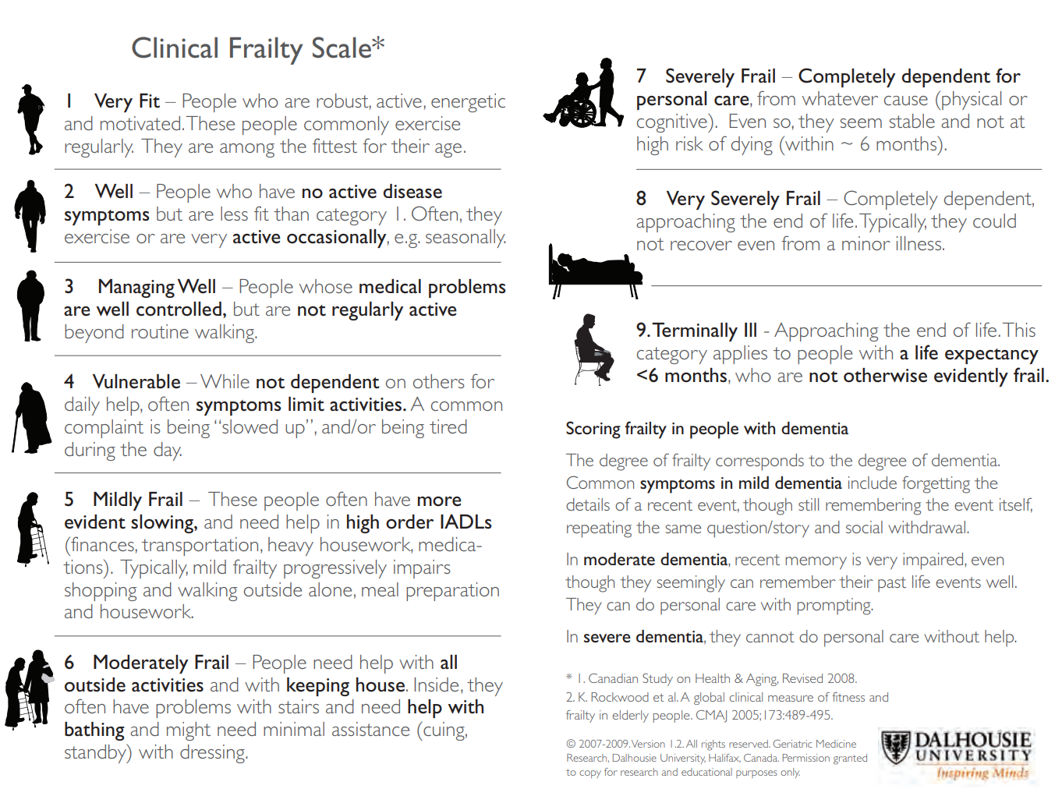
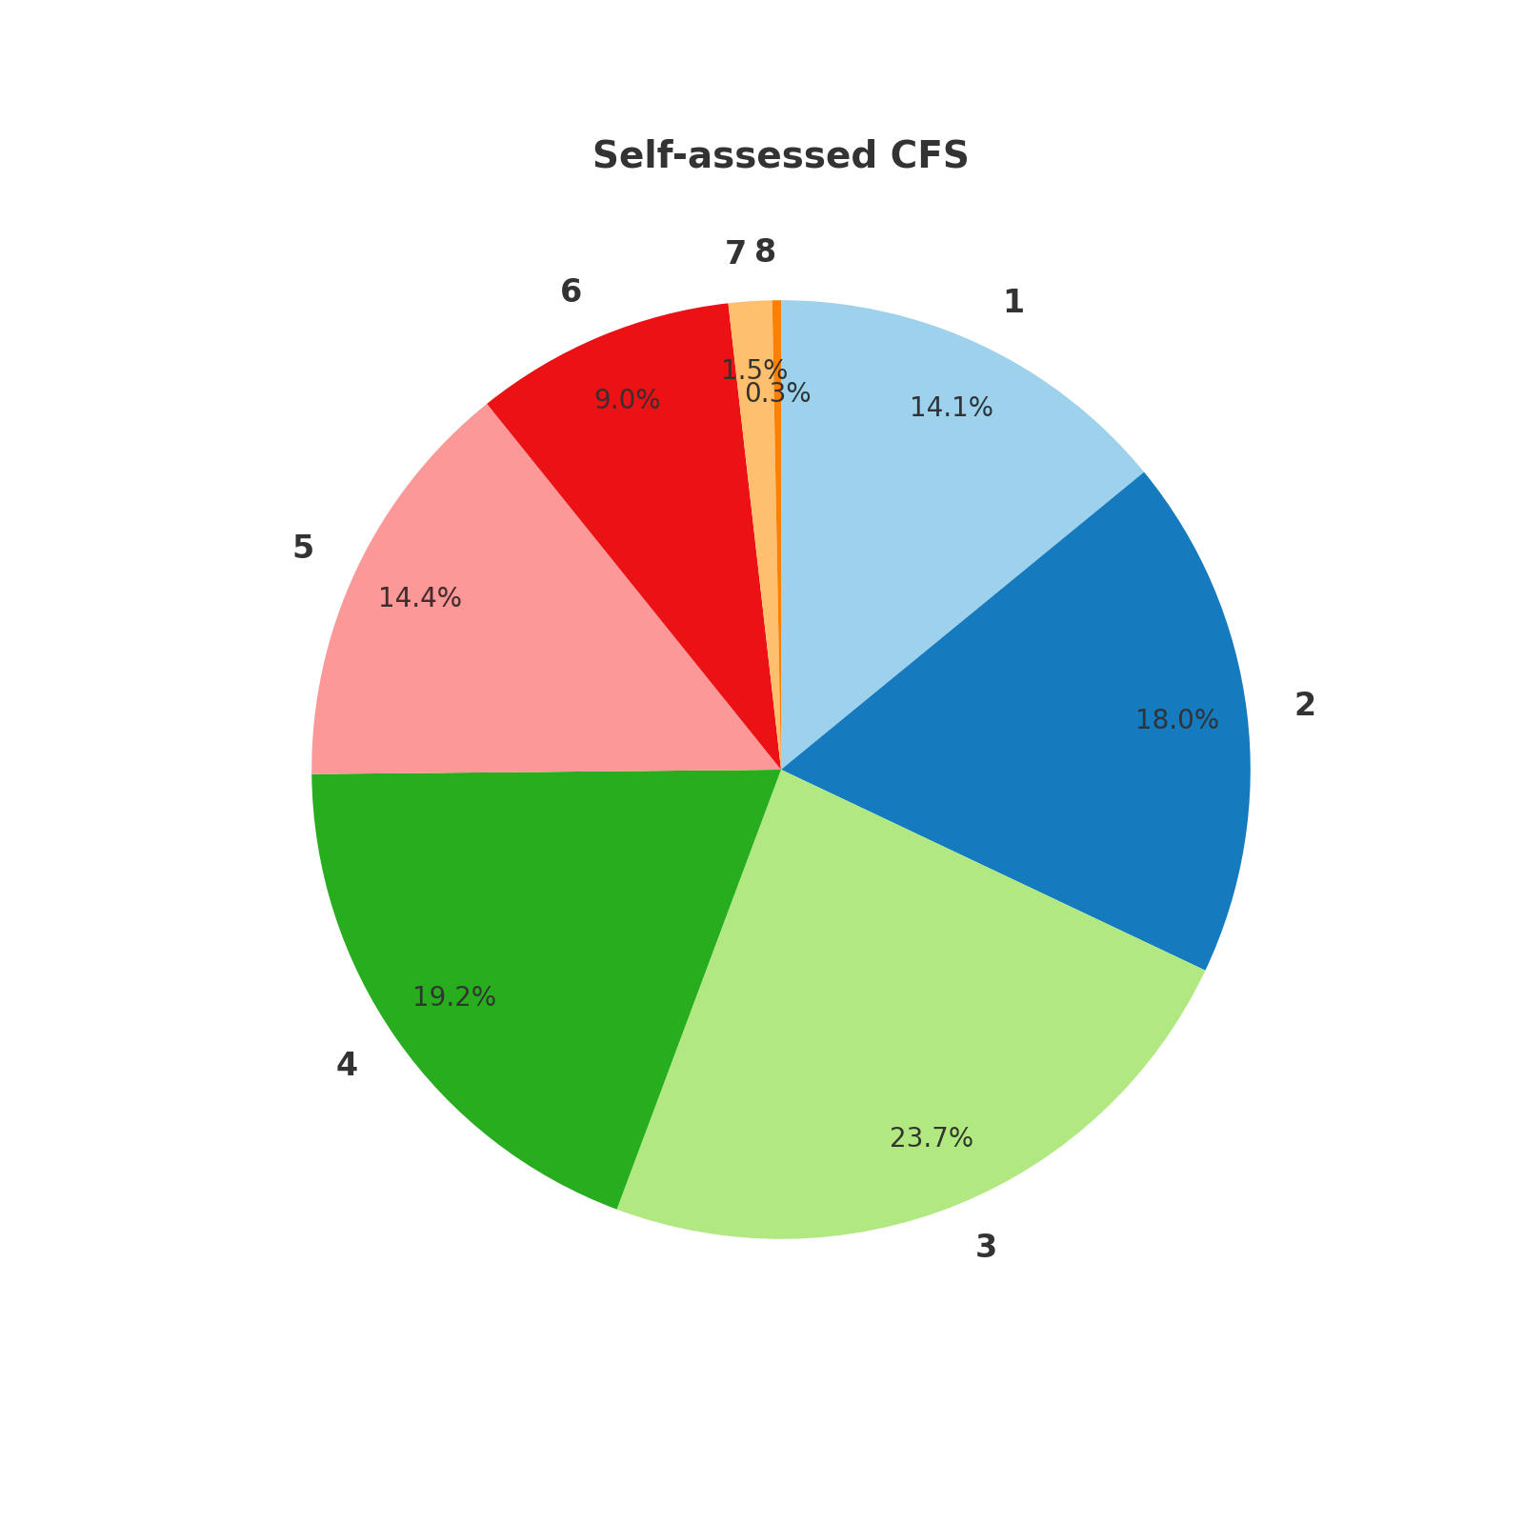
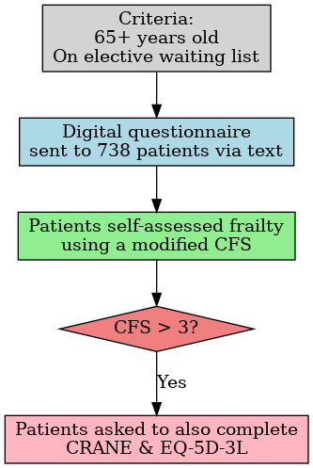
Prevalence of Frailty Among General Surgery Patients at Morriston Hospital
R Evans¹ , J Lewis-Jackson², K James³
1,3; Morriston Hospital, Swansea Bay Health Board
2; Swansea University
Introduction
Results
Frailty is a significant risk factor for perioperative complications and mortality (1). The British Geriatrics Society and Centre for Perioperative Care recommend that patients with frailty (CFS ≥5) undergo Comprehensive Geriatric Assessment (CGA) before surgery (2). Recent evidence suggests that CGA offers both clinical and cost benefits in the elective setting (3,4). We aimed to assess the prevalence of frailty among patients on the general surgery waiting list at Morriston Hospital, with the goal of identifying those who may benefit from perioperative review.
Demographics:
Average age: 72 years (±5.07)
M:F split – 61.81% (n=212) / 38.19% (n=131))
Questionnaire response rate: 46.48%
Frailty data:
Average CFS score: 3.34 (±1.58)
24.77% (83) reported a CFS score of ≥5.
Among those with CFS >3:
Average CRANE score: 5.76
Average EQ-5D-3L score: 0.56
Objectives
Evaluate the prevalence of frailty among patients on the general surgery waiting list at Morriston Hospital using a novel format of the Clinical Frailty Score (CFS).
Identify patients at risk of frailty and geriatric syndromes to facilitate geriatric review at our POPS clinic pre-operatively.
Methodology
Digital questionnaires were sent via text to 738 elective general surgery patients aged 65+, with a 7-day completion window and a reminder after 5 weeks.
Frailty was self-assessed using a modified Clinical Frailty Scale (CFS); those scoring above 3 also completed the CRANE and EQ-5D-3L questionnaires. The CRANE included questions regarding falls and cognition, with weighted scoring applied.
Analysis focused on response rate, age, and frailty.
Conclusion
There is a significant prevalence of frailty among general surgery patients, with nearly a quarter self-scoring a CFS of 5 or higher.
These results highlight the need for a tailored perioperative care pathway for frail surgical patients. This data helped us identify patients who may benefit from a perioperative review in our POPS clinic. These results may also serve as a helpful benchmark for other health boards looking to establish a similar service.
References
Lin H-S, Watts J, Peel N, Hubbard R. Frailty and postoperative outcomes in older surgical patients: a systematic review. BMC Geriatrics 2016;16(1):1–12
British Geriatrics Society. (2021).Guideline for perioperative care for people living with frailty undergoing elective and emergency surgery.
Partridge, J. S., Healey, A., Modarai, B., Harari, D., Martin, F. C., & Dhesi, J. K. (2021). Preoperative comprehensive geriatric assessment and optimisation prior to elective arterial vascular surgery: A health economic analysis. Age and Ageing.
Eamer, G., Saravana-Bawan, B., van der Westhuizen, B., Chambers, T., Ohinmaa, A., & Khadaroo, R. G. (2017). Economic evaluations of comprehensive geriatric assessment in surgical patients: A systematic review. Journal of Surgical Research, 218, 9–17

