Slide 1


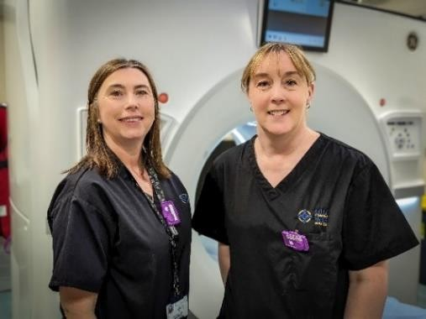
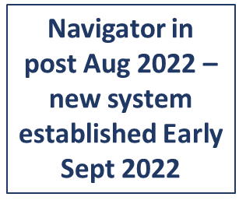
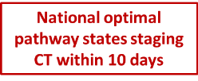
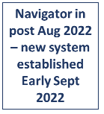
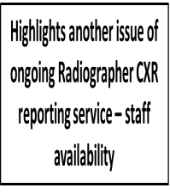
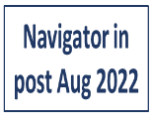
Radiology Pathway Navigation: A New Direction.
Louisa Edwards-Brown, Advanced Radiography Practitioner/Project Lead Sarah Maund, Radiology Cancer Navigator - CTMUHB
Contact: Louisa.Edwards@wales.nhs.uk Sarah.Maund2@wales.nhs.uk
Project Background:
The patient journey through diagnosis and treatment for suspected cancer is complex, with multiple investigations; the pathway process can be upsetting &
Project Outcomes:
Addition of a new Advanced Practice Radiography
role which has:
Reduced waiting times
Improved patient centred care & services
confusing for patients causing
unnecessary anxiety.
Streamlining Radiology pathways would provide more clinical coordination for
Project Impact:
Average Days taken for Vetting/Justification Process
Key Conclusions:
The project has had a positive outcome and been successful in delivering the objectives. The benefits outlined by
patients with connections between
Radiology and clinical teams allowing more prompt diagnosis and optimal treatment options.
Implementing a new Advanced Practice role of Radiology Cancer Navigator, would enable changes to be achieved and collaborative working.
6
5
4
3
2
1
0
5 5
staff, added to the data collected
showing reduced times, improved
vetting and waiting pathway processes,
2.5
2
2
streamlined workflows and time savings alongside the patient case studies, all support the need for this Radiology based Advanced Practice role.
The role also supports the workforce development plans outlined in
1
Project Objectives:
Jul-22 Aug-22
Average days USC
Sep-22 Oct-22
Average days routine
Streamline and reduce pathway
delays and waiting times.
Healthcare Science in NHS Wales: Looking Forward
Quality and Safety section - Wales
Coordinated care for patients requiring multiple examinations.
Radiology point of contact for patients/pathway teams.
Improve pre and post procedure patient information – digital access.
Improve the Radiology referral system.
Average days from Colonoscopy to CT Staging Scan for patients diagnosed with lower GI cancer
13
Government National Clinical Framework.
as an Advanced Practice role extending
14
12
10
8
6
4
2
0
Diagnostic Radiographers practice, transferring knowledge.
scope of and
skills
The role has benefitted staff and
4
patients throughout its first nine months. It does not seem prudent or morally acceptable to allow the service to revert to its previous situation and knowingly instigate longer waiting times with a less patient centred service to restart.
Next Steps:
Project Approach:
Implement new Advanced Practice role
Radiology Cancer Navigator (Sarah Maund).
Jan-July 22 Aug 22 - Feb 23
GP Request Chest X-Ray to CT Staging Scan
12
10
8
6
4
2
0
New role, which could be adopted by
Collaborate with pathway work
10
all Radiology departments.
stream colleagues.
Attend MDTs and Cancer Meetings.
Provide more joined up and continuous care for patients.
Point of contact for patients and clinical teams.
Review vetting processes.
Undertake referral vetting to reduce delays.
 |  | 7
 |  |  | 2 hrs
 |  | 1
Feedback and present the results of
the project, with a podcast and video also produced.
Next aim is to employ another
Radiology Cancer Navigator to jointly cover the Royal Glamorgan Hospital, Llantrisant and Prince Charles Hospital, Merthyr (CTMUHB).
Oct 21 - Jan 22 Average Days Wait
Sept 22 - Jan 23 Shortest wait
Analysis of this work would form the
Improve patient information.
“It’s greatly helped our patients in reducing
their time on the pathway and preparing
them for MDT as quickly as possible.”
Nicola Edwards - Colorectal Cancer Nurse Specialist
basis for lobbying to embed these roles as substantive posts.
Further work could be undertaken
with Bevan Commission, Wales Cancer Network and other appropriate external
Bevan Exemplar
bodies to share and spread the
Planned Care Innovation Programme
Radiology Pathway Navigation project to all Health Boards in Wales.
Doing things differently for a prudent, sustainable recovery bevancommission.org/programmes/planned-care

