Slide 1




Adopt, Spread & Embed Programme
National Showcase
2nd September 2025

Slide 2
Agenda
13.00 – 13.20: Welcome and Introduction to Adopt, Spread & Embed Programme
13.20 – 13.25: Welsh Fracture Liaison Service
13.25 – 13.30: Carpal Tunnel Surgery – Introducing the Lean, Green, More Efficient Pathway
13.30 – 13.35: Building Capacity in Gastroenterology Planned Care
13.35 – 13.50: Questions & Answers
13.50 – 13.55: Perioperative care of Older People undergoing Surgery (POPS)
13.55 – 14.00: Radiology Pathway Navigation –A New Direction
14.00 – 14.05: Enhanced Community Gynaecology Service
14.05 – 14.30: Questions & Answers & Wrap up

Slide 3
The challenge we face
“The inability to successfully realise the adoption, spread and scale of innovation leads to the overuse of unhelpful care, underuse of effective care, unnecessary costs to the system, unnecessary harm, as well as delays and worse outcomes for patients”
(Berwick, 2009).
Despite a wealth of innovative practice across health and social care in Wales, the system continues to face a stubborn adoption gap. In reality, this gap is more akin to a chasm.
Other nations have begun to invest in a variety of different mechanisms to support and accelerate the adoption of health and social care innovation on a national scale. For example, Scotland has developed the Accelerated National Innovation Adoption (ANIA) Pathway; England uses Health Innovation Networks (HINs) as a vehicle.
“Healthcare innovations do not scale easily because many elements have to be brought together at the same time in order for them to be adopted widely….. All this is often too complex for institutions to deal with because it requires many different parties to come together in the right environment, and enablers have to be developed so that scaling can proceed.” (Professor Tan Chorh Chuan, 2024).

Slide 4
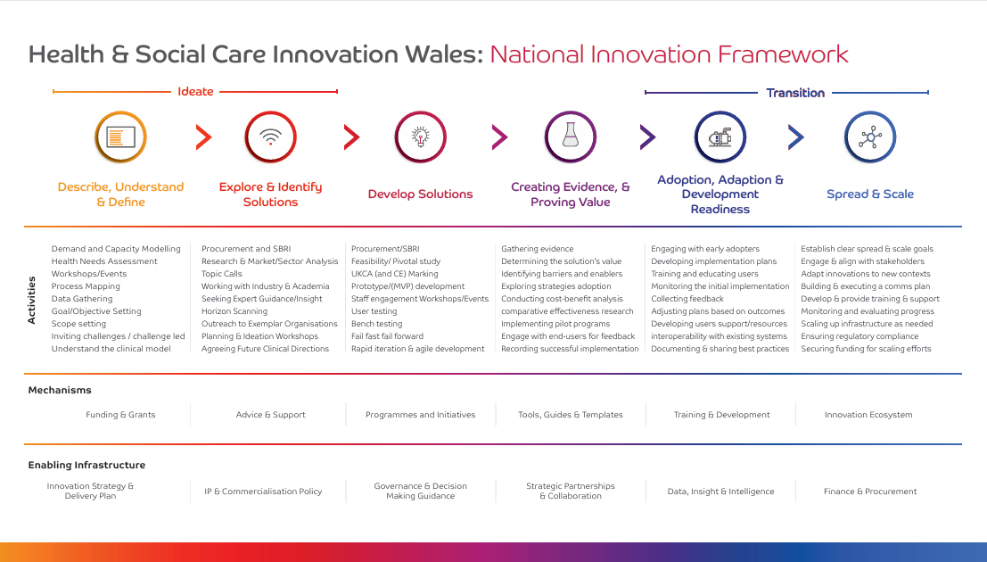
Background to the Programme
Wales’ National Innovation Framework sets a clear blueprint for moving ideas bench to bedside.
Investment has focused on upstream innovation, with lesser focus on adoption, spread, and scale.
Spread and Scale Academy provides a critical learning means, but Wales lacks the hands of practical support to navigate the process on the ground.
As a result, many projects stall after proving value, highlighting the need to bridge the adoption chasm.
Using underspend from the Planned Care Innovation Programme, in partnership with WG and the Strategic Programme for Planned Care – Designed and Launched ASE.

Slide 5
Aims of the Programme
Two-Fold Ambition:
Support the adoption, spread and scale of evidence-based interventions, to drive improvements in quality, efficiency and outcomes across Planned Care Services.
Design and test national innovation adoption pathway/process/tools to support the transformation of planned care and other services.

Slide 6
Adoption, Spread & Scale Process
Designed using insight from a scoping review of Implementation Science Frameworks, International Best Practice and Wales’ Context.
Pre-Adoption
Adoption Decision
Post-Adoption
Prioritisation & Assessment
Proposition (Case for Change)
Engagement
Adoption Decision
Adaptation & Planning
Activation & Preparation
Implementation & Evaluation
Spread &
Scale
Sustain & Normalise

Slide 7
Stage Gate Management System
Assessment
Proposition
Engagement
Adoption Decision
Adaptation & Planning
Activation & Preparation
Implementation & Evaluation
Sustain & Normalise
Scale
Continuous Monitoring
Phase 1
Phase 2
Phase 3
Phase 4
Phase 5
Phase 6
Phase 7
Phase 8
Final Phase
Gate 1
Gate 2
Gate 3
Gate 4
Gate 5
Gate 6
Gate 7
Gate 8
18 – 24-month Cycle

Slide 8
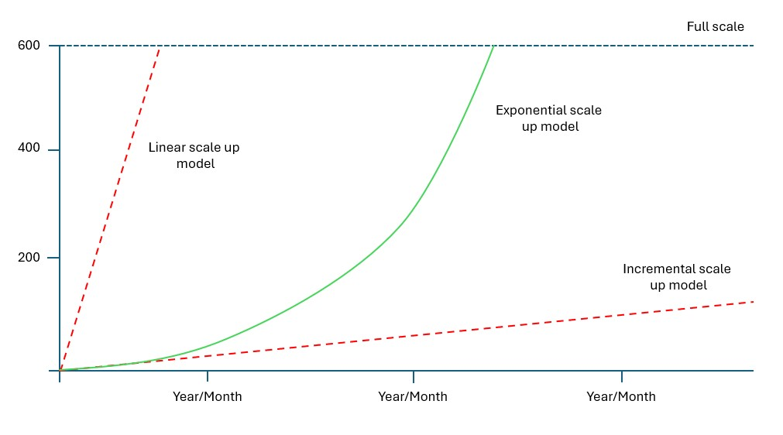
Exponential Scale Up Model
Linear models spread too fast, losing control and fidelity.
Incremental models move too slowly, risking loss of momentum.
Exponential models start small, build confidence, then accelerate, balancing control with speed for sustainable scale.

Slide 9
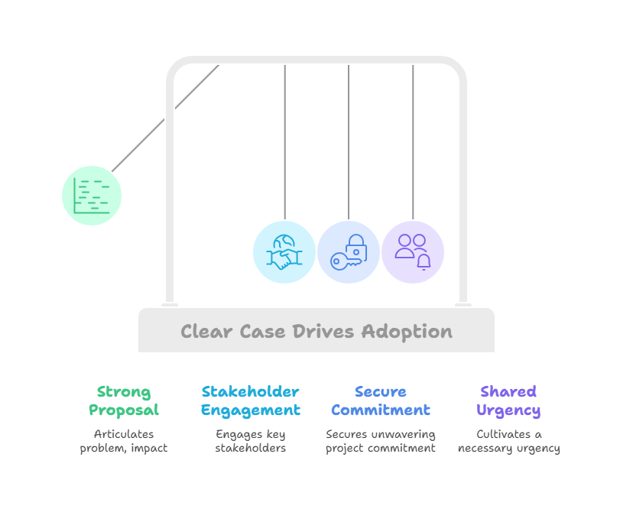
The Case for Change
Problem & baseline: Define the gap (demand, waits, variation, harm). Show current metrics (capacity, costs, outcomes, equity).
Proposed model: What changes, for whom, where. Core components: e.g. SOPs, workforce & skill-mix, digital/IG readiness.
Evidence & options: Evidence base; why this option; alignment to policy/strategy e.g. MAG, IMTP.
Benefits & value: Quantified impact (e.g. waits, throughput, bed days, , £, carbon, PROMs/PREMs, equity). KPIs + data sources.
Implementation and evaluation strategy: Milestones, resources & costs, roles, training, risks/mitigations, governance, monitoring and evaluating.
Sustain & spread with bundles: How it embeds; adoption bundles.

Slide 10
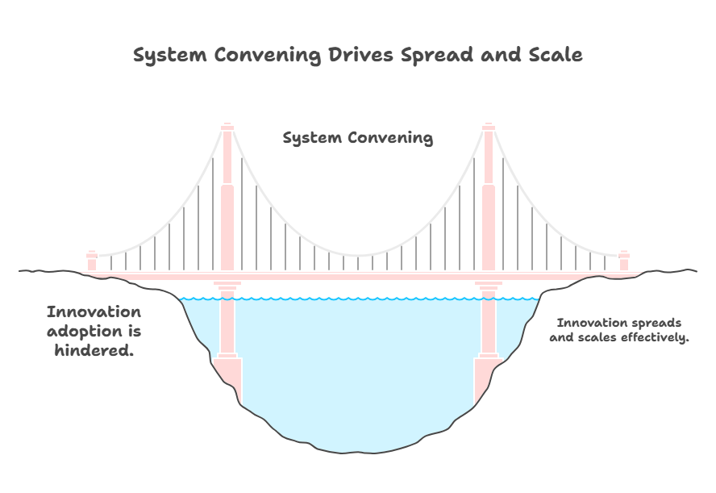
System Convening
Innovations often stall not from lack of value, but because the system is fragmented or slow to align.
ASE convenes stakeholders across sectors, acting as a neutral broker to build trust, align efforts, and secure early buy-in.
This coalition-building enables innovations to spread and embed with system-wide support.

Slide 11
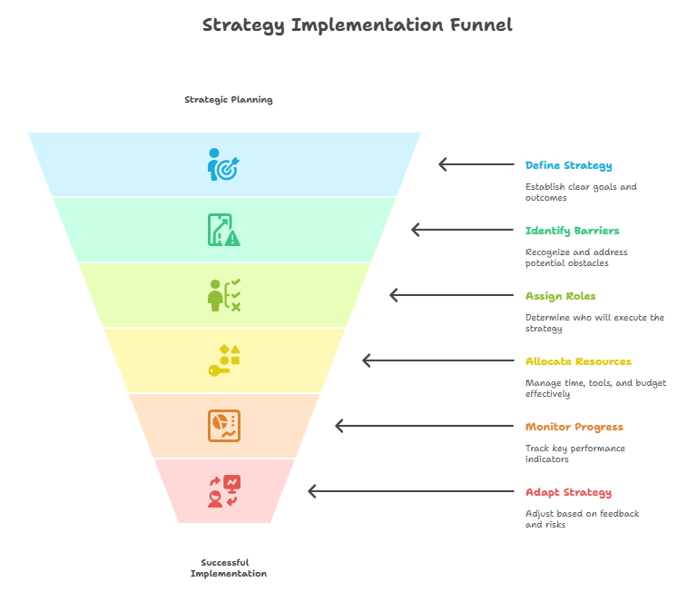
Implementation Strategy
Aim: Aim and target outcome(s) (e.g., adoption, fidelity).
Rationale & mechanism: How it works and barriers addressed.
Actors & actions: Who delivers and what they do.
Target & setting: Who or what changes, and where.
Timing & frequency: When, how often, how long (phase-matched).
Resources & cost: Time, tools, budget, staffing.
Measures & monitors: Process and outcome KPIs
Adaptation & fidelity: What can flex; what must stay consistent.
Risks & mitigations: Likely hurdles + contingencies.

Slide 12
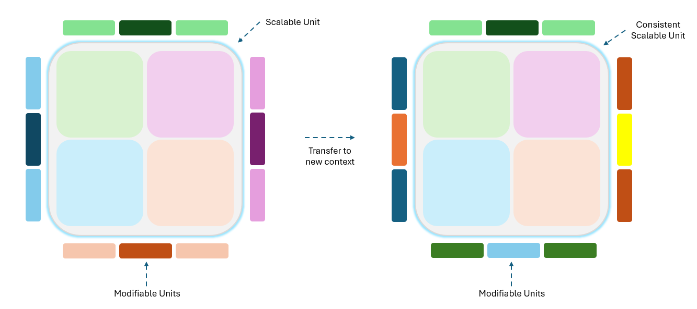
Innovation Adaptation
Innovations must adapt to local contexts while keeping core elements consistent.
ASE supports projects to define scalable units (must stay the same) and modifiable units (can change).
This balance ensures spread with both fidelity and flexibility, making adoption practical and sustainable.

Slide 13
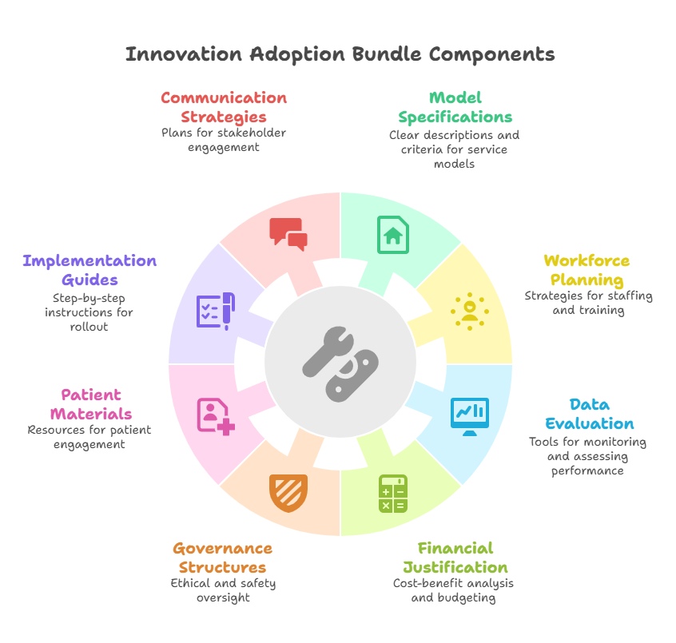
The Adoption Bundle
Model spec & SOPs: e.g., Plain-English description of the service model, inclusion/exclusion, step-by-step workflows, escalation, and hand-offs.
Implementation toolkit: e.g., 90-day plan with milestones and go/hold/scale gates, site-readiness checklist, room/list setup, equipment/procurement list.
Roles & workforce pack: e.g., Job descriptions, competencies, supervision model, example job plans, training plan, and onboarding checklists.
Data & evaluation pack: e.g., Baseline dataset, run-chart templates, fidelity checklist, PROMs/PREMs, and a 30/60/90-day review cadence.
Benefits case & costing: e.g. Baseline vs target, capacity, LOS, £/WTE, consumables, carbon, and a ready-to-edit business case.
Governance & safety: e.g., Risk register, clinical safety (e.g., DCB templates where relevant), IG/DPIA notes, incident/reporting routes, and QA checklist.

Slide 14
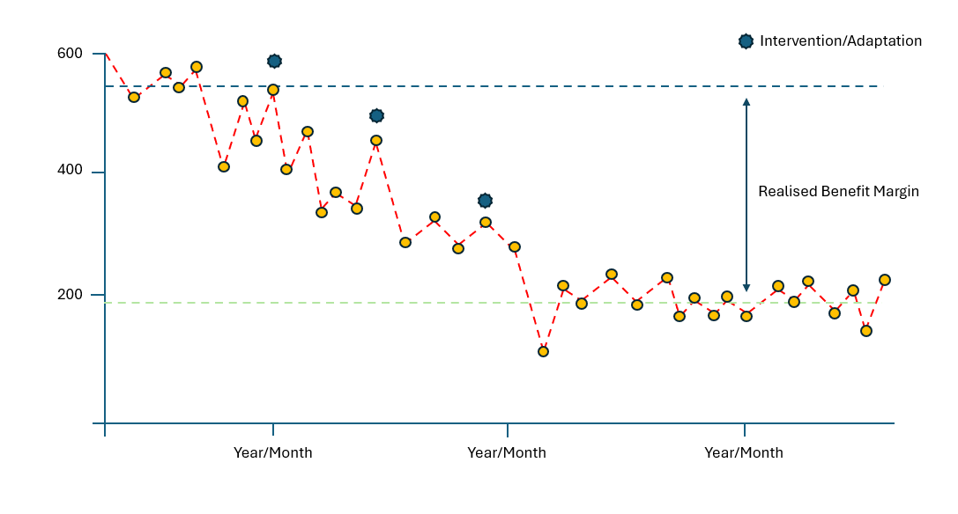
Monitoring Systems
Projects use Run Charts and SPC Charts to track progress and identify real improvements vs normal variation.
Both primary indicators (outcomes, efficiency, cost) and secondary indicators (staff/patient experience) are monitored.
Ongoing measurement helps teams celebrate success, spot issues early, and sustain improvements at scale.

Slide 15
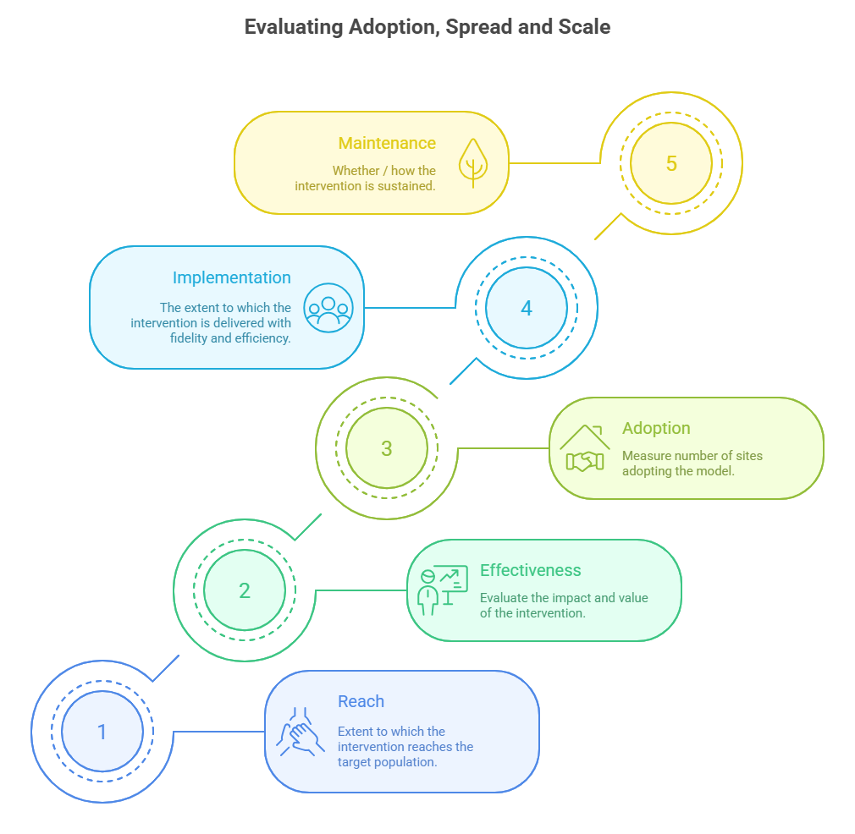
Tailored Evaluation Framework
Evaluation is critical to understanding impact of projects and driving improvement. Evaluating the spread and scale of interventions, requires a different approach to measuring the effectiveness of innovation. Working with projects, we use an adapted version of the RE-AIM framework. This ensures evaluation is systematic, transparent, and aligned with both system priorities and project learning needs.
Reach: Who and how many benefit, with attention to equity.
Effectiveness: Value and improvement achieved.
Adoption: Health boards and sites taking up the model.
Implementation: Fidelity and efficiency of project delivery.
Maintenance: Sustained performance and further spread.

Slide 16
Project Title: | Lead HB: | PC Area: | WG Priority Areas: | Key Benefits:
Establishing a Perioperative Care of Older People Undergoing Surgery (POPS) Service in Elective General Surgery | CAVUHB & SBUHB | Theatre Optimisation & Anaesthetic CIN | Preventative health; Improved diagnostics; Reducing surgical waiting lists; Reducing time in hospital; Supporting a talented workforce; Planned care recovery. | ↓ Length of stay ~4.5 bed days/patient; £803 saving/patient; 1 in 7 avoid unnecessary surgery (shared decision‑making); ~900 fewer unnecessary procedures (Wales scenario); ~28,350 bed days released (Wales scenario); 4,000+ additional operations enabled.
Gynaecology Community Hubs | HDUHB | Diagnostics Cancer Network | Improved diagnostics; Reducing waiting times; Reducing time in hospital; Supporting a talented workforce; Planned care recovery and building capacity. | £268 resource release per patient; ~£73,968/yr resource released per weekly clinic; +276 urgent suspected cancer (USC) slots freed per site annually; fewer hospital visits; ↓ carbon.
Radiology Pathway Navigation – A New Direction: Streamlining the referral pathway and reducing waits for CT, X‑Ray and endoscopy | CTMUHB | Diagnostics Cancer Network | Diagnostics; Reducing waiting lists; Supporting a talented workforce; Planned care recovery. | +710 CTs added/site/year; 273 radiologist hours saved/site/year (~£26k); ~£68k outsourcing avoided/site; 69% same‑day colorectal staging CT; 84% faster CXR reporting; 29% faster CXR→CT; 46–52% faster to MDT.
Building Capacity and Reducing Waits in Gastroenterology Planned Care | BCUHB | Diagnostics | Improved diagnostics; Reducing waiting times; Supporting a talented workforce; Planned care recovery and building capacity. | Waits cut from >3 yrs to ~3 months; 318 patients removed from list; ~500 consultant slots created; ~£108k consultant time released/site in 9 months; 100% positive patient feedback.
Carpal Tunnel Surgery: Introducing the lean, green, more efficient pathway | BCUHB | Theatre Optimisation & Surgery | Reducing waiting times; Supporting a talented workforce; Planned care recovery and building capacity. | Shift to minor‑ops: −65% resource use; −66% clinical waste; −80% CO₂ (≈−22.14 kg/case); ~£37.42 consumables saving/case; ~£1,120 resource release/case; >300 cases delivered; frees main theatres for complex cases.
Welsh Fracture Liaison Service (FLS) Model | ABUHB | Diagnostics | Improved diagnostics; Reducing waiting times; Supporting a talented workforce; Planned care recovery and building capacity. | Digital case‑finding ↑ identification 22.6% → 61%; treatment rate 66%; follow‑up ×3; prevents refractures; value modelling indicates ~£7.5m NHS + ~£3.5m social care benefits if fully applied; programme cost ~£2.5–£4.9m/yr; bed days and costs avoided through secondary prevention.

Slide 17
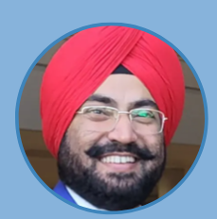
Dr. Inder Singh
Consultant Geriatrician
Aneurin Bevan University Health Board
Welsh Fracture Liaison Service

Slide 18
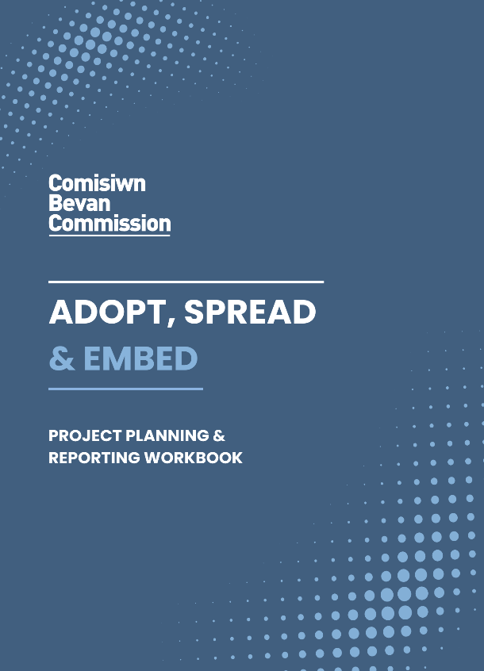





Dr Inder Singh
Consultant Geriatrician
National Clinical Lead, Bone Health, Wales
Adopt, Spread and Embed Online Showcase
2nd September 2025

Slide 19

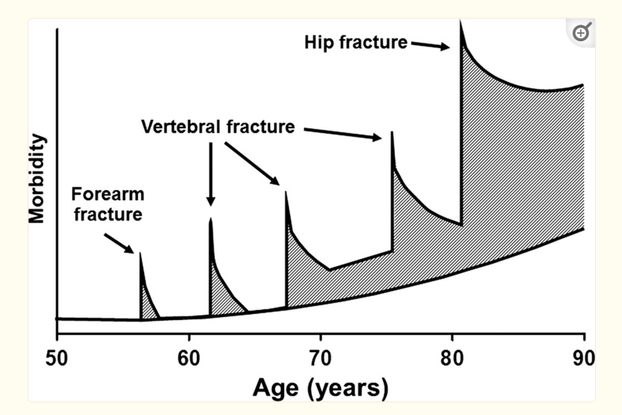
More than a silent condition: The fracture cascade
Accumulation of fracture-specific morbidity over life
Kanis JA, Johnell O. The burden of osteoporosis. J Endocrinol Invest 1999

Slide 20


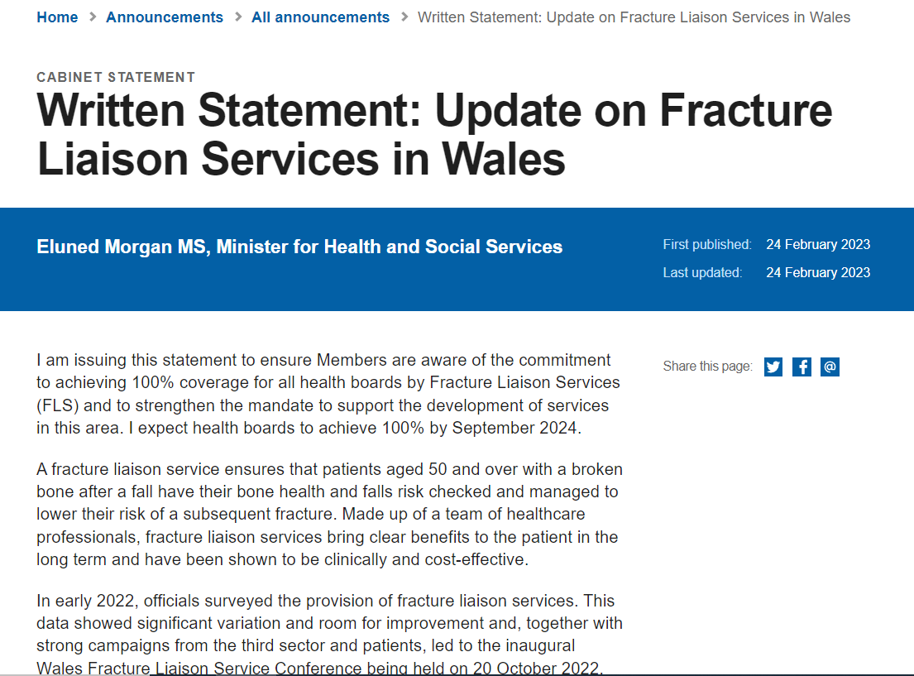
Written Statement: Update on Fracture Liaison Services in Wales (24 February 2023) | GOV.WALES
Ministerial Commitment on Fracture Liaison Services
WG expects all Health Boards to achieve 100% coverage by September 2024

Slide 21
FLS Wales - Cost and Benefits
Total Annual Fragility Fracture cost, Wales = £133 M
  Acute = £7,316,489; Community = £198,680; Social = £3,532,155
  Calculations (2024): expected hip # = 4070 and all fragility fractures = 23510
Cost of running FLS/year = £2.5 to £5 M
If we have FLS for the next 5 years – Cost avoidance = (£11M)
Figures adapted using Royal Osteoporosis Society Economic calculators and Reduce Hip Fracture Service Implementation Toolkit

Slide 22
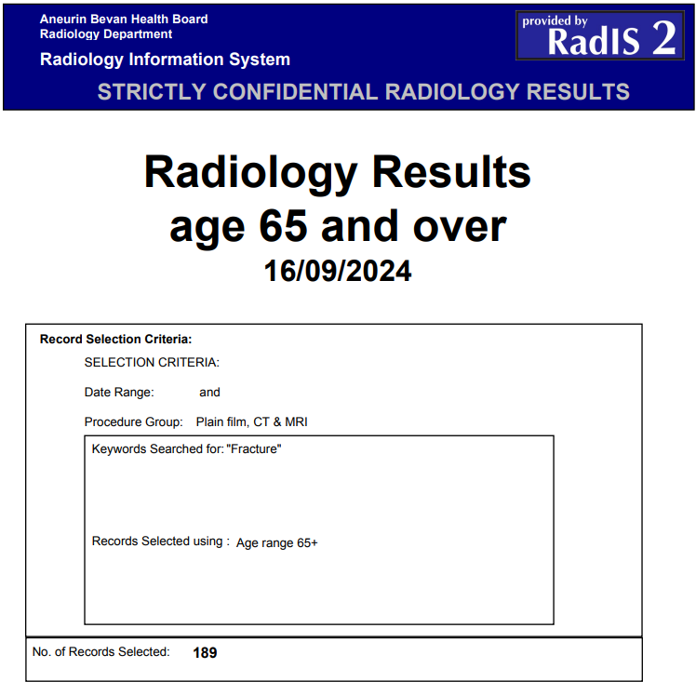
Clinical Innovation – Digital identification
– Weekly radiology reports – reviewed by Specialist Nurses

Slide 23
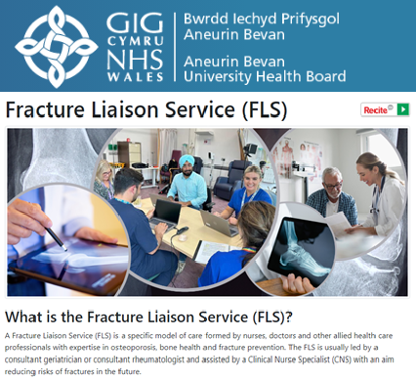

Slide 24

Written Statement: Fracture Liaison Services Rolled Out Across Wales (30 September 2024) | GOV.WALES
Our priority in the next phase of this work will be:
- To nurture the ongoing development of services
- Continue to work with Powys THB
- Timely access to DXA) services

Slide 25




ADOPT and SPREAD
Upscaling of Learning
Overcoming Regional Variabilities – Setting Priorities
Early Adopters: Dr Raja Biswas, CTM UHB FLS team, Rowland Dafydd and Radiology team, CTM UHB for supporting fracture identification digitally
Acknowledgements: Patients, Welsh FLS team, NHS Wales, NHS p & I, Six-Goals, WG, ROS and many more!

Slide 27
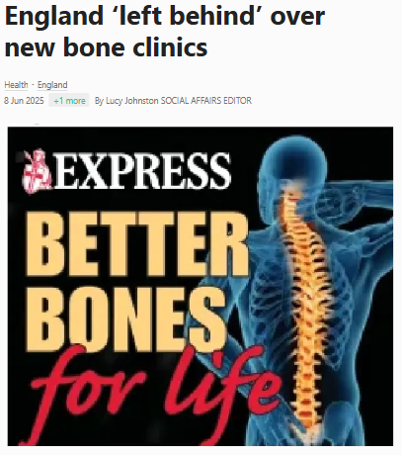
Conclusions
Our collective aim should be….
‘let first fracture be the last’

Slide 28
Top Tips
Educate and train
your team
Manage workload and work in partnership with existing teams
Engage with executive members
Involve digital technology
Gather electronic patient feedback
Share successes

Slide 29
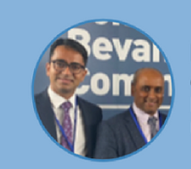
Mr Preetham Kodumuri, Orthopaedic Consultant
Mr Edwin Jesudason, Orthopaedic Consultant
Betsi Cadwaladr University Health Board
Carpal Tunnel Surgery
– Introducing the Lean, Green, More Efficient Pathway

Slide 30


ORTHOPAEDIC OUTPATIENT TRIUMPH:
Mastering Daycase Surgery
PREETHAM KODUMURI &
PRASH JESUDASON

Slide 31

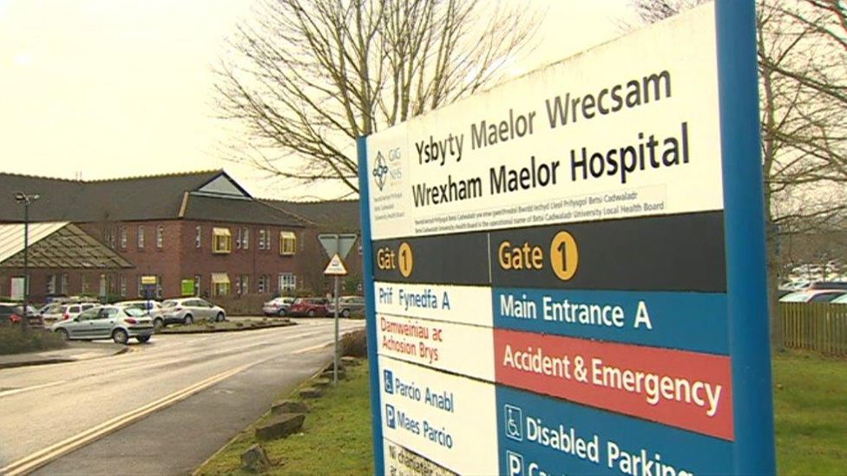
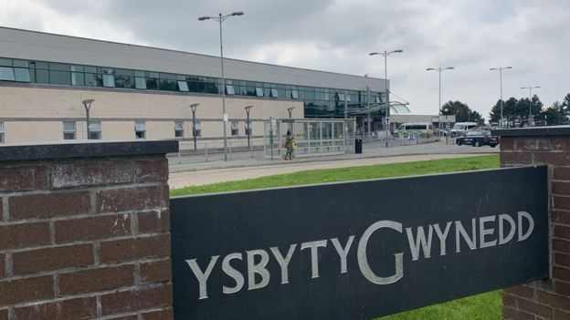
COLLABORATION

Slide 32
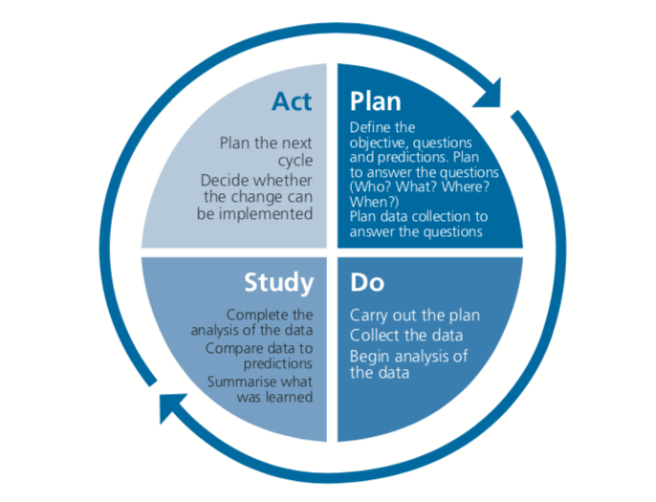
PRINCIPLES OF SUSQI
Step 1 | Set goals | Define the primary and secondary aims of this QIP
Step 2 | Study the system | Focus on carbon intensive features of CTR set up inside theatre and patient pathway
Step 3 | Design improvement | Plan and implement “lean and green” theatre set up and “Greener pathways”
Step 4 | Measure Impact | Clinical waste Carbon footprint Cost savings Wider applicability

Slide 33
AIMS
Reduce carbon footprint in carpal tunnel release by
  “Lean and Green” instrument set up
  Smaller drapes (Phase 1)
  Green patient pathway (Phase 2)

Slide 34
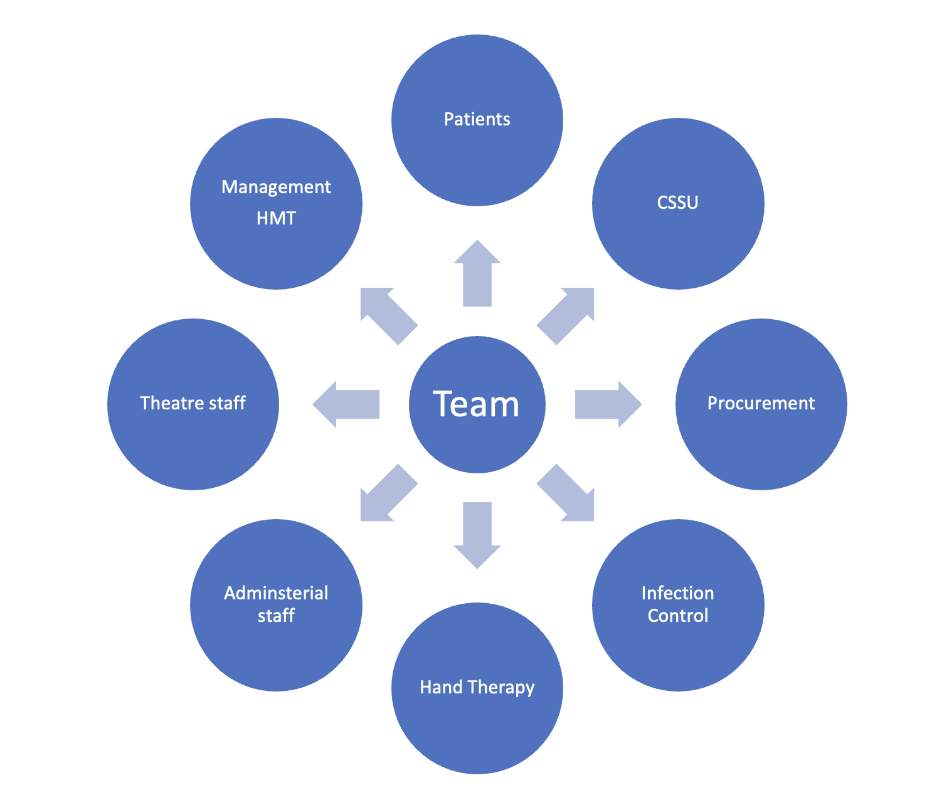


BUILDING AN EFFECTIVE TEAM

Slide 35
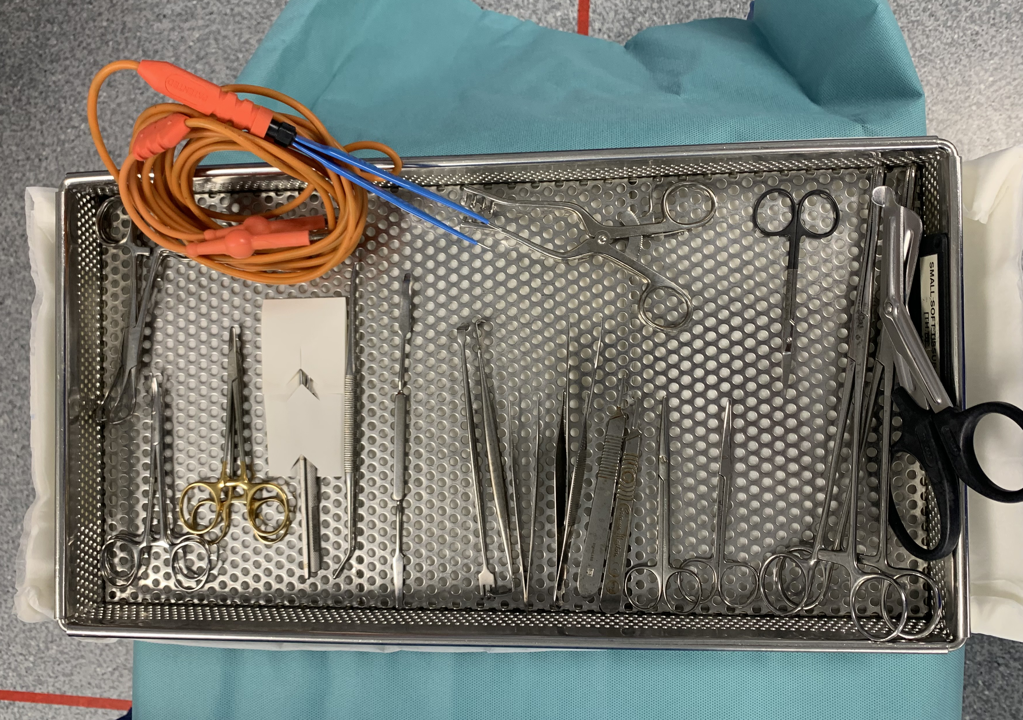
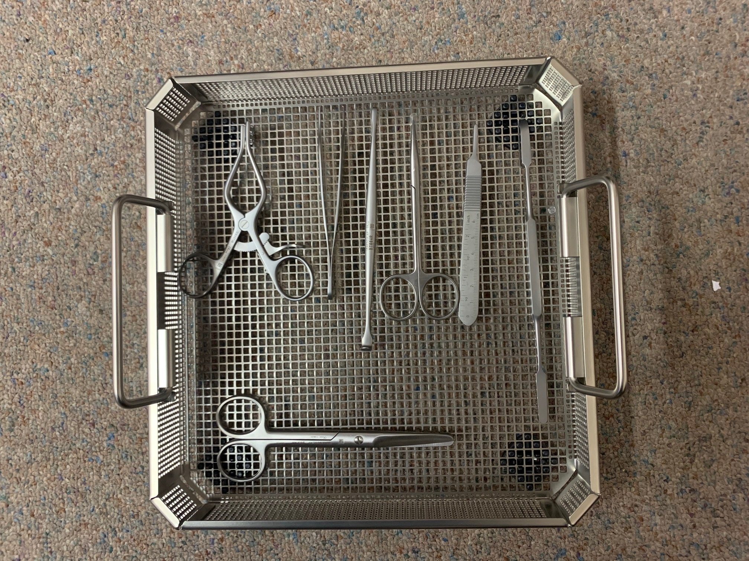
Standard Set
Green Set

Slide 36
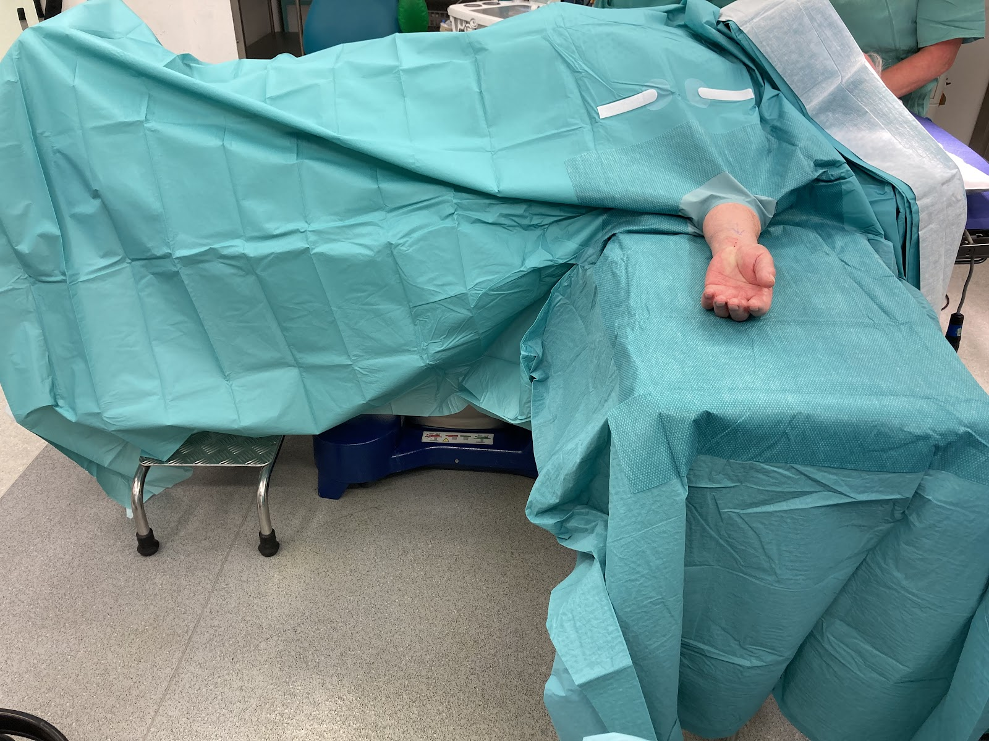
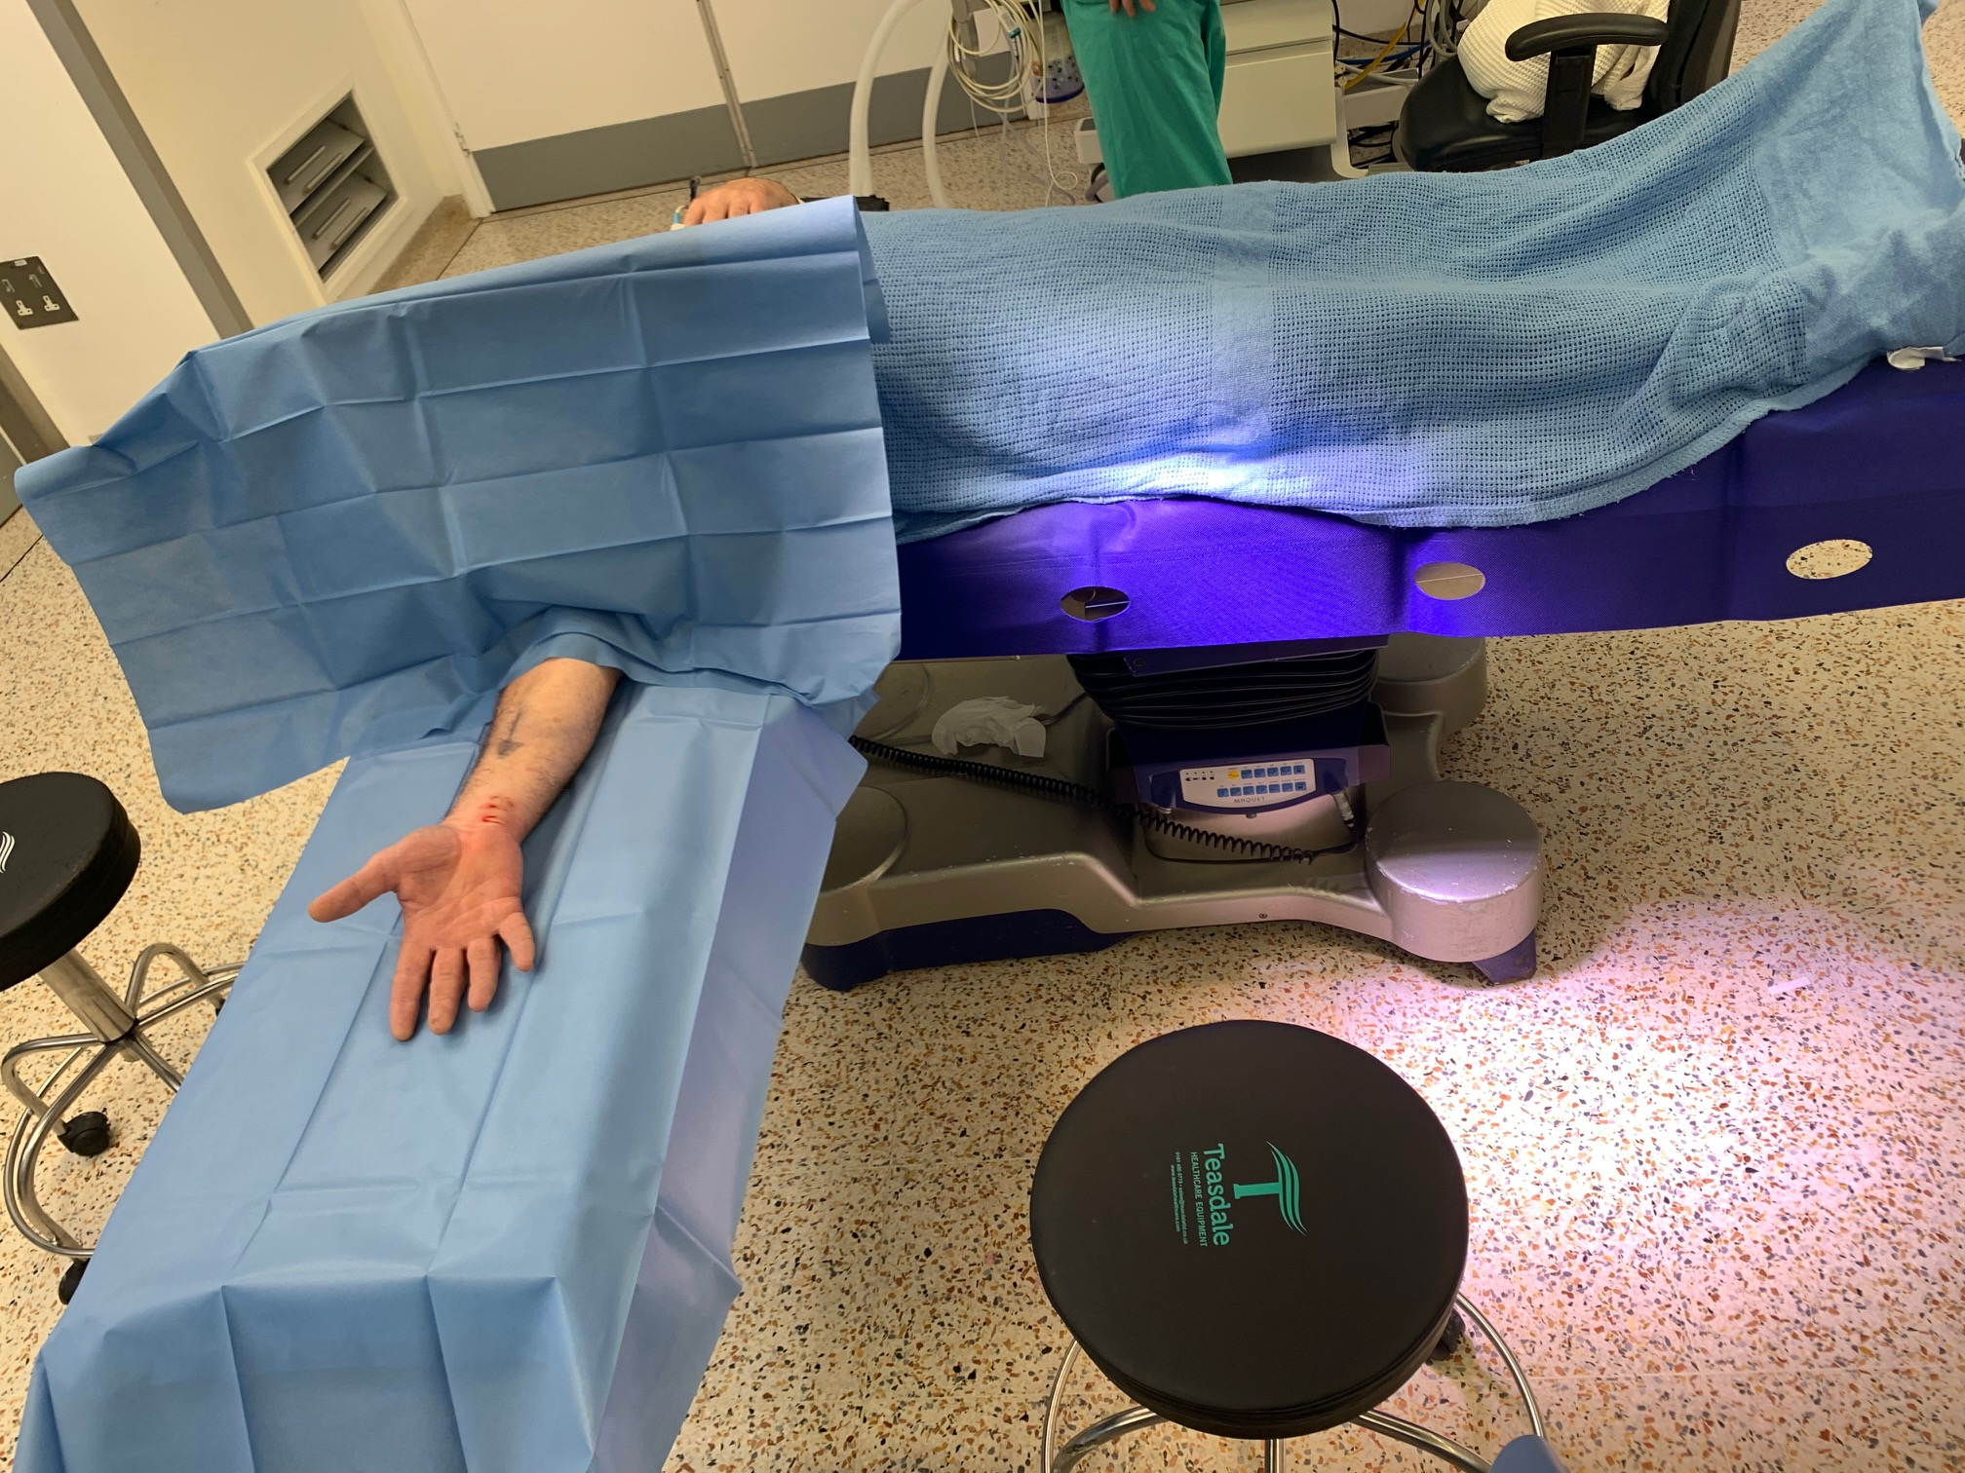
TRADITIONAL DRAPING
LEAN AND GREEN DRAPING

Slide 37
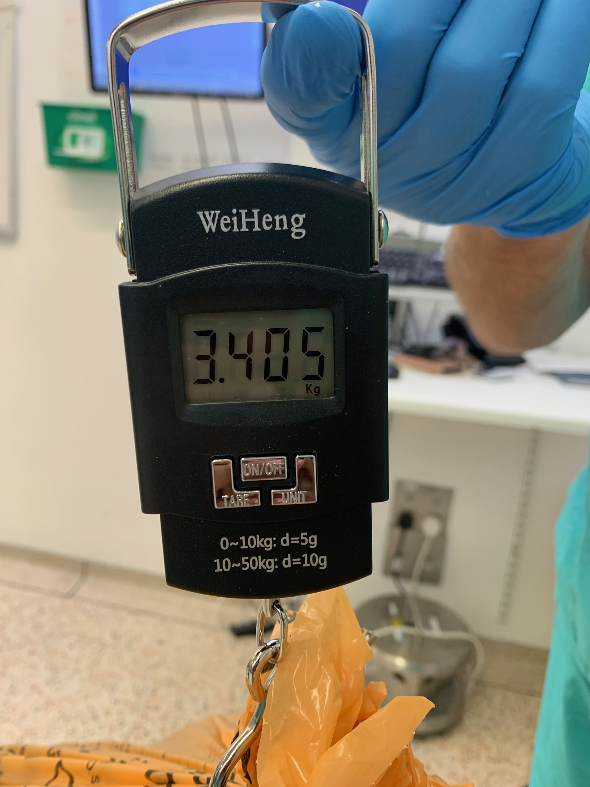
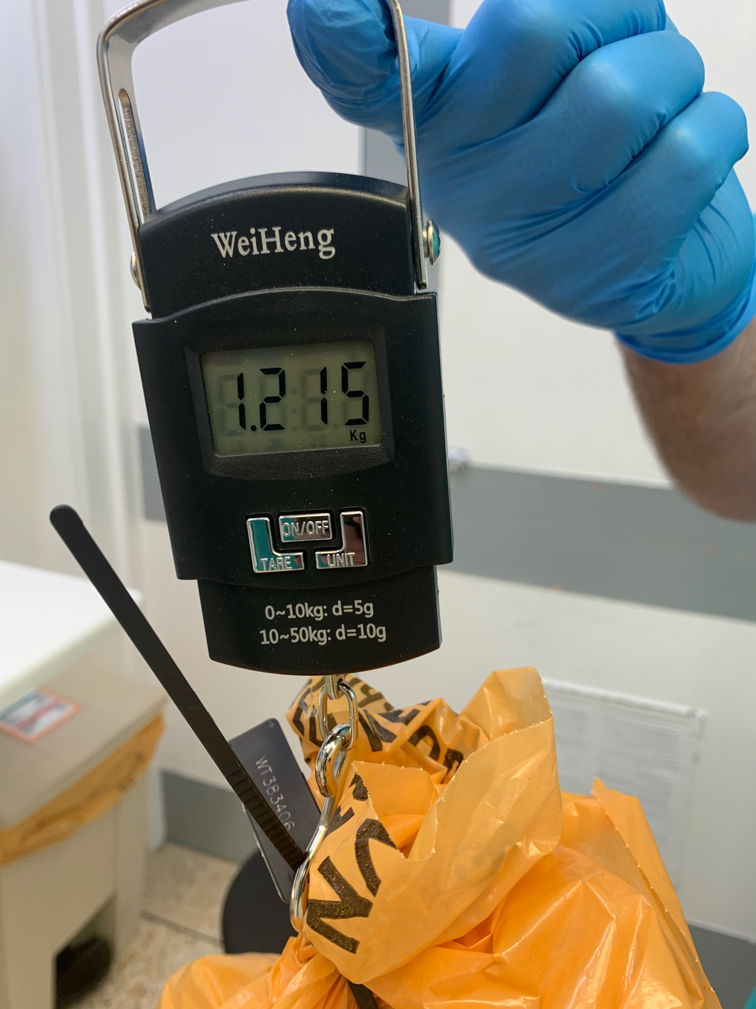
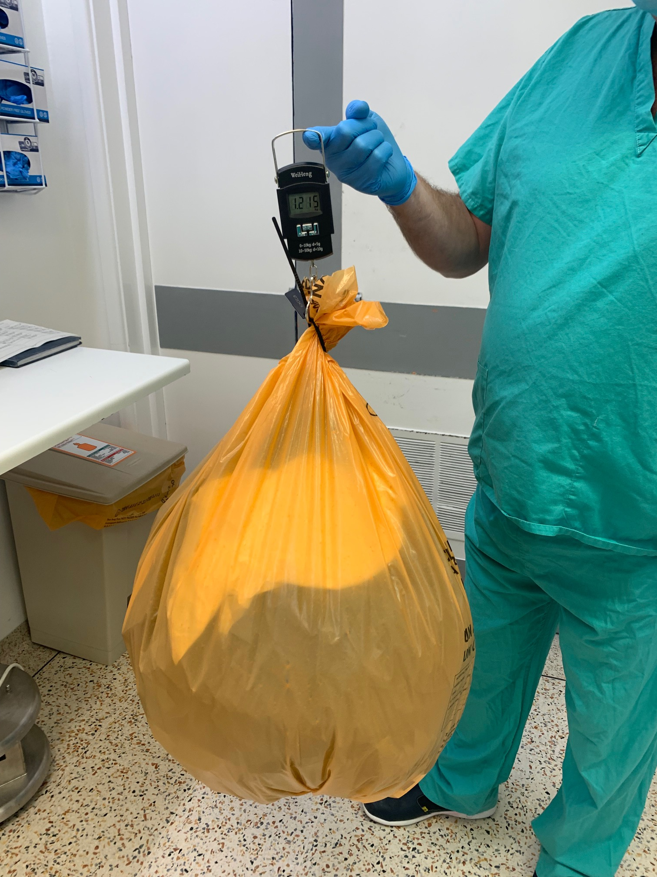
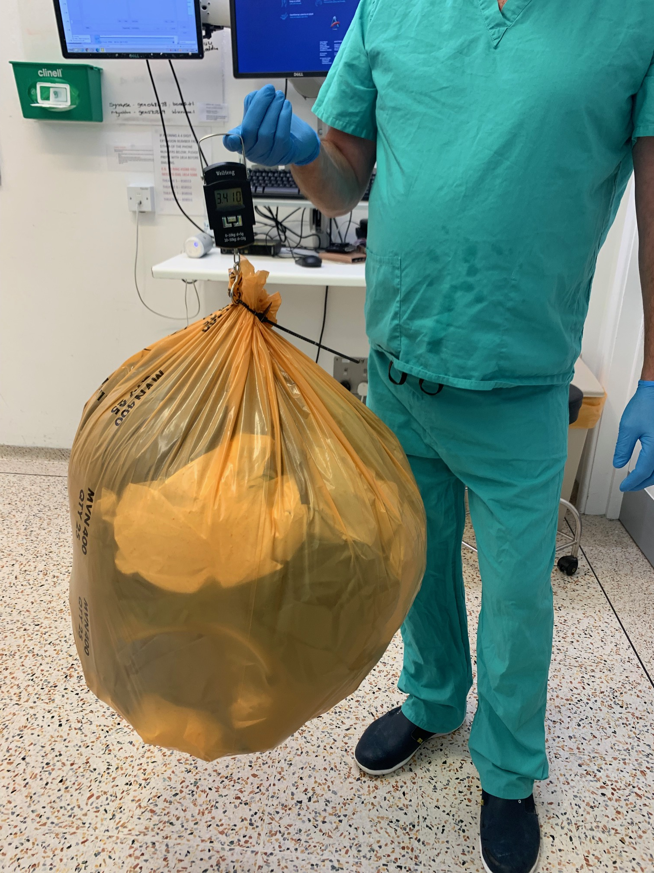
WASTE GENERATED PER CASE
Standard List Green List

Slide 38
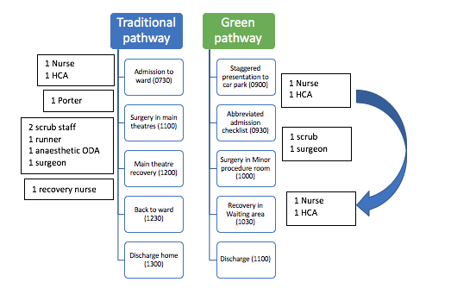
TEAM & TIME
TOTAL 9
TOTAL 4
Total time 4.5 hrs
Total time 2 hrs

Slide 39
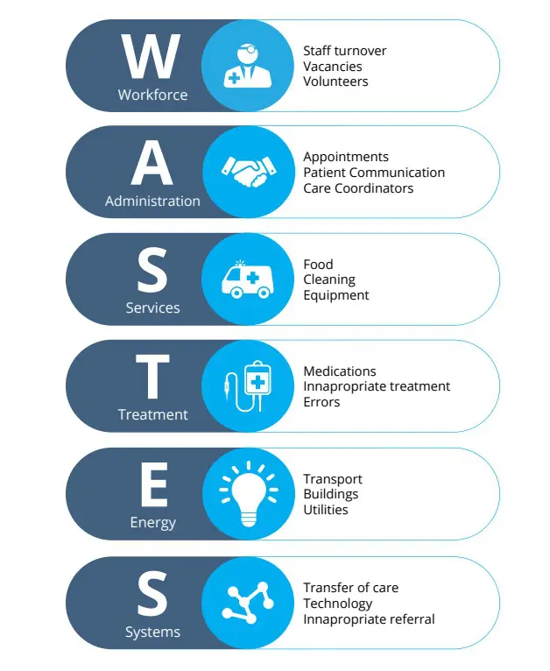
THE SIX THEMES OF LET’S NOT WASTE
66% staff savings
50% less appointments
80% CO2 savings
66% less clinical waste
65% financial savings (MOPS room)
Patient hotline; No complications

Slide 40




ADOPT AND SPREAD
Reduce clinical waste by 65%
Design greener patient pathways
Annual UK savings £89.6 Million
Annual savings 1300 tonnes CO2e
Minimal stay in hospital, bypasses ward admission, increased productivity, scalable to bigger surgical procedures.

Slide 41
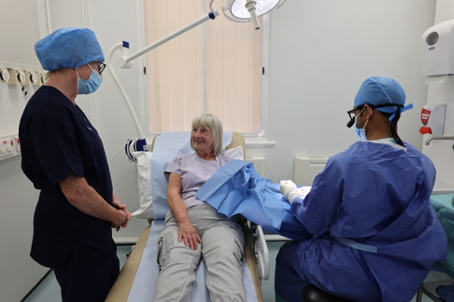
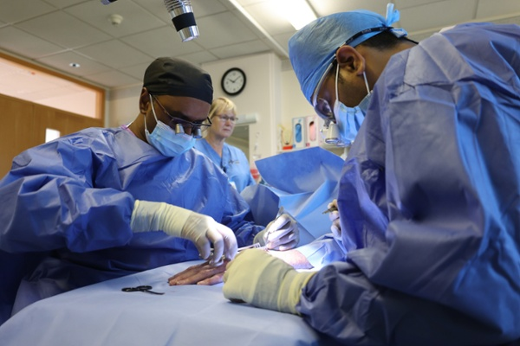
ACTIVITY SO FAR
WREXHAM
  250 cases to date
BANGOR
  140 cases to date
No complications or adverse events
Overwhelmingly positive staff and patient feedback
In Wrexham and Bangor, we estimate this had freed up 26 all day theatre lists, freeing space for 104 major cases (based only 4 cases per list)

Slide 42
NATIONAL & INTERNATIONAL IMPACT
Awards
  Sir Mansel Aylward award 2024 for innovation
  Winner for Betsi Cadwaladr Health Board for sustainability
  Runner up for NHS Wales award 2024
  MSc in hand surgery - Mr Kodumuri
National adoption
  Part of the National Clinical strategy for orthopaedic surgery
  Cardiff and Vale considering moving to this model of working
  Further discussion at British Hand society (BSSH) as to how to promote implementation elsewhere
International
  Presented at major international conferences
  3 manuscripts published so far, one of which was awarded the “top ten most cited papers in hand surgery of 2024 (European journal of hand surgery)

Slide 43
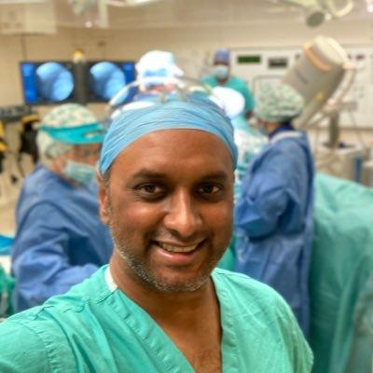
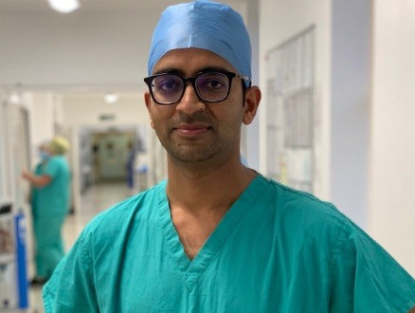
DIOLCH YN FAWR IAWN
THANKS FOR YOUR ATTENTION

Slide 44
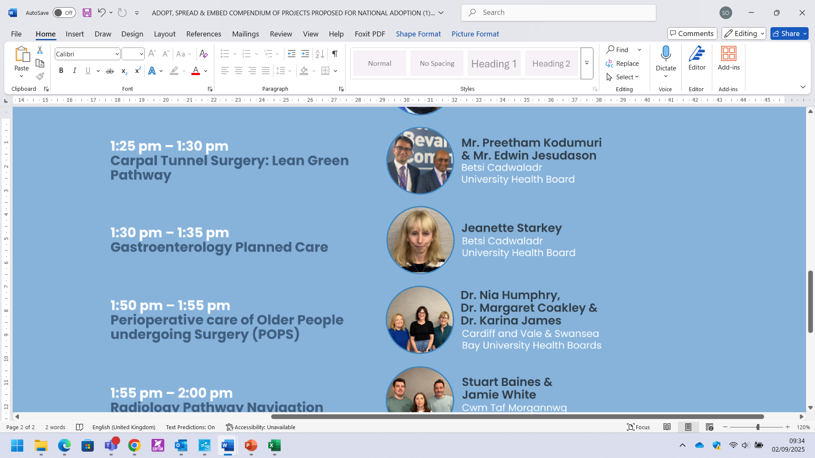
Jeanette Starkey
Advanced Practitioner Dietician
Betsi Cadwaladr University Health Board
Building Capacity in
Gastroenterology Planned Care

Slide 45



Advanced Clinical Practitioner Dietitian Led Gastroenterology
Jeanette Starkey, ACP Gastroenterology Dietitian, Clinical Lead &
Dr T Mathialahan, Gastroenterology and Hepatology Consultant, Clinical Lead

Slide 46
Background
Routine gastro waiting list: 144 weeks (784 patients) routine
Urgent gastro waiting list: 53 weeks (328 patients)
39% increase in referrals to secondary care gastro service
Reduced gastro consultant staffing: 2 WTE, 1 part time;
  ideal staffing is 6 WTE per population of 250,000
  Inability to recruit over past 4 years
20% of patients referred to secondary care gastro are diagnosed with functional gut issues

Slide 47
Aims and Objectives
Create ACP Dietitian Led Gastroenterology Clinic
  Band 8A Dietitian; 0.6 WTE Band 3
Patients referred to secondary care gastroenterology services will be triaged by gastro consultants via Referral Management System;
  those identified as likely functional gut issues will be referred directly to dietitian for initial assessment, diagnostics and management
Reduce current 144 week waiting list of routine gastroenterology patients
Enable consultants to see urgent or more complex patients timely, reducing risk of admission and improving management plans for patient
Provide a more streamlined, safe and effective pathway for the patient

Slide 48
Approach
Established 4-5 new patient clinics per month (25 patients per month)
Established 2 follow up clinics per week (48 appointments per month)
Gastro consultants triage referrals and identify those appropriate for ACP dietitian clinic as part of Referral Management System (RMS)
Weekly 1 hour supervision with gastroenterology consultant to review cases and organize investigations

Slide 49
Outcomes
Clinical Activity 259 referred by Gastro Referral Management System (RMS) team 225 Patients seen in clinic 66 patients contacted from 3 year waiting list Plus 27 removed from waiting list as either non-responders to invite to attend or declined appointment as symptoms improved since initial referral = 318 people in total, not added or taken off gastro consultant waiting list in 12 months Referral time Reduced from 3 years to 3-4 months for low risk gastroenterology patients Re-referrals back to gastro consultants 3 at dietitian request 1 at patient request 3 at consultant request

Slide 50
Outcomes
86 (38%) of patients managed fully without consultant input clinic before discharge 139 (62%) of patients required some form of input from gastro consultant to arrange further investigations. Many of these were simply a signature to request investigation rather than detailed review
Investigations | Number
Colonoscopy | 40
Sigmoidoscopy | 12
endoscopy | 35
CT Scan | 20
MRI | 11
SehCat | 13
US abdo/pelvis/TAV | 35
Total | 166 Investigations for 139 patients

Slide 51
Outcomes
Diagnosis Most new diagnoses were managed completely by the dietitian with a combination of commencing on medication, diet and lifestyle Exception: cancer, colitis, polyps, gynae
Diagnosis | Number
Colonic cancer | 1
Bile acid diarrhoea | 7
Pancreatic enzyme insufficiency | 8
Small intestinal bacterial overgrowth | 8
H.pylori | 3
Rectal/colonic polyps | 6
Gastritis/oesophagitis/duodenitis | 32
Hiatus hernia | 5
Diverticular disease | 18
colitis | 2
Gynae related | 6 (onward referral)
Functional gut | 129

Slide 52
Outcomes
Consultant time 225 new appt consultant slots released (30mins each, 112hrs consultant time released) 225 follow up appt slots released (20 mins each, 75hrs consultant time released) Plus associated admin – letters, reviewing, actioning results est 30mins per patient = 112hrs = 500 appointment slots released a year, 299 hrs consultant time released (39 days) Over 12 months, 32 supervision sessions between dietitian and consultant for 139 patients (either to arrange investigations or review case) On average 35-45 mins of consultant time = 19-24hrs of consultant time per annum Estimated 3-6 full days a year of consultant time to support dietitian led gastroenterology clinic (1hr per week provision but not always used due to staff shortages)

Slide 53
Outcomes
Capacity 1400 new appointments available in gastro consultant clinics per annum / 250 new slots in dietitian led clinic = 18% increase in gastro consultant clinic capacity a year if low risk patients are triaged to Dietitian led clinic 2064 follow up appointments available in gastro consultant clinics 250 follow ups in dietitian led clinic = 11% increase in gastro consultant capacity a year = Total 14% increase in gastro clinic capacity a year 275hrs or 1250% increase in gastro consultant hours (24hrs vs 299hrs) to see more urgent, complex patients

Slide 54
Outcomes
Cost Effectiveness Consultant Clinic Sessions 250 new appointments @ £532 per appt = £133,000 250 f/u appointments @£273 per appt = £68,250 = £201,250 cost of consultant time Vs ACP Dietetic Clinic Sessions 250 new appointments @ £303 per appt = £75,750 250 f/u appointments @214 per appt = £53,500 = £129,250 Cost Benefit of ACP Dietitian vs Consultant Clinics = £72,000

Slide 55
Did it Work?
Has become embedded within gastroenterology pathways as an alternative route for patients
Established good communications and shared care with gastroenterology consultants, GPs and patients
Evidenced that patients can be assessed, investigated, diagnosed and managed by ACP Dietitian

Slide 56
Benchmarking
Dietitian led Gastroenterology Clinics - Already proven models elsewhere
ACP Dietitian Led Gastroenterology Clinic: Sheffield Teaching Hospital (Prof David Sanders, 2023)
    Reduced gastro waiting list
    Cost effective
    Freed consultant time
The activities of a dietitian-led gastroenterology clinic using extended scope of practice, Queensland, Australia (2016, 2018)
  78% of category 2 and 3 patients referred to the gastroenterologist could be managed exclusively in the dietitian-led clinic.
  Extended scope model of care could benefit the efficiency and acceptability of Australia's public health system.
Dietitian Led Gastroenterology Clinics, Tallaght University Hospital (TUH), Dublin (2021)

Slide 57
Stakeholder Feedback
Patient Feedback
How did you find the service you received overall?
  Excellent 90%
  Very good 10%
Did you feel reassured that your concerns had:
  Been listened to: Yes absolutely
  Been understood: Yes definitely
Did you receive the care you expected in terms of:
  Addressing your symptoms: Yes definitely 100%
  Investigating your symptoms: Very effective 100%
Did you feel the right care compared to seeing a gastroenterology consultant
  All said “yes definitely” – “to me, she specialises in this and by working in this way it saved me from having to go to a consultant
And finally, a quote from one patient “ I have to say that this is a 5 star team. They work quietly in the background without any fuss and bother and just worked hard – they deserve an award for this work’’

Slide 58
Conclusion
Investing in an enhanced gastroenterology dietetic team to improve patient access to timely, evidenced based service.
This model supports the needs of the overall gastroenterology service in primary and secondary care at lower cost compared with consultant time, as well as reducing medication costs, investigation costs, improving timely care with excellent patient outcomes and with high patient satisfaction
  Modernizes outpatient services
  Utilizes broader team skill mix
  This model is supported by gastroenterology locally and recognised nationally.
  Fits into NHS Wales workforce plan and values

Slide 59
Dr. Nia Humphry, Consultant Geriatrician
Dr. Margaret Coakley, Consultant Anaesthetist
Cardiff & Vale University Health Board
Dr. Karina James, Consultant Geriatrician
Swansea Bay University Health Board
Perioperative care of Older People undergoing Surgery (POPS)

Slide 60

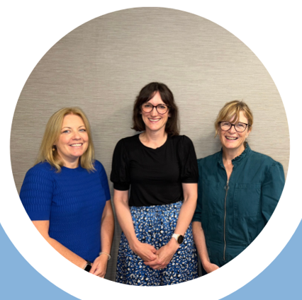
Perioperative Care of Older People Undergoing Surgery (POPS)
Elective General Surgery
Dr Karina James Consultant Geriatrician SBUHB
Dr Nia Humphry Consultant Geriatrician CAVUHB
Dr Margaret Coakley Consultant Anaesthetist CAVUHB

Slide 61
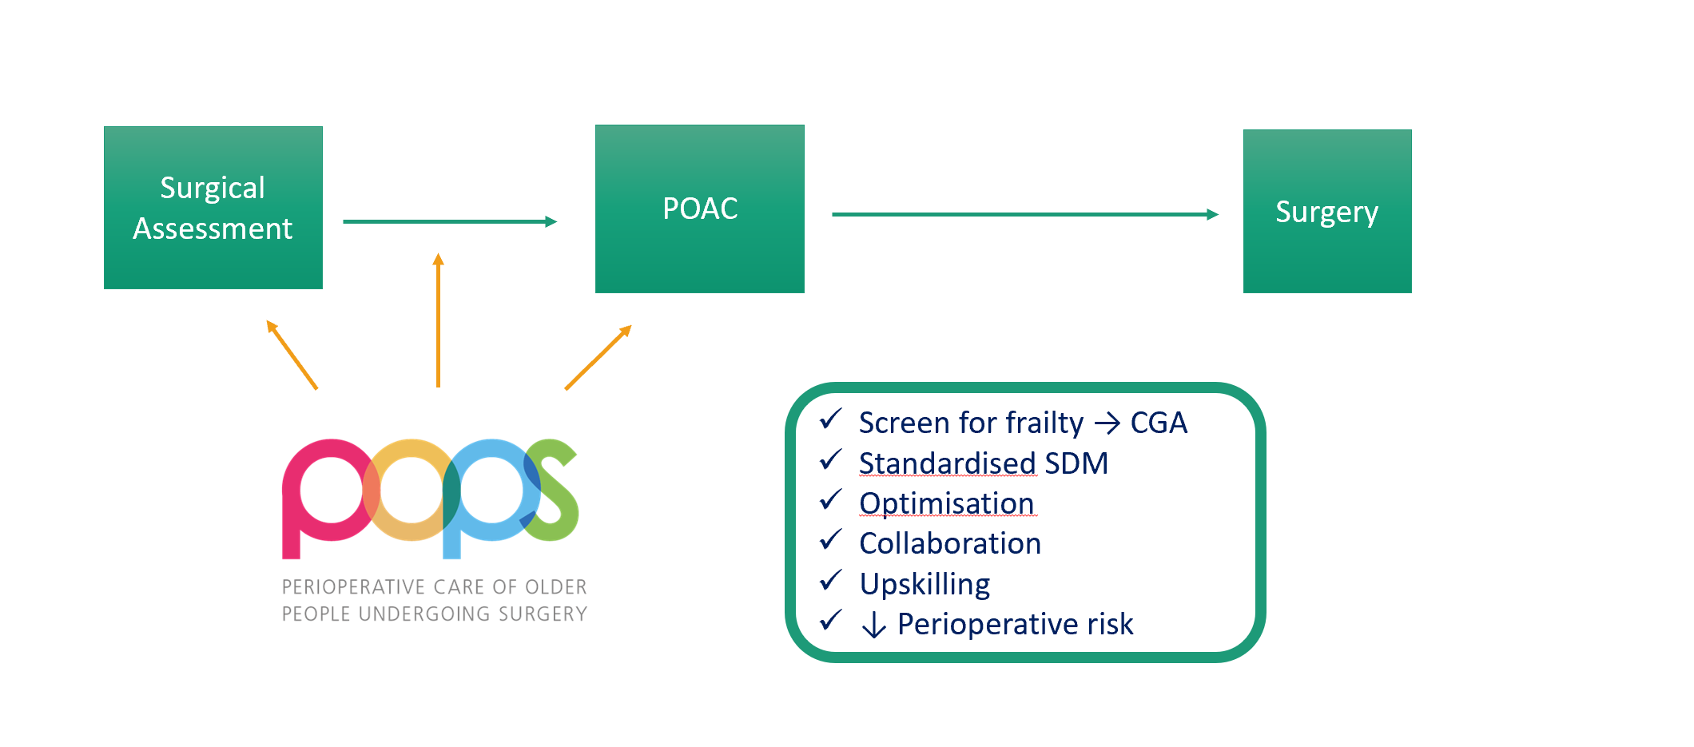

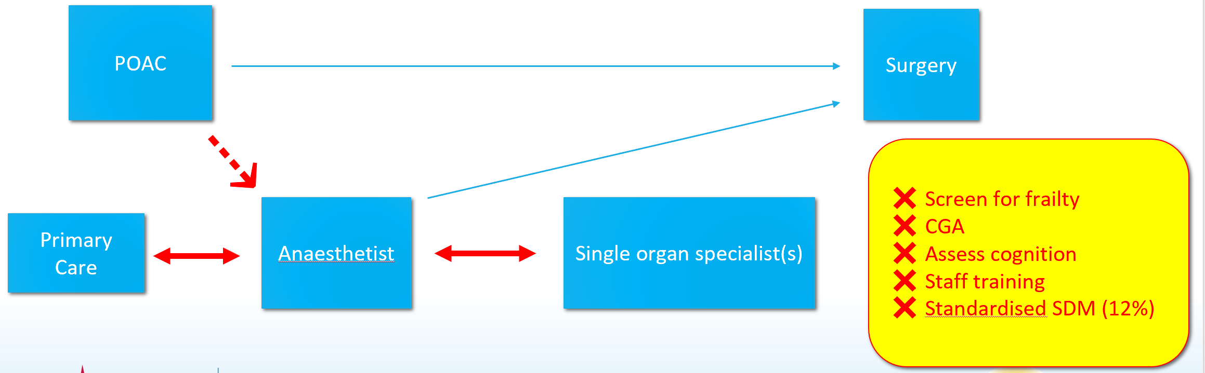


Background
Surgical population is ageing
Frailty = ↑risk
Waiting lists increasing
Comprehensive Geriatric Assessment (CGA):
Geriatrician-led, holistic approach → collaboration
Patient optimisation & preparation
↓ risks
↓ cost (medical complications, length of stay, not proceeding)
Notes:
By 2030 20% of those undergoing surgery will be >75
A proportion of older patients are also living with frailty and have less reserve to deal with stressors such as surgery.
Frailty = high risk, but this is not routinely assessed / considered in current pathways
This group have a 4-fold increased risk of complications, 30% longer LOS as well as increased risk of mortality. For some, surgery may not be the right answer.
>6000 people living with frailty awaiting surgery in Wales
National guidance states these patients need a different pathway
Current pathways do not meet the needs of this complex patient group.
CPOC guidance September 2021 – key standards of screening for frailty, and care underpinned by CGA and SDM for those who are frail
Vascular rct GSTT 1165 saved/pt
15% DNP after POPS ax
Reduced referrals to single organ specialists / oncall medical team

Slide 62


POPS in Wales (So Far)
2022: Pilot in elective surgery
  SDM : 14% patients not proceeding → saving ~£10K / month
  Medication reviews → saving £41 / patient / month
2023: Substantive elective service
  General Surgery + others
  Clinical Nurse Specialist, Consultant Geriatrician (0.5), Co-Ordinator (0.4)
2022: Pilot in elective surgery
  Digital tools – Power BI, self-screening of frailty
  Cost savings demonstrated – substantive funding
2023: Substantive elective service
  HVLC & colorectal cancer; frailty screening all stage 5 patients
  Consultant Geriatrician (0.3), 2 JCFs, Band 3
Notes:
CAV – service more than pays for itself through reduced referrals to other specialties, medication reviews and patients choosing not to proceed after SDM discussion

Slide 63
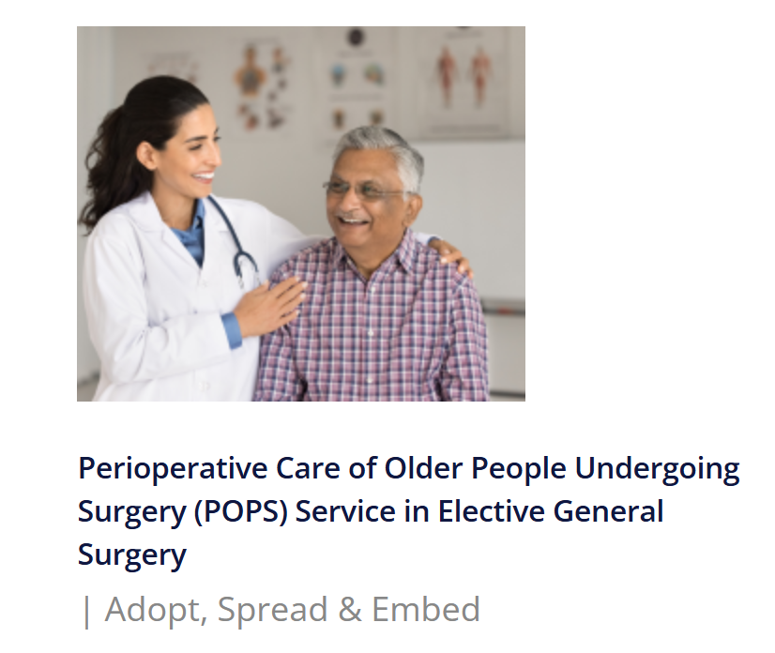

Adopt, Spread & Embed
Planned Care funding until April 2025
£102K / health board:
Staff: 3PA Consultant Geriatrician, B6 CNS, B3 Administrator
Set-up equipment / licensing costs
Define Case for change
Collaboration – resources, experience
Reach stakeholders
Savings if model scaled across Wales:
£3.3m patients not proceeding (n=884)
£1.4m primary/secondary care appts
£258,000 medication changes
Notes:
Working alongside BC since February to:
develop a case for change
build a toolkit of resources (assessment proformas, letter templates, job descriptions)
and pooling our experience across the 2 HBs
Through the Planned Care Team NHS Wales P&I, working alongside Richard Egan and Bethan Clift, secured funding to enhance patient outcomes and deliver cost savings

Slide 64
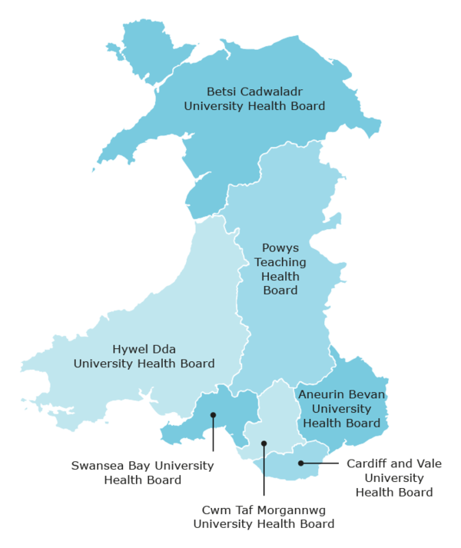
Progress So Far…
Betsi
interest (anaesthetics)
Hywel Dda
strong interest (geriatrics, anaesthetics)
Aneurin Bevan
good engagement (geriatrics, surgery)
seeking external geriatrician support
Swansea Bay
advertising for consultant post
specialty to be decided
CAV
Consultant sessions from Sept
CNS – secondment to be recruited
Co-ordinator role – in discussion
CTM
Interest (geriatrics)
Notes:
Non-adopting health boards - comparators

Slide 65



Future Steps
Recruitment
2025/26
↓ variation
Notes:
Support sites with recruitment to roles across the HBs over this last month of Q2
Time-critical in terms of shaping the change - funding timeframe from NHS P&I & BC programme support to August 2026
Achieve what we can in this time as a step towards reducing the harmful geographical variation in perioperative care for those living with frailty in Wales

Slide 66
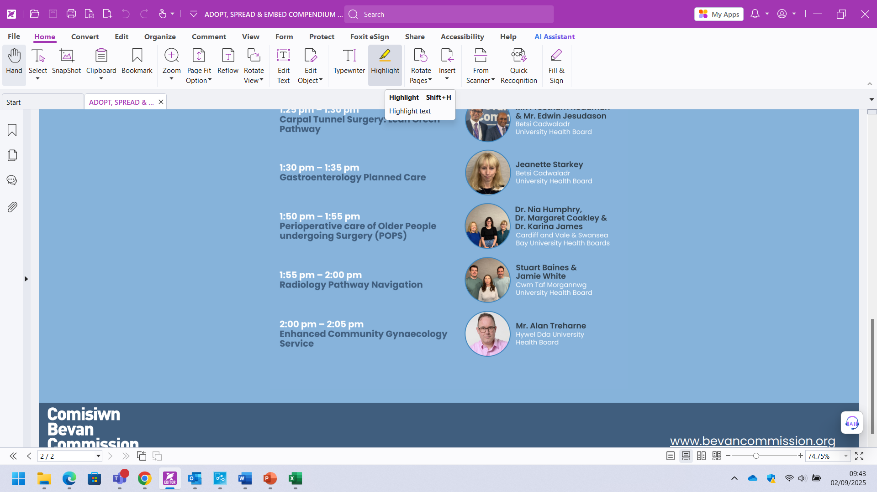
Stuart Baines, Consultant Radiographer
Jamie White, Advanced Practitioner Radiographer
Sarah Maund, Radiology Navigator
Cwm Taf Morganwg University Health Board
Radiology Pathway Navigation
–A New Direction

Slide 67



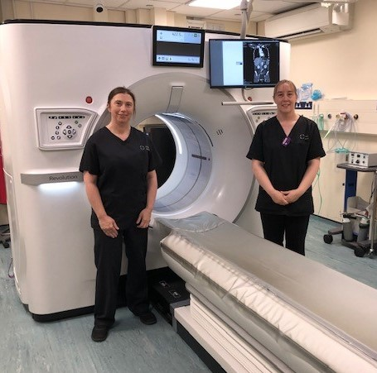
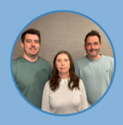

Slide 68

Radiology Navigator Model - Project Background
WALES - Lung/Colorectal Ca – Early detection is key!
Workforce Challenges:
  Rising demand for Radiology (11%pa)
  Radiologist shortfall: 30%
  Radiology pathway bottlenecks affecting patient outcomes
  Innovation required - Skills Mix for Radiographers – Radiology Navigator
Welsh Government priorities:
  Streamline Diagnostics
  Detect cancer early
  Pathway innovation
  Outpatient transformation and staff development
  National Optimal Pathways (NOP’s)
Radiology Navigator facilitates:
  Facilitate Staging CT and MRI scans, Same Day where possible
  Undertakes IRMER justification of CT/MRI referrals
  Single point of contact for patients and clinicians
  Increase USC CT Capacity
First formal Radiology Navigator in Wales – POWH, CTMUHB Sept 2022

Slide 69


Radiology Navigator Project Evaluation
4 Elements Evaluated:
1) Additional USC CT Scanning capacity created
2) Streamlining IRMER Justification of CT and MRI referrals
3) Colorectal cancer Radiology pathway data
4) Lung cancer Radiology pathway data

Slide 70
POWH Additional CT Scanning Capacity
1
Radiology Navigator is a qualified Radiographer
  Able to organise & perform short notice USC CT and MRI scans
Radiology Navigator delivered 710 short notice USC CTs last year
  Unfunded CT scanner sessions
Comparison – Llantrisant Health Park (LHP) purchased CT capacity
  710 CT scans = £206,667 in cost avoidance

Slide 71
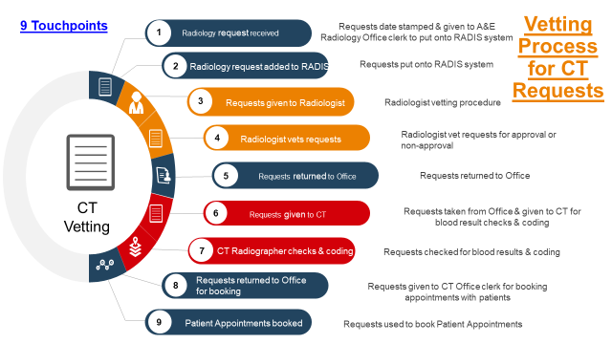
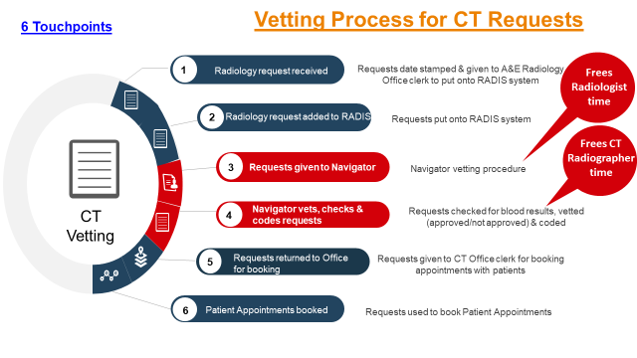
Process Mapping – CT and MRI Vetting/Justification
2

Slide 72
IRMER Vetting Process –
Average Days
2
Navigator in post Aug 2022 – new system established Early Sept 2022

Slide 73
2
CT Vetting Process: Navigator vs Radiologist
Saved 273 hours of radiologist time per year, per DGH site (68.3 sessions). 3xDGH sites in CTMUHB.
  2,253 CT scan reports = £165,357 in cost avoidance
  Equates to £78k Radiologist time vs £28.8k Navigator time
  205 sessions = Additional 2,253 CT/MRI reports each year
(3x DGH sites)

Slide 74
Data – Colorectal and Lung Cancer Pathways
3+4
Evaluation Period
  Pre-intervention (2019–2022)
    Vs
  Post-intervention implementation (2022–2024)
National Optimal Pathways (NOP’s) - for 1) Colorectal and 2) Lung Cancers
  Radiology elements within these NOP’s modernised

Slide 75
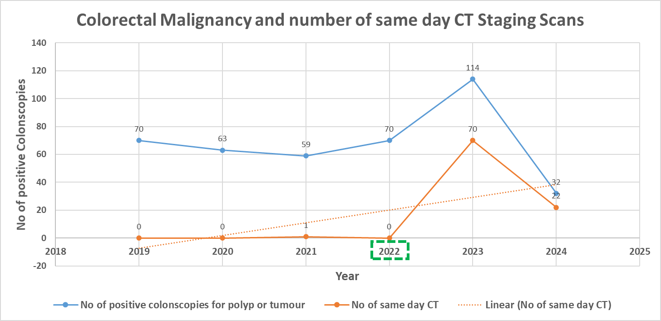
Colorectal Cancer Pathway:
POWH Endoscopy to Staging Computerised Tomography (CT)
3
Notes:
Rad Navigator started in 2022, correlates to a sharp spike in same day CT scans in 2023

Slide 76
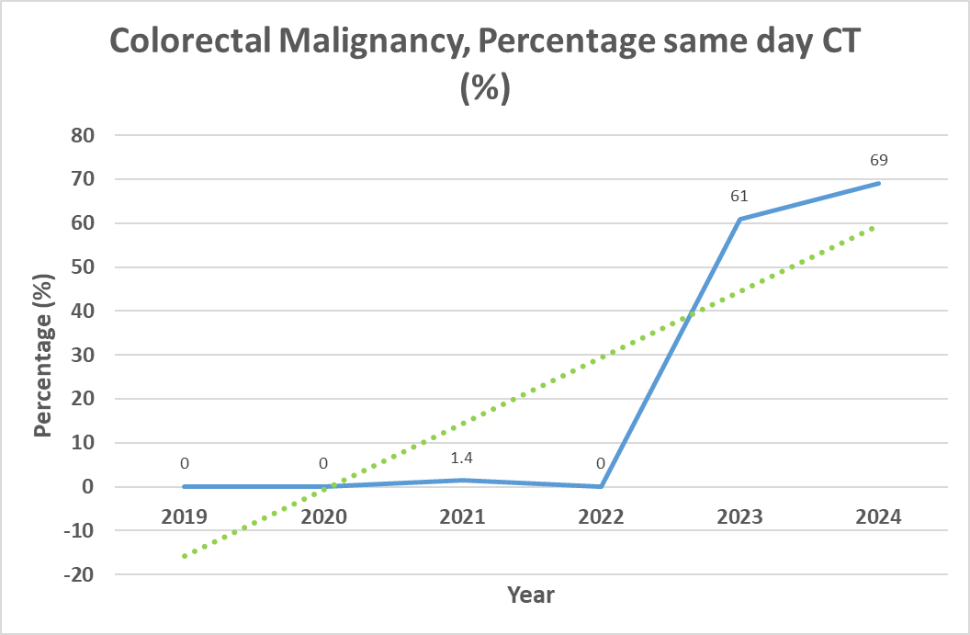
Colorectal Cancer Pathway:
POWH Endoscopy to Staging Computerised Tomography (CT)
3
Notes:
Stopped using CANISC in CTMUHB in 2024 hence apparent reduced cancer numbers

Slide 77
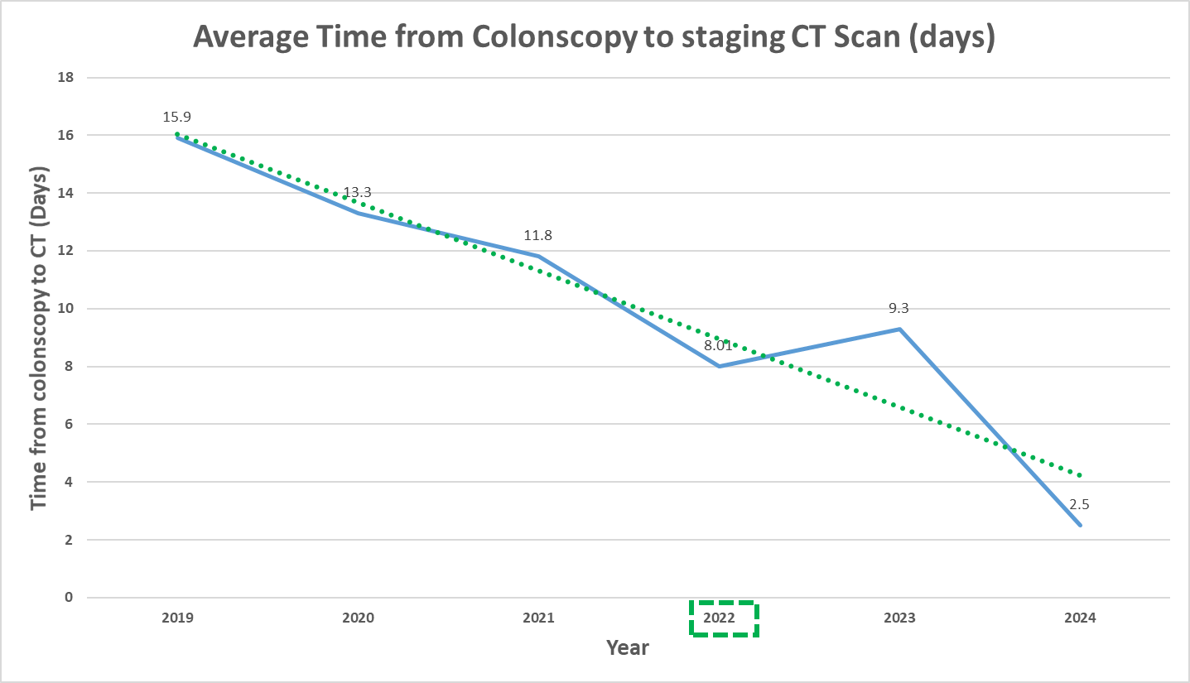
Colorectal Cancer Pathway:
POWH Endoscopy to Staging Computerised Tomography (CT)
3
Notes:
Colonoscopy to Staging CT reduced by 13.4 days!

Slide 78
POWH Endoscopy to Staging Computerised Tomography (CT), Summary
• 69% of patients received a staging CT scan on the same day as their positive colonoscopy in 2024 (0% in 2022, 1.4% in 2021)
• 100% patients received a staging CT within an average of 2.5 days from colonoscopy
  69% improvement from 2022 (8 days)
• CT reports were completed within 1.63 days on average.

Slide 79
POWH Radiology Lung Cancer
Pathway: CXR Report to Staging CT
4
Notes:
65% reduction comparing 2020 to 2024

Slide 80
POWH Radiology Lung Cancer
Pathway: CXR Referral to MDT
4
Notes:
Pathway reduced by 15.7 days comparing 2020 to 2024

Slide 81
What Next?
Adopt, Spread and Embed (bevancommission.org) across all CTMUHB Radiology sites
  Potential funding available CTMUHB Nov 2025
    1x additional Radiology Navigator
    +/- Band 2/3 Clerical support
  Reduce inequality across CTMUHB sites
Integrate Radiographer CXR Hot Reporting SCP project in POWH
Dissemination and consideration for adoption in other Welsh Health Boards.

Slide 82

Many Thanks for Listening
Stuart.Baines@wales.nhs.uk
Sarah.Maund2@wales.nhs.uk
Jamie.White@wales.nhs.uk

Slide 83
Mr Alan Treharne, Gynaecology Consultant
Hywel Dda University Health Board
Enhanced Community
Gynaecology Service

Slide 84
Adopt, Spread and Embed
Enhanced Community Gynaecology Services
Showcase Event, 2nd September, 2025
Alan Treharne, Consultant Gynaecologist
Hywel Dda University Health Board

Slide 85
What have we delivered?
Enhanced Community Gynaecology Service (ECGS)
Bevan Exemplar 8 – Adopt, Spread & Embed Programme
Consultant-led community gynaecology
Designed to improve efficiency, access and outcomes
Aligned with Welsh NHS priorities: prevention, community care, efficiency

Slide 86
Why change is needed – Now
Rising HRT-related bleeding referrals (≈600 annually in Hywel Dda)
Around 8% of women in Wales on HRT → ~2,300 potential annual referrals
Many patients unnecessarily enter the cancer pathway
Existing model = multiple appointments, hospital-based, resource-heavy

Slide 87
The ECGS model
Three core community clinic types:
HRT Irregular Bleeding Clinic – ultrasound, biopsy, minor procedures
Mixed Gynaecology Clinic – endometriosis, PCOS, pelvic pain, heavy bleeding
One-Stop Hysteroscopy/Ultrasound Clinic – rapid diagnostics for high-risk/cancer pathway patients
Consultant-led, one-stop model; faster diagnosis, reduced hospital dependency, improved patient experience

Slide 88
Impact and value
Patient benefits: one-stop care, closer to home, fewer delays
System benefits:
  Frees cancer pathway & radiology capacity
  Reduces unnecessary hospital referrals
Financial savings:
  £268 per patient
  One clinic/week (46 weeks) → £74k savings per year
  Scaled to all Wales → £4.4M annual savings or 30,000+ appointments

Slide 89
Spread and embed investment
Requirements for roll-out:
1 consultant per health board (1 clinic day/week)
Nurse + admin support
Community clinic space & ultrasound equipment
Has been done for no investment (Bevan Exemplar Cohort 8)
Ready for national adoption: clinically effective, financially sustainable
to transform planned care across Wales

Slide 90
Evidence and outcomes
Service evaluation of One-Stop Bleed Clinic
(Aberystwyth, May 2024 – Feb 2025, n=200)
81.4% of patients seen within 14 days
61.5% had ultrasound in clinic
Future potential:
Expand to other gynae presentations (e.g. fertility, pain, PCOS)
Take-Home:
Proven efficiency, faster cancer pathway compliance, improved diagnostic capacity and significant cost savings

Slide 91
What we have not discussed…
Beyond service delivery
The potential for research and academic outputs
Opportunities to innovate and diversify the model into other gynaecological areas
Pathways for national and international collaboration
The next chapter
Harnessing data for wider healthcare transformation
Exploring digital, diagnostic, and educational innovation
Building a foundation for the future of women’s health in Wales and beyond
This is just the beginning…

Slide 92
Final thought
“Things are only impossible until they are not”
Jean-Luc Picard
Captain, USS Enterprise, Starfleet

Slide 93
Adopt, Spread & Embed Programme
National Showcase
2nd September 2025

