Slide 1




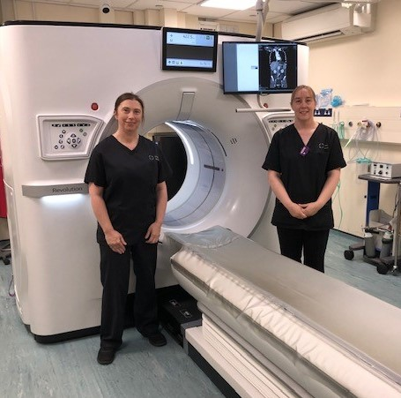
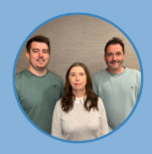
Stuart Baines – Consultant Radiographer
Jamie White – Advanced Practitioner Radiographer
Sarah Maund – Radiology Cancer Navigator

Slide 2

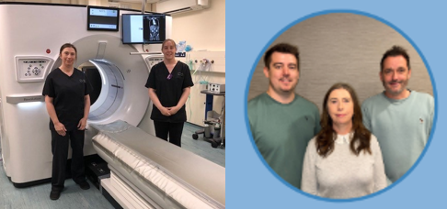


Radiology Navigator model - Project Background
WALES - Lung/Colorectal Ca – Early detection is key!
Workforce Challenges:
  Rising demand for Radiology (11%pa)
  Radiologist shortfall: 30%
  Radiology pathway bottlenecks affecting patient outcomes
  Innovation required - Skills Mix for Radiographers – Radiology Navigator
Welsh Government priorities:
  Streamline Diagnostics
  Detect cancer early
  Pathway innovation
  Outpatient transformation and staff development
  National Optimal Pathways (NOP’s)
Radiology Navigator facilitates:
  Facilitate Staging CT and MRI scans, Same Day where possible
  Undertakes IRMER justification of CT/MRI referrals
  Single point of contact for patients and clinicians
  Increase USC CT Capacity
First formal Radiology Navigator in Wales – POWH, CTMUHB Sept 2022

Slide 3
Radiology Navigator Project Evaluation
4 Elements Evaluated:
1) Additional USC CT Scanning capacity created
2) Streamlining IRMER Justification of CT and MRI referrals
3) Colorectal cancer Radiology pathway data
4) Lung cancer Radiology pathway data

Slide 4
POWH Additional CT Scanning capacity
1
Radiology Navigator is a qualified Radiographer
  Able to organise & perform short notice USC CT and MRI scans
Radiology Navigator delivered 710 short notice USC CTs last year
  Unfunded CT scanner sessions
Comparison – Llantrisant Health Park (LHP) purchased CT capacity
  710 CT scans = £206,667 in cost avoidance

Slide 5
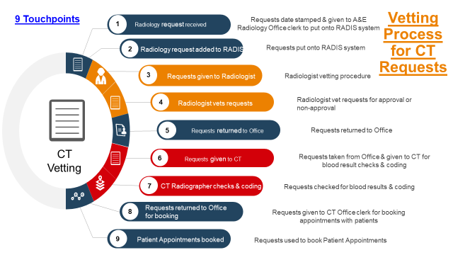
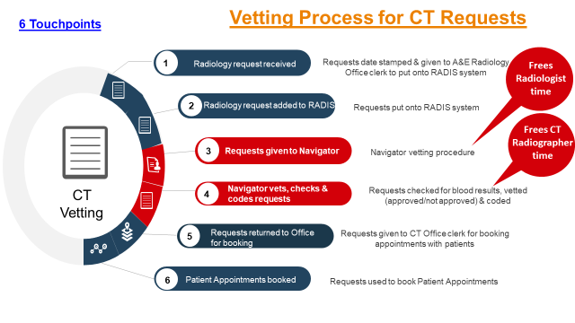

Process mapping – CT and MRI Vetting/Justification
2

Slide 6
IRMER Vetting Process – Average days
2
Navigator in post Aug 2022 – new system established Early Sept 2022

Slide 7
2
CT Vetting process: Navigator vs Radiologist
Saved 273 hours of radiologist time per year, per DGH site (68.3 sessions). 3xDGH sites in CTMUHB.
  2,253 CT scan reports = £165,357 in cost avoidance
  Equates to £78k Radiologist time vs £28.8k Navigator time
  205 sessions = Additional 2,253 CT/MRI reports each year
(3x DGH sites)

Slide 8
Data – Colorectal and Lung Cancer pathways
3+4
Evaluation Period
  Pre-intervention (2019–2022)
    Vs
  Post-intervention implementation (2022–2024)
National Optimal Pathways (NOP’s) - for 1) Colorectal and 2) Lung Cancers
  Radiology elements within these NOP’s modernised

Slide 9
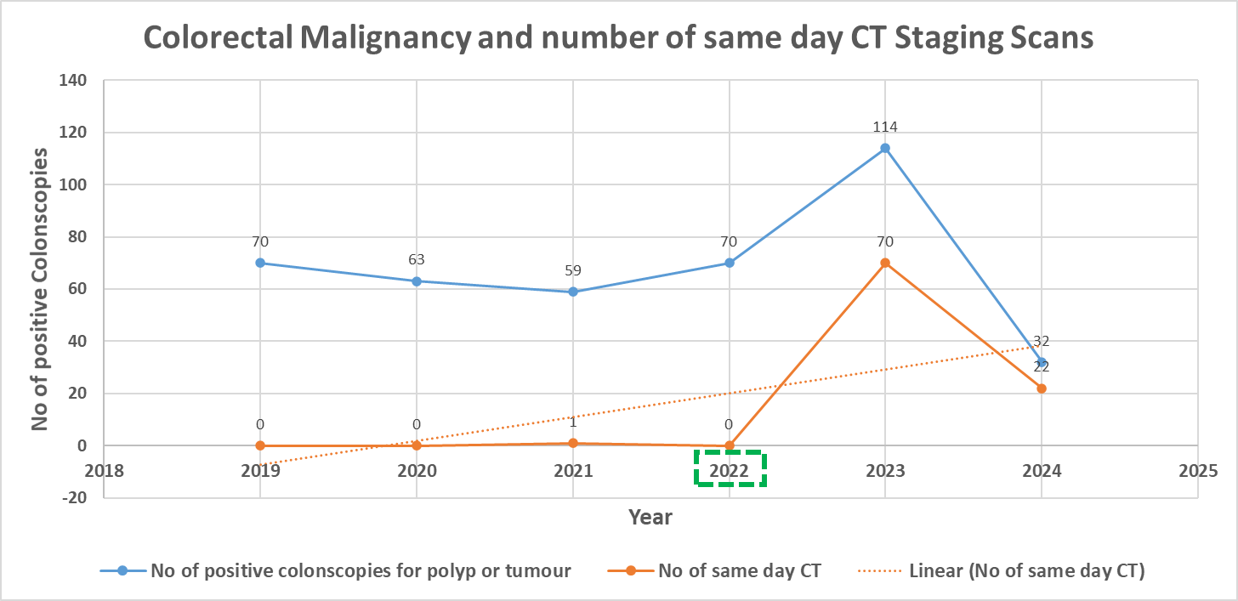
Colorectal Cancer pathway:
POWH Endoscopy to Staging Computerised Tomography (CT)
3
Notes:
Rad Navigator started in 2022, correlates to a sharp spike in same day CT scans in 2023

Slide 10
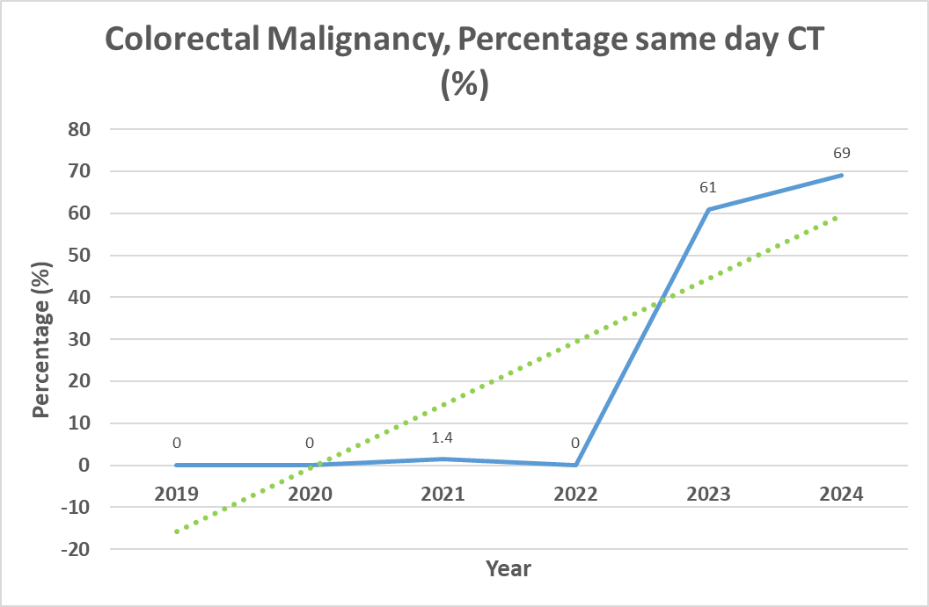
Colorectal Cancer pathway:
POWH Endoscopy to Staging Computerised Tomography (CT)
3
Notes:
Stopped using CANISC in CTMUHB in 2024 hence apparent reduced cancer numbers

Slide 11
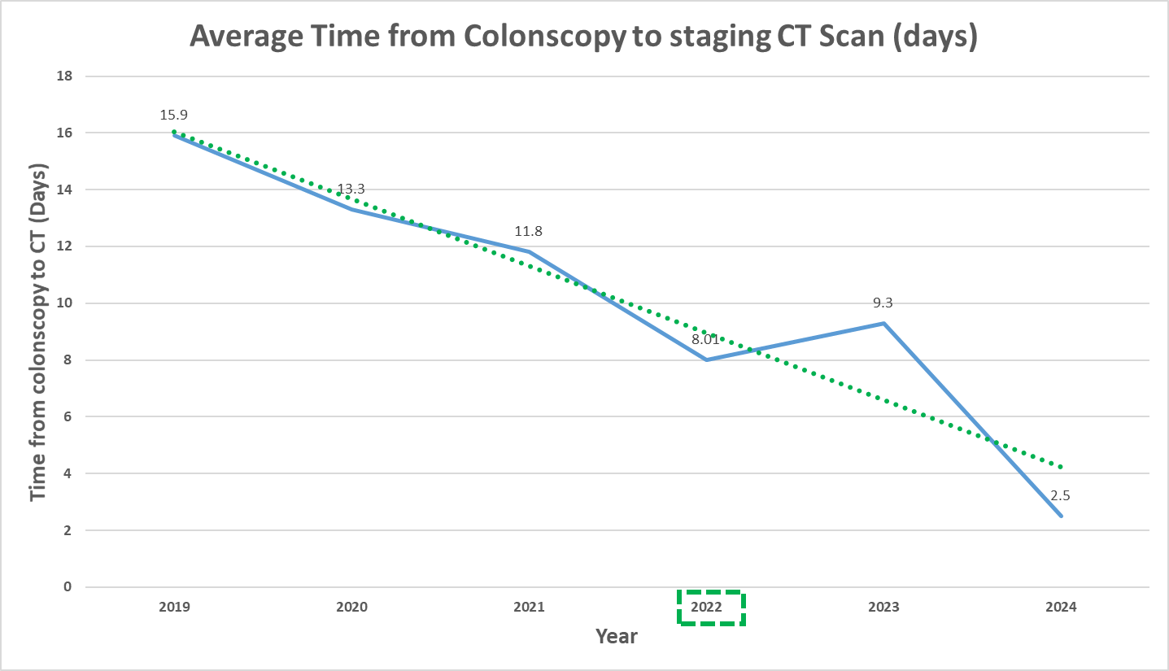
Colorectal Cancer pathway:
POWH Endoscopy to Staging Computerised Tomography (CT)
3
Notes:
Colonoscopy to Staging CT reduced by 13.4 days!

Slide 12
POWH Endoscopy to Staging Computerised Tomography (CT), Summary
• 69% of patients received a staging CT scan on the same day as their positive colonoscopy in 2024 (0% in 2022, 1.4% in 2021)
• 100% patients received a staging CT within an average of 2.5 days from colonoscopy
  69% improvement from 2022 (8 days)
• CT reports were completed within 1.63 days on average.

Slide 13
POWH Radiology Lung Cancer pathway: CXR report to Staging CT
4
Notes:
65% reduction comparing 2020 to 2024

Slide 14
POWH Radiology Lung Cancer pathway: CXR referral to MDT
4
Notes:
Pathway reduced by 15.7 days comparing 2020 to 2024

Slide 15
What Next?
Adopt, Spread and Embed (bevancommission.org) across all CTMUHB Radiology sites
  Potential funding available CTMUHB Nov 2025
    1x additional Radiology Navigator
    +/- Band 2/3 Clerical support
  Reduce inequality across CTMUHB sites
Integrate Radiographer CXR Hot Reporting SCP project in POWH
Dissemination and consideration for adoption in other Welsh Health Boards.

Slide 16

Many Thanks for Listening
Stuart.Baines@wales.nhs.uk
Sarah.Maund2@wales.nhs.uk
Jamie.White@wales.nhs.uk

