Slide 1



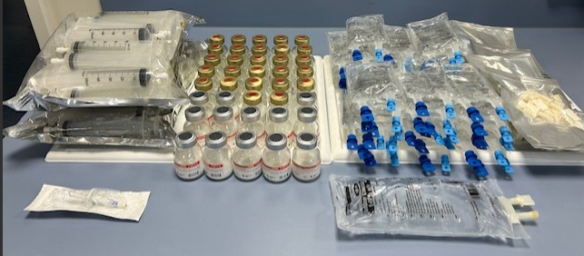
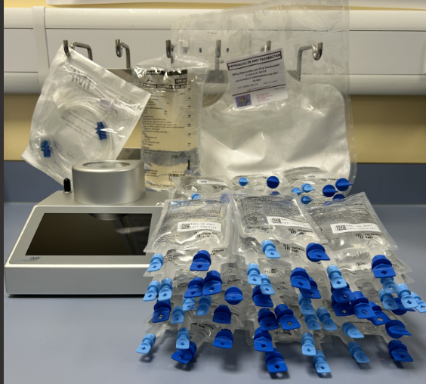


Enhancing Sustainability Through Insourced Semi-Automated Production of Piperacillin/ Tazobactam Ready To Administer Doses
Goodwin, C. D.¹, Jones, R.M.¹, and Merriman, A.J.¹
Betsi Cadwaladr University Health Board
Background and Importance
In 2020 it was reported that piperacillin/ tazobactam (PipTaz) is the second most commonly issued antibiotic in acute environments in England [1]. In North Wales these doses are prepared by nurses on hospital wards. Each dose has a 15 minute preparation time and with a usual regimen of 3 or 4 daily doses per patient this is a significant use of nurses time.
In 2018 Welsh Government published “A Healthier Wales” [2], and in 2025 the UK Government published “Fit for Future: A 10-year health plan for England” [3], these outline the long-term strategies for the NHS. A pillar of both of these documents is the implementation of new technologies and innovation to transform the healthcare service.
In this research we look at the insourcing of PipTaz ready to administer (RTA) doses to Pharmacy Aseptic Services utilising PipTaz multidose bags.
Aims and Objectives
The aim of this research was to determine whether in-sourcing the manufacture of ready to administer piperacillin/ tazobactam doses to pharmacy aseptic services in BCUHB could be done to provide a sustainable solution.
Materials and Methods
Figure 1: Stability Data
Manufacturing process development was carried out in accordance the ICH guidelines and Good Manufacturing Practice. Time in motion and production studies were carried out to obtain efficiency data for the new process.
Results
A semi-automated manufacturing method utilising the PipTaz multi-dose bags was developed . This produces a yield of 49 doses in approximately 45 minutes using 51 aseptic manipulations.
The number of disposable consumables used in the manufacturing process was reduced from 196 to 3.
Stability studies carried out on the RTA doses was demonstrated to be 21 days at 5ºC ± 3ºC and 3 days at 25 ºC in 0.9% sodium chloride mini-bags at an API concentration of 37.5 mg/ mL.
Figure 2: Comparison of Consumables
Conclusions and Relevance
This research demonstrates that by utilising new technologies including the multi-dose PipTaz bag; Pharmacy Aseptic Services is able to insource the manufacture of RTA doses to help overcome downstream issues within the healthcare environment.
In doing so the manufacturing process sees a reduction in manufacturing time by 81%, of aseptic manipulations by 74% and in waste generation by 98% by weight.
The host site in North Wales, prescribes an average 130,000 doses of intravenous PipTaz each year. This suggests that the sustainable insourcing of manufacture could be an enabler of meeting the targets outlined in various NHS policy.
References
Christopher Goodwin
Senior QA / QC Analyst
E: Christopher.goodwin2@wales.nhs.uk
T: 03000 857589
1. Department of Health and Social Care. (2020, October 29). Transforming NHS pharmacy aseptic services in England. GOV.UK. https://www.gov.uk/government/publications/transforming-nhs-pharmacy-aseptic-services-in-england/transforming-nhs-pharmacy-aseptic-services-in-england 2. Welsh Government. (2018). A healthier Wales: Our plan for health and social care. https://www.basw.co.uk/system/files/resources/180608healthier-wales-mainen.pdf 3. Department of Health and Social Care. (2025, July 30). Fit for the future: 10 year health plan for England (accessible version). GOV.UK. https://www.gov.uk/government/publications/10-year-health-plan-for-england-fit-for-the-future/fit-for-the-future-10-year-health-plan-for-england-accessible-version
3PC-016

